Slide 1
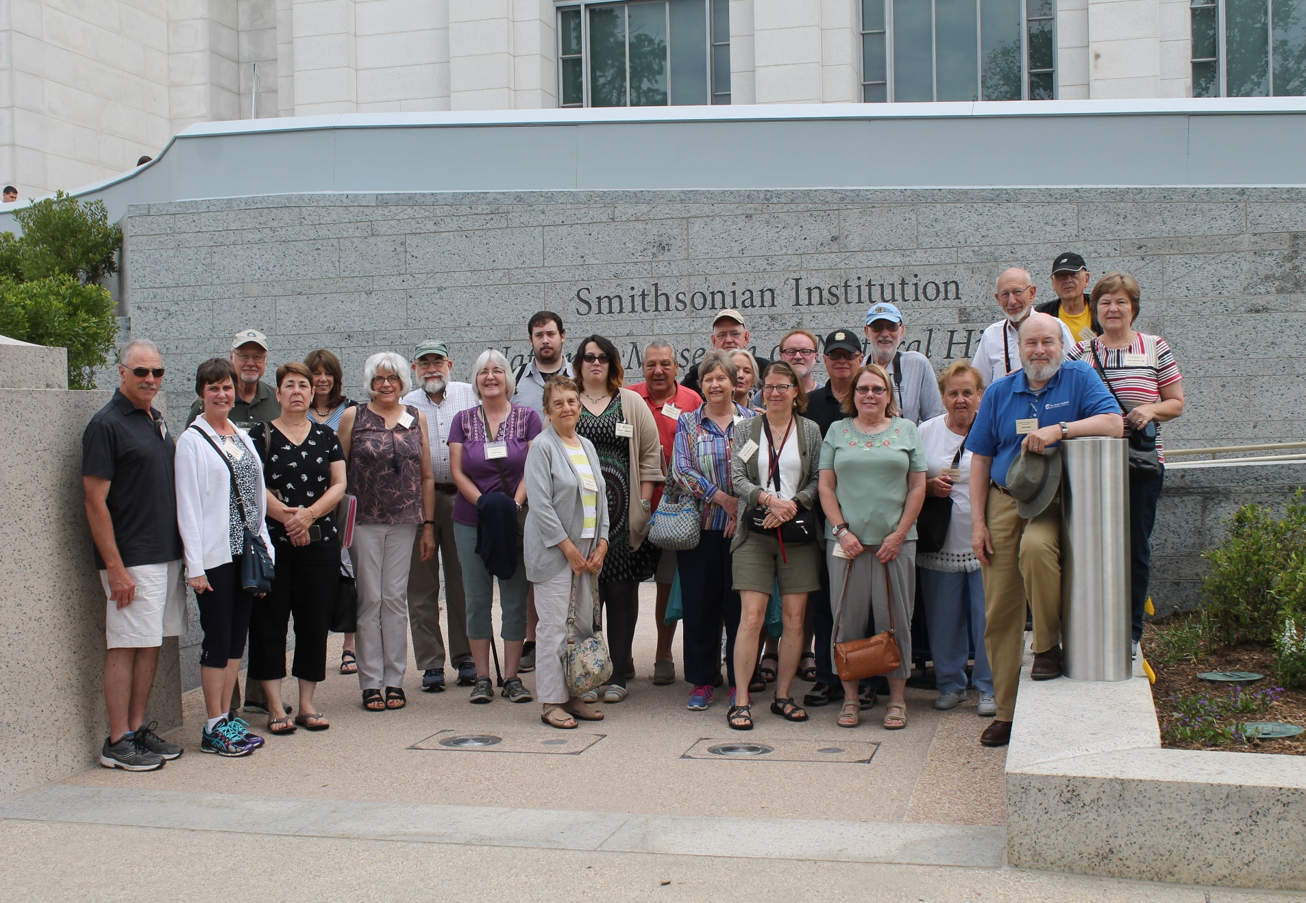
Day Two, Saturday, June 15 After breakfast at the hotel, our first stop was the Natural History Museum to visit Dr. Doug Owsley’s Lab.

Slide 2
Dr. Owsley shared with the group his recent research regarding 17th century settlers from St. Mary’s City and Jamestown. He also discussed the research being conducted by student interns and other researchers working in his lab.

Slide 3
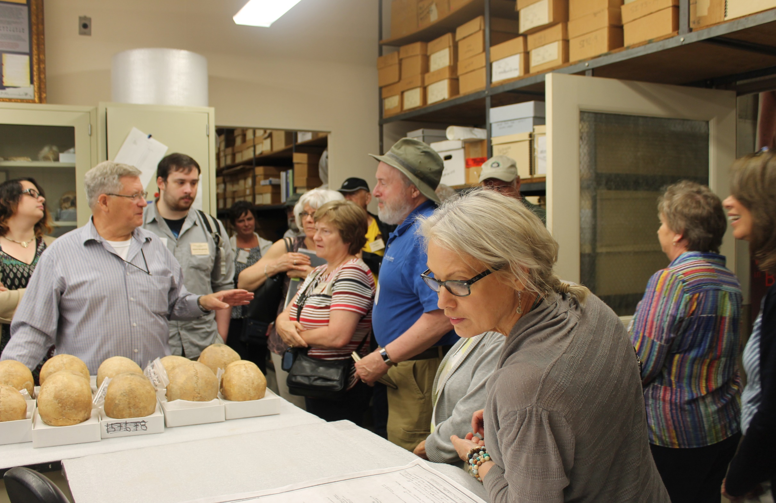
Dr. Owsley telling about his lab

Slide 4
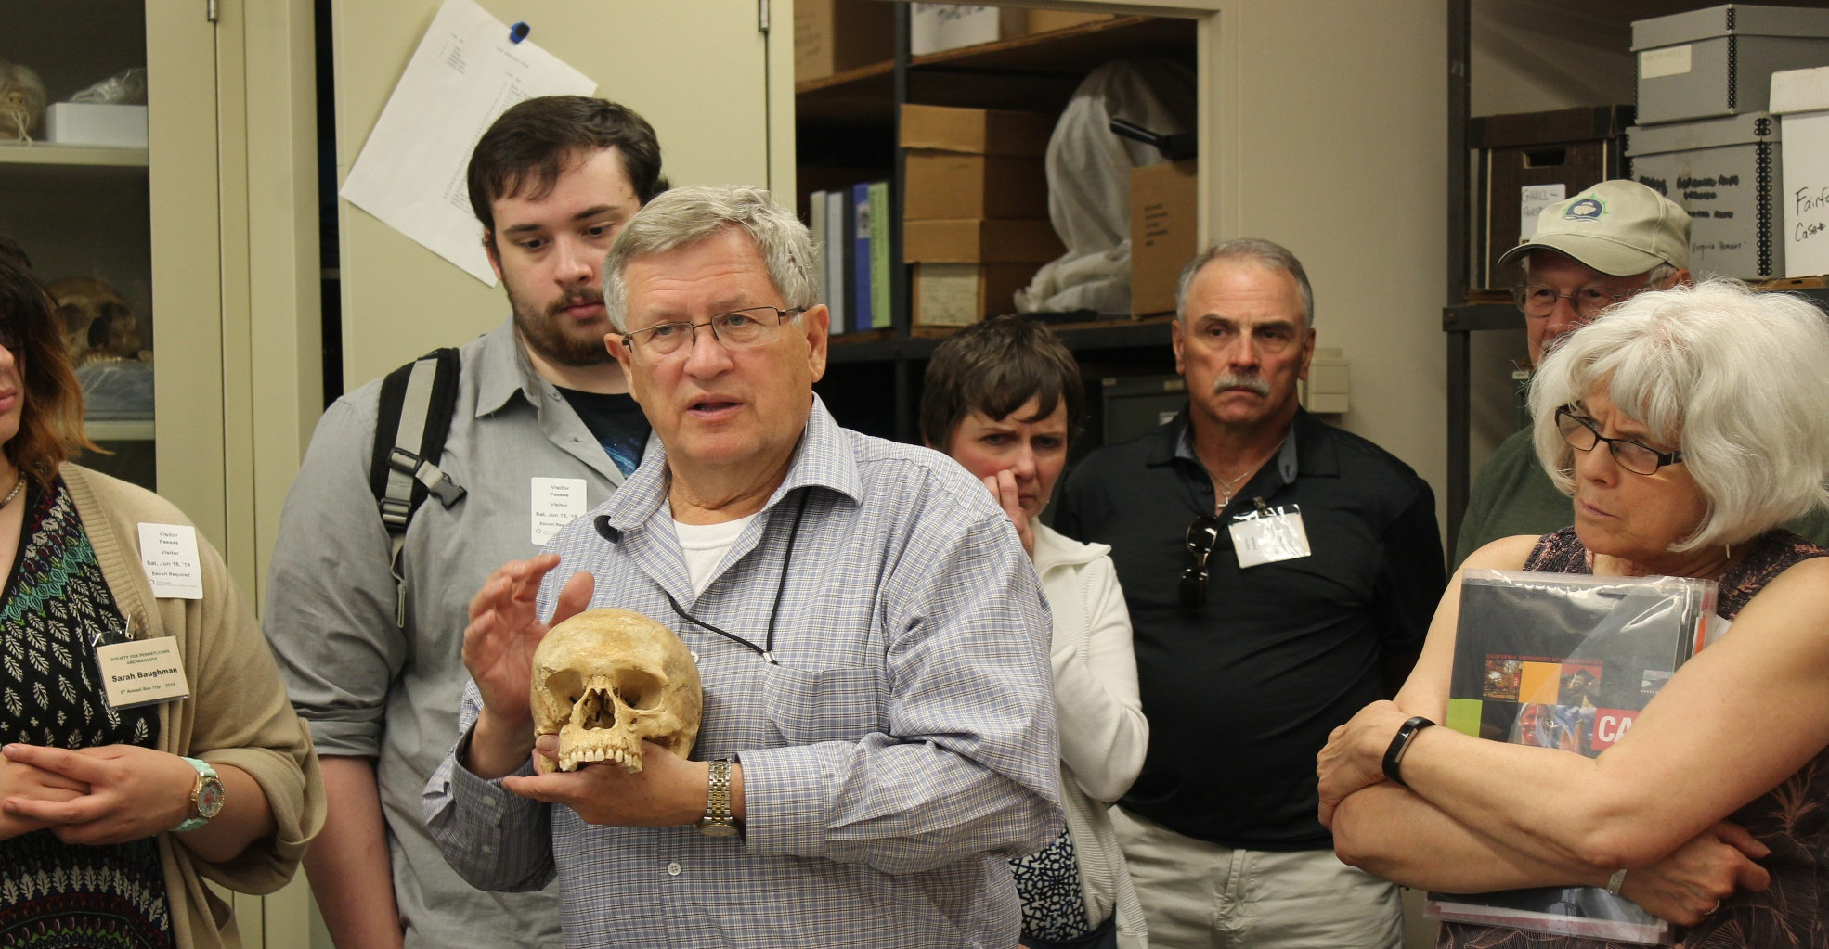
Dr. Owsley describing the differences between African, Asian, and European Skulls

Slide 5
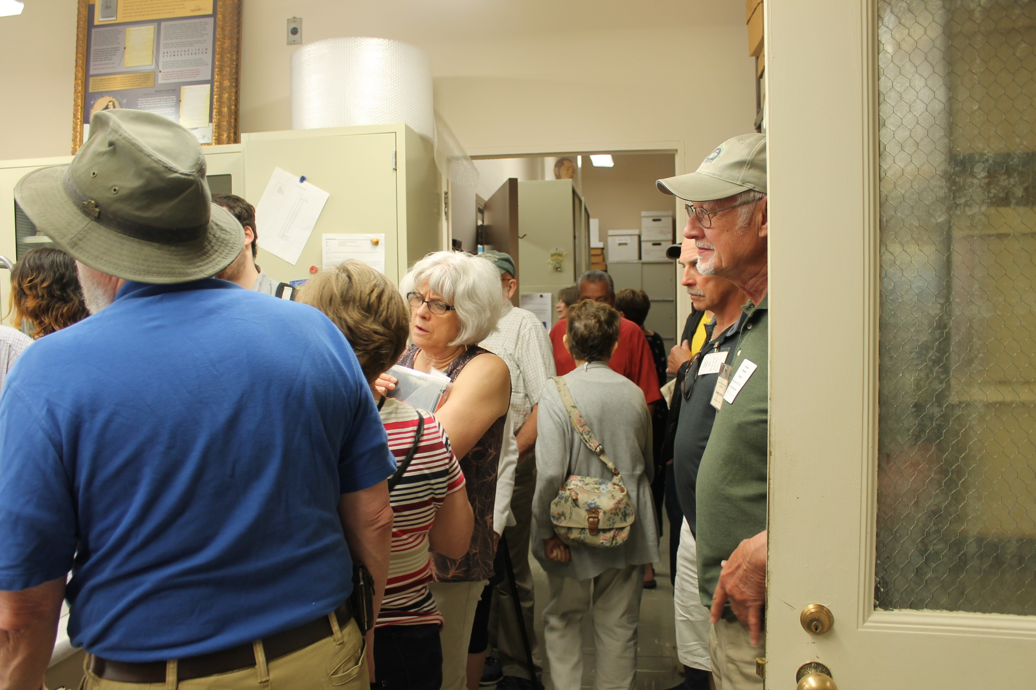
Group listening to Dr. Owsley discussing his recent research

Slide 6
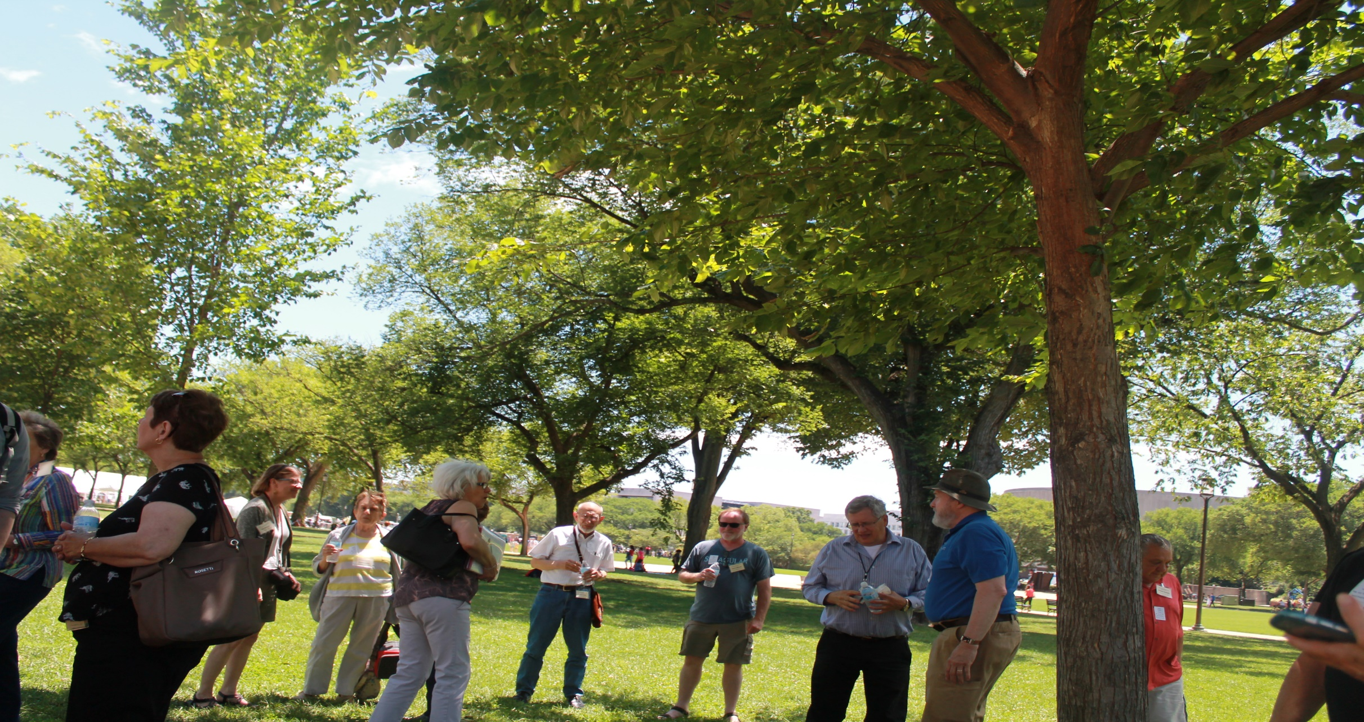
Following the tour of Dr. Owsley's lab, the group ate lunch on the mall in from of the museum. Dr. Owsley jointed the group for lunch.

Slide 7
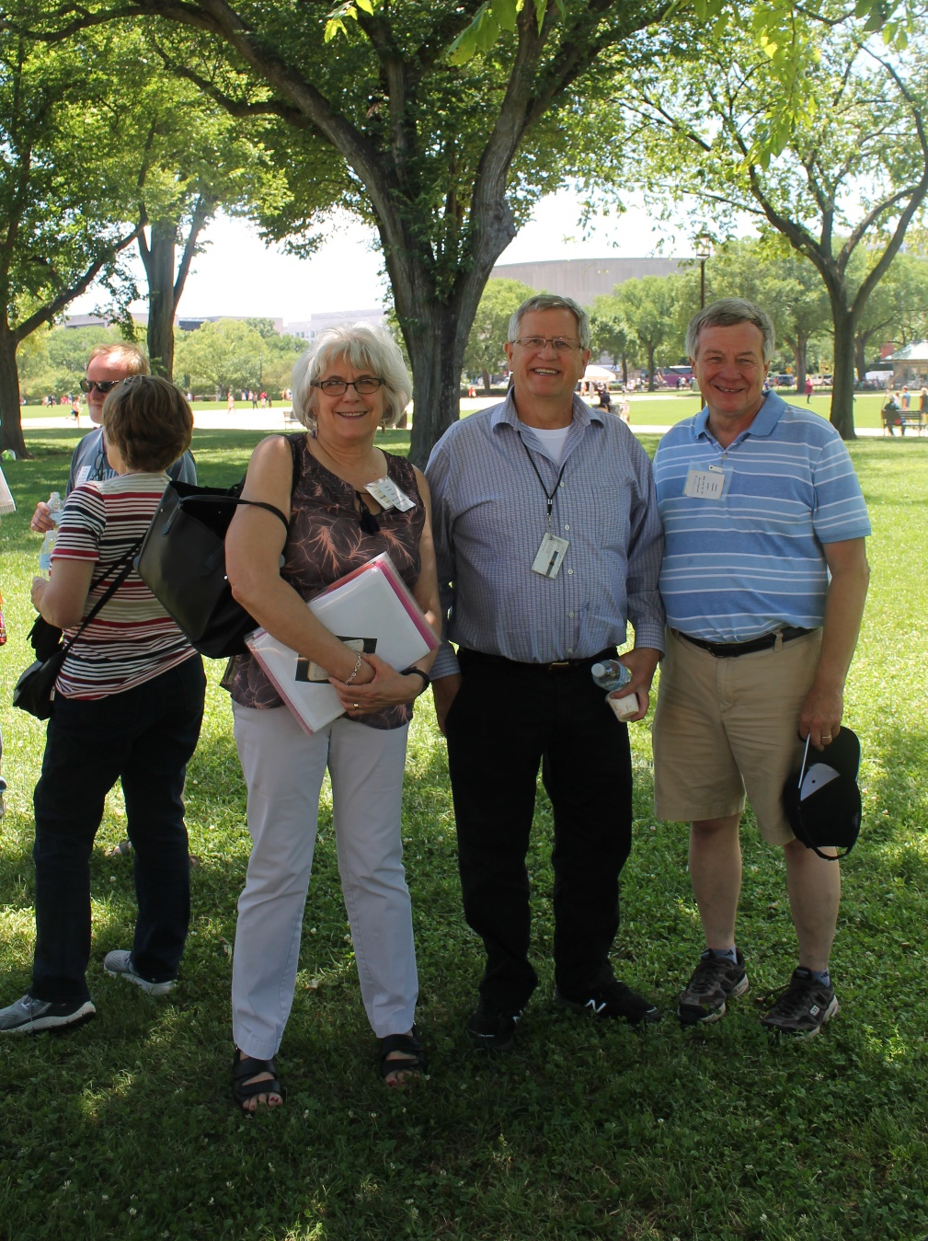
Dr. Owsley graciously posed with Sarah and John for a photograph.

Slide 8
After leaving D.C., we traveled to Alexandria to meet with city staff archaeologist Ben Skolnick at the Bus Garage for a presentation about the four 18th wooden sailing ships found during excavations along the shoreline of Old Alexandria.

Slide 9
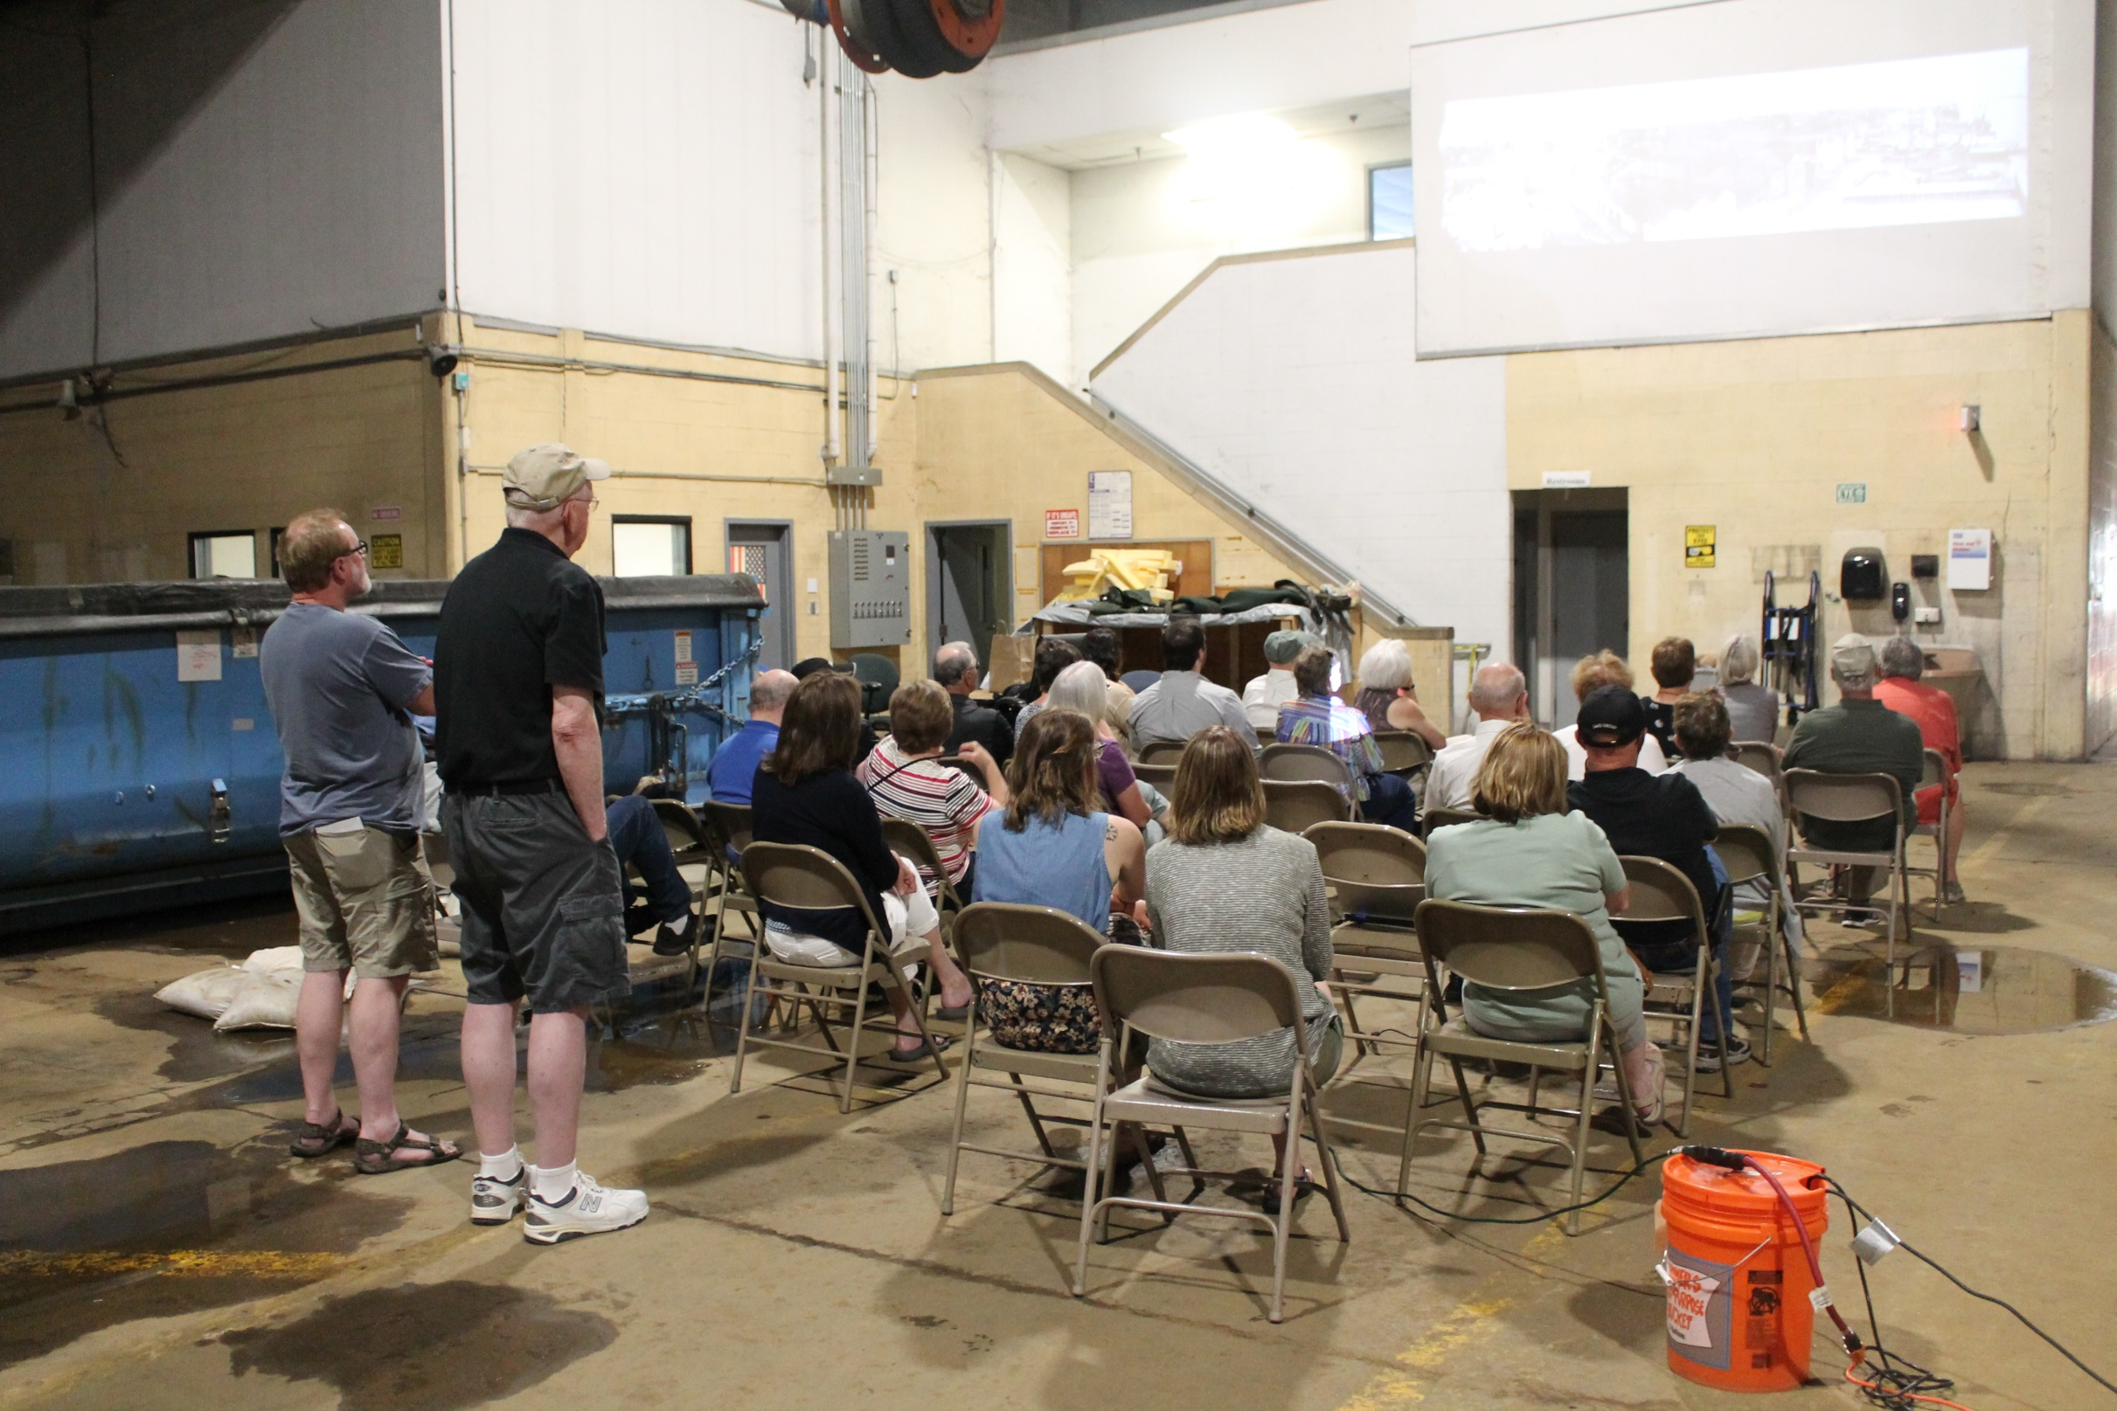
Group seated in Bus Garage

Slide 10
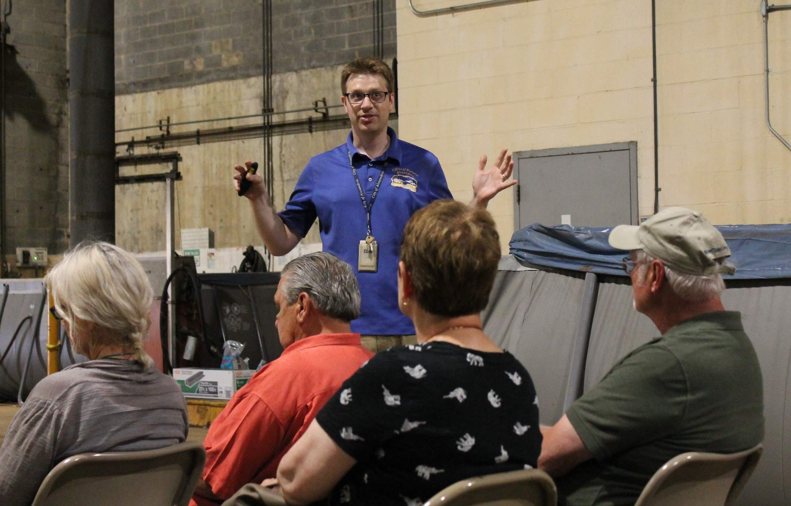
Staff Archaeologist Ben Skolnick

Slide 11
After the talk/lecture, we were able to view some of the actual ship timbers currently being preserved in large swimming pool inserts at the bus barn facility

Slide 12
Tom Glover pondering the magnitude of the ship preservation Office by the City of Alexandra
Ben answering questions about the preservation process of the ships at Alexandria

Slide 13
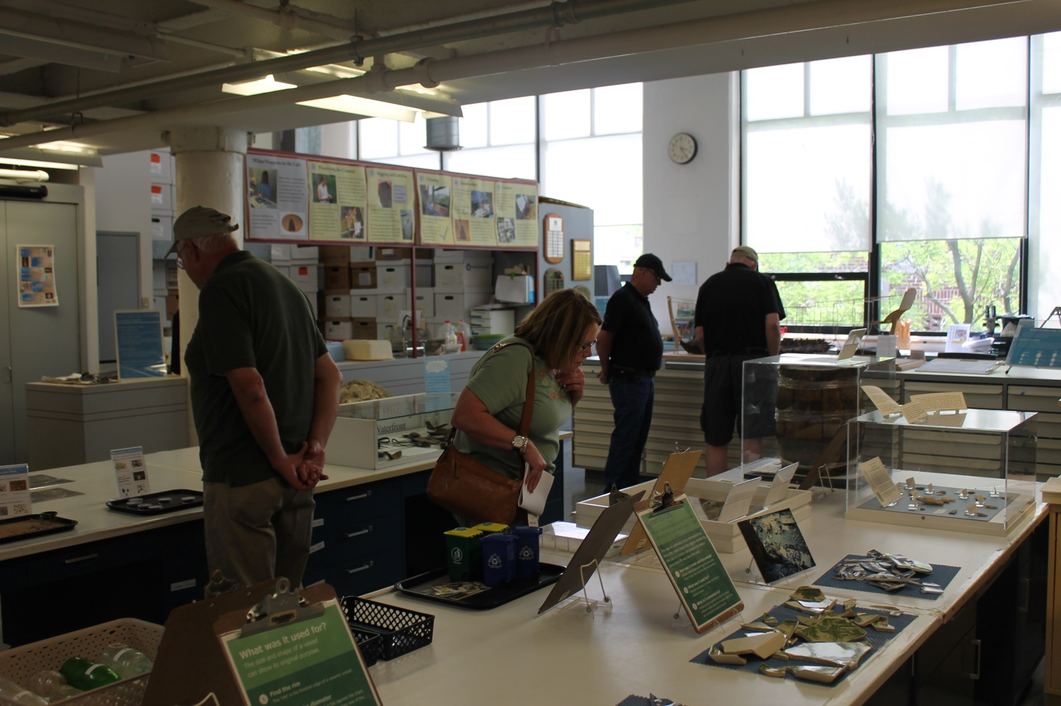
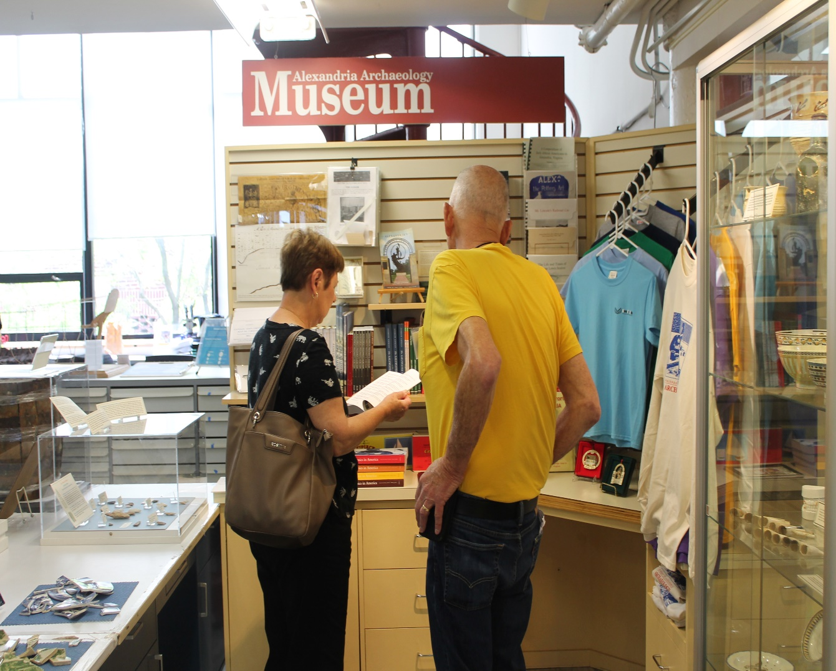
After leaving the bus barn, we departed for Old Town Alexandria to visit the public museum and the gift shop

Slide 14
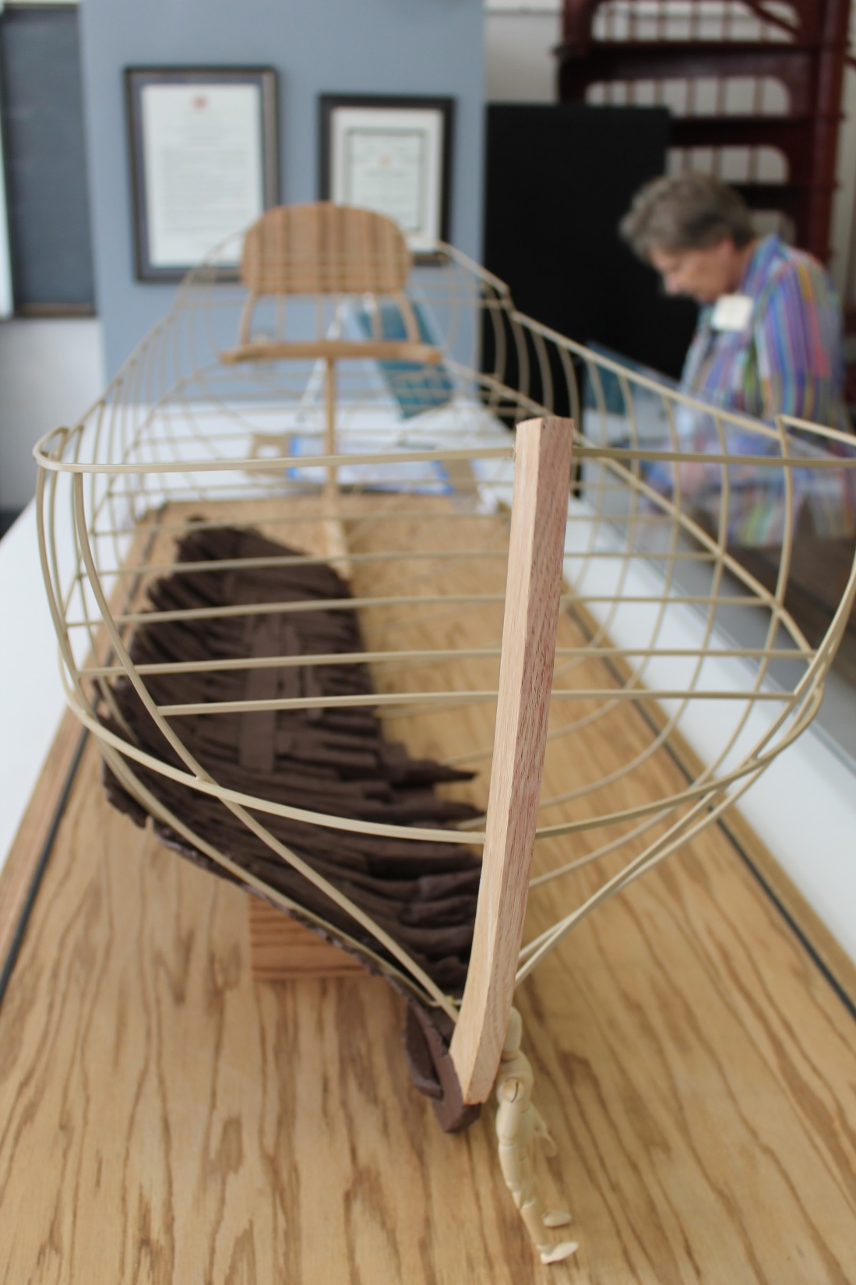
Model of one of the sailing ships found at Alexandria. Model shows what remained of the ship when found by archaeologists

Slide 15
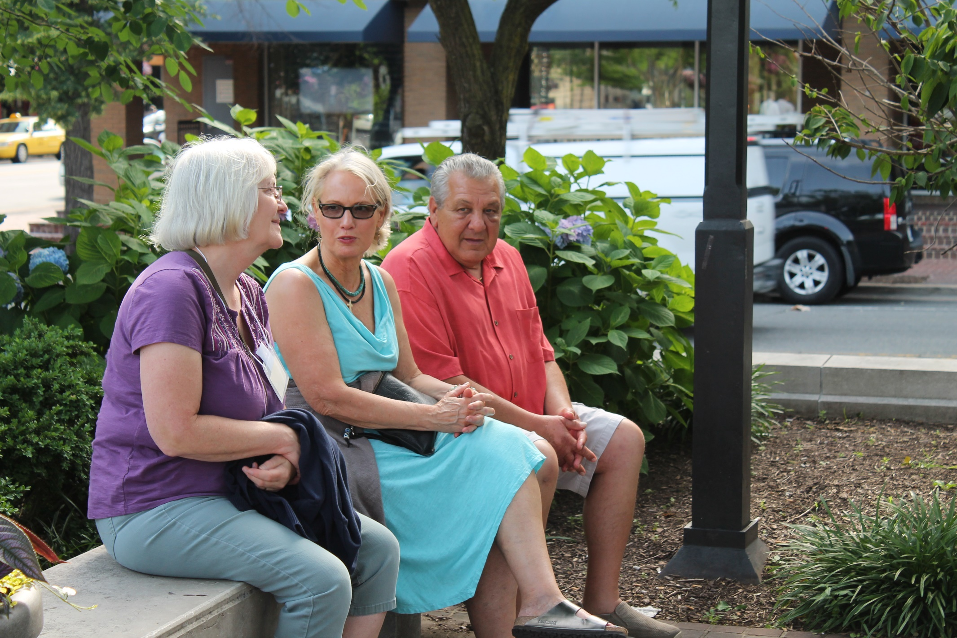
Jean, Beverly and Dwayne resting after shopping in Alexandria

Slide 16
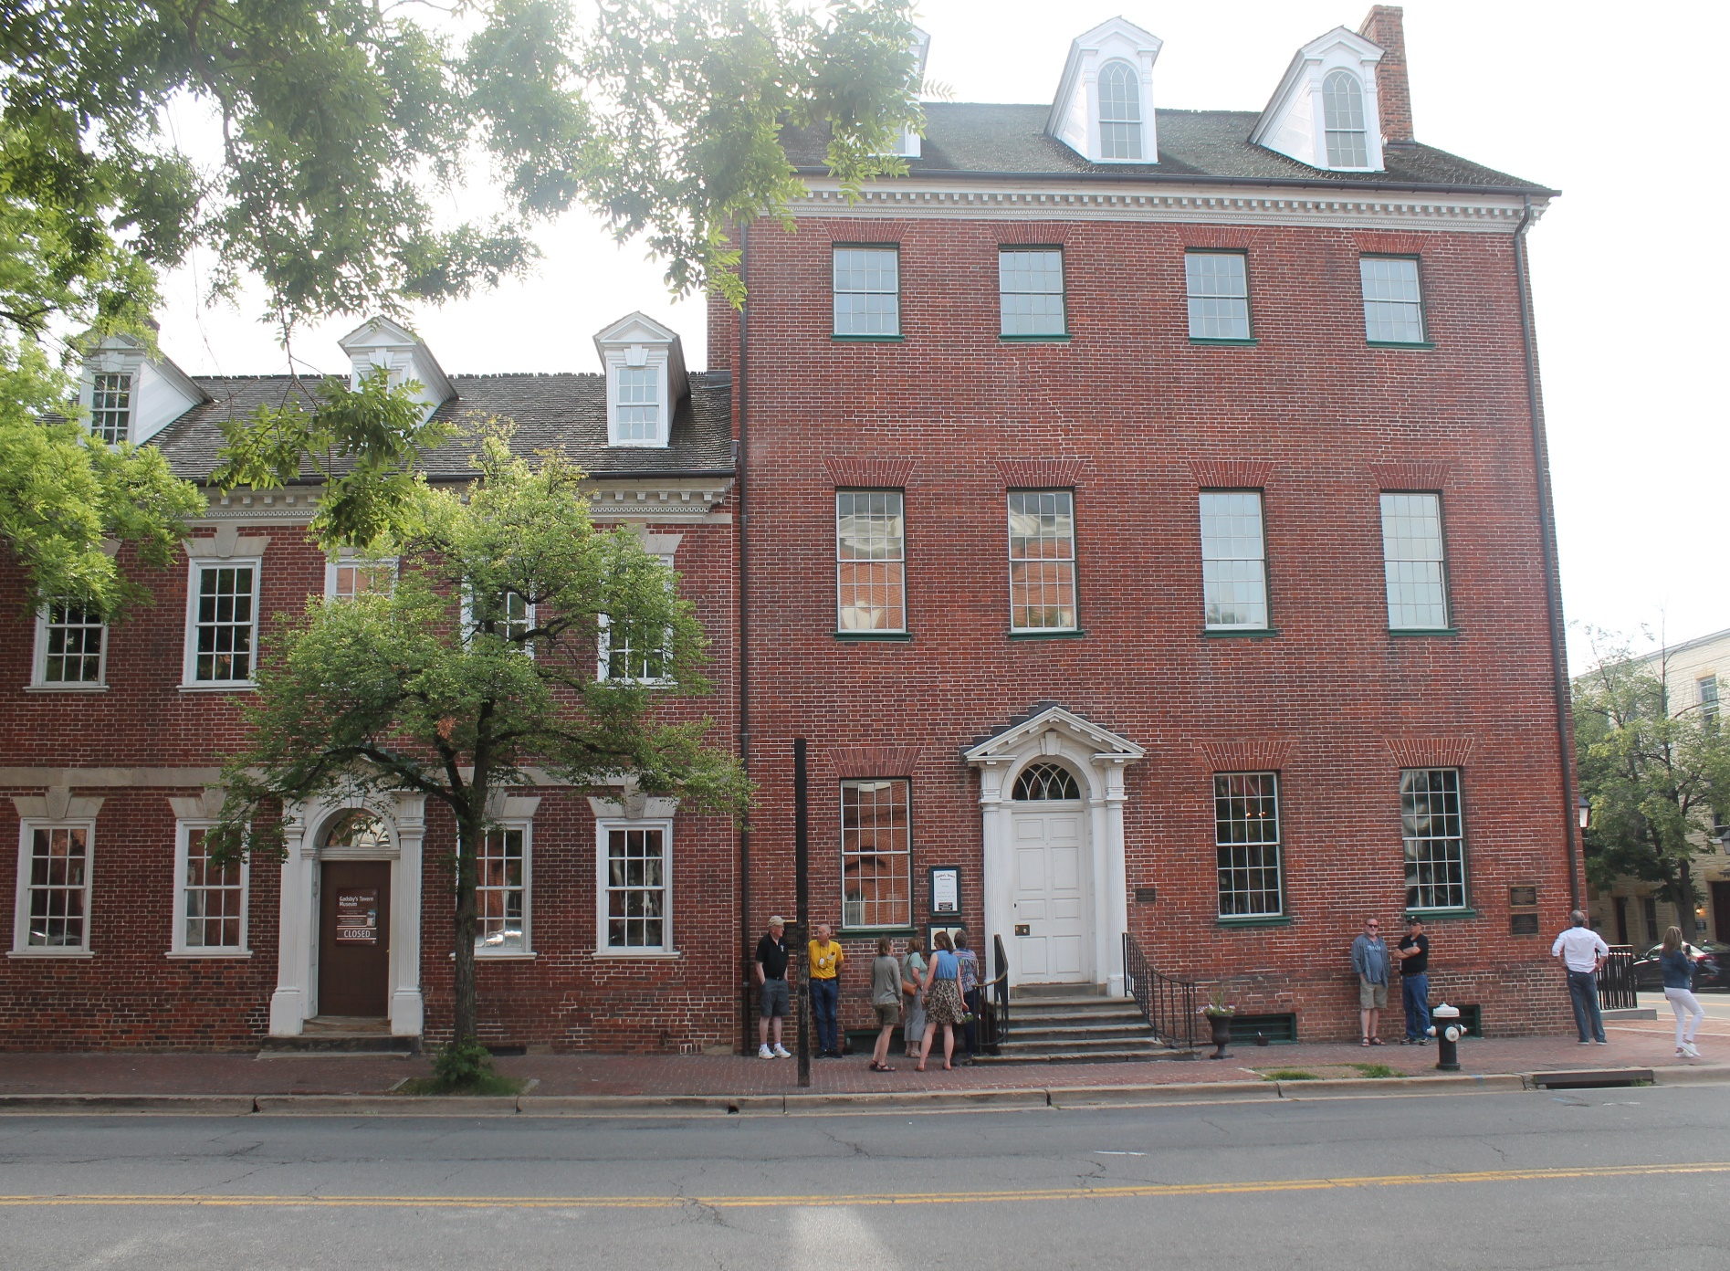
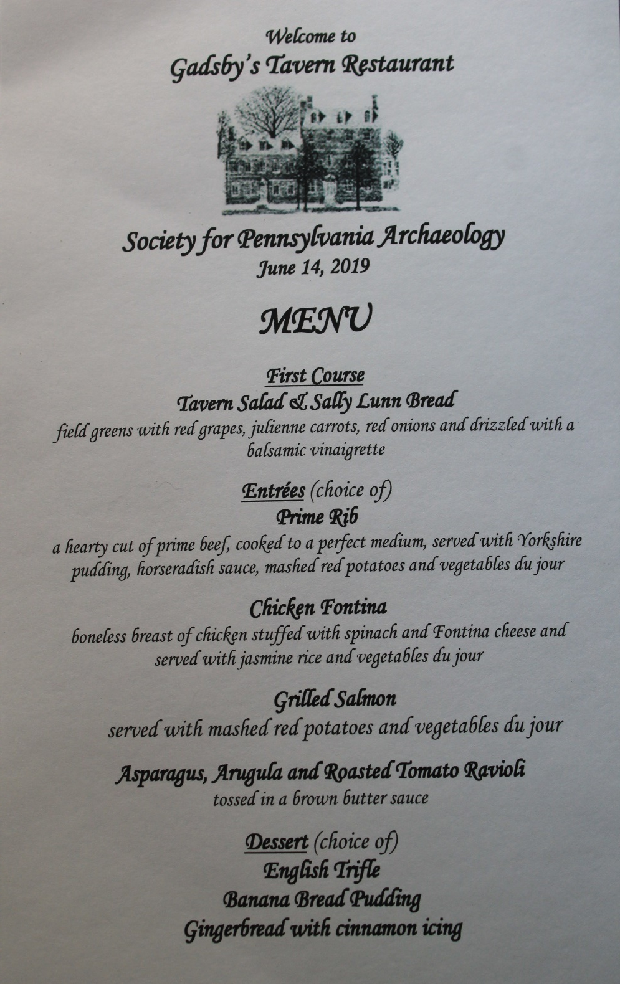
Our group ate dinner at Gadsby’ Historic Tavern

Slide 17
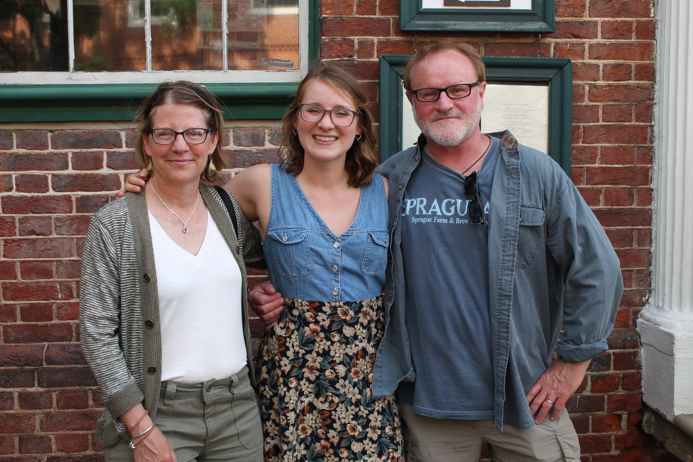
Chuck and Kim Williams were able to have their daughter who lives and works nearby join us for dinner

Slide 18
Inside dinning room at Gadsby’s

Slide 19
After dinner, we returned to the hotel for the evening to talk and socialize.

