Slide 1
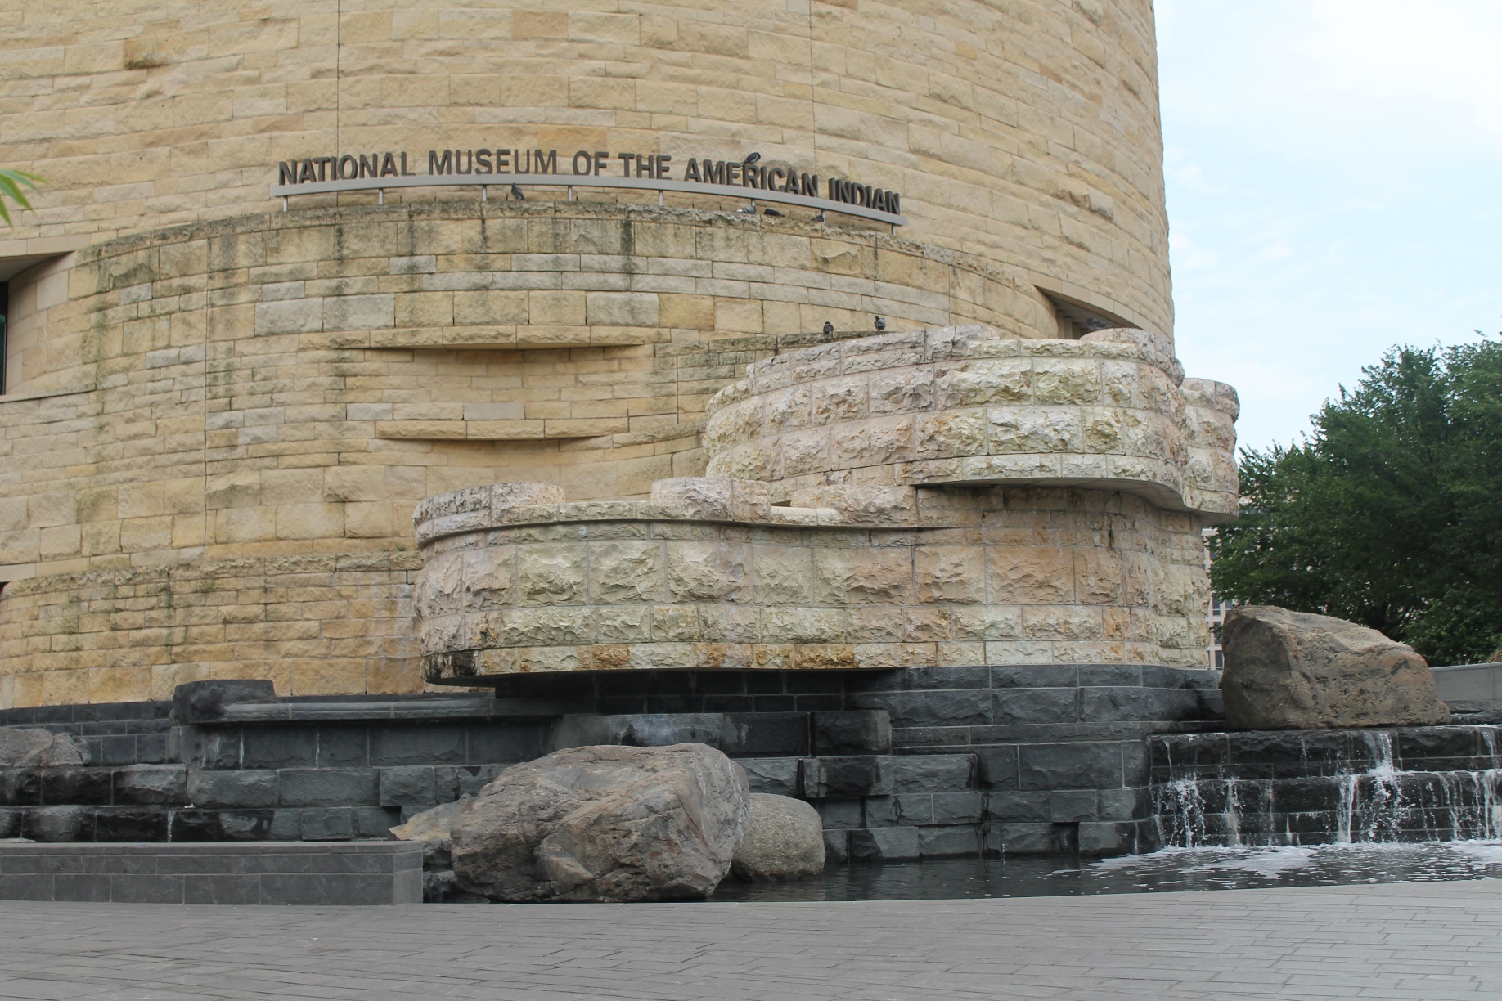
Day Three, Sunday,
June 16
On our last day, we visited the National Museum of the American Indian

Slide 2
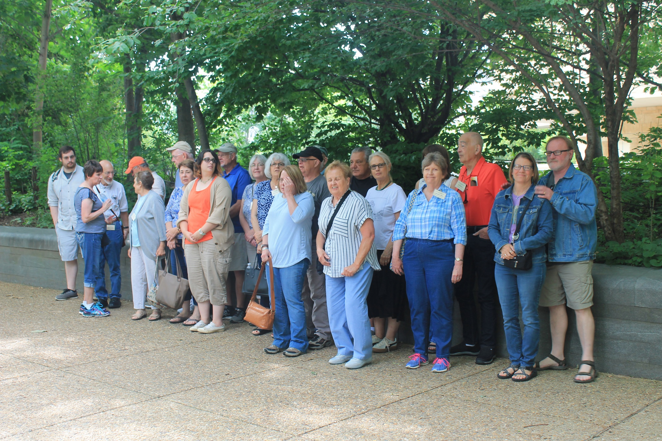
Group picture outside of the museum

Slide 3
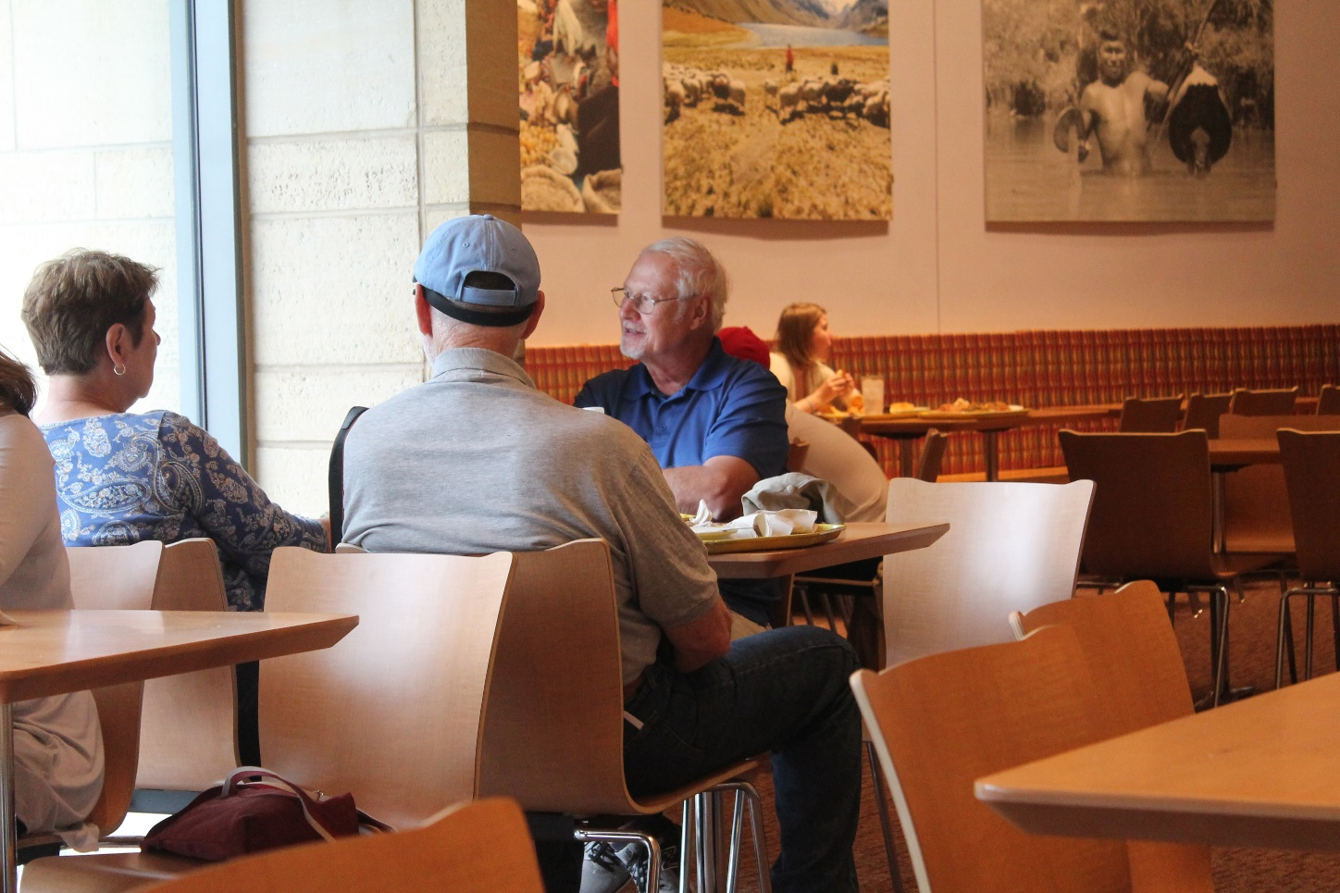
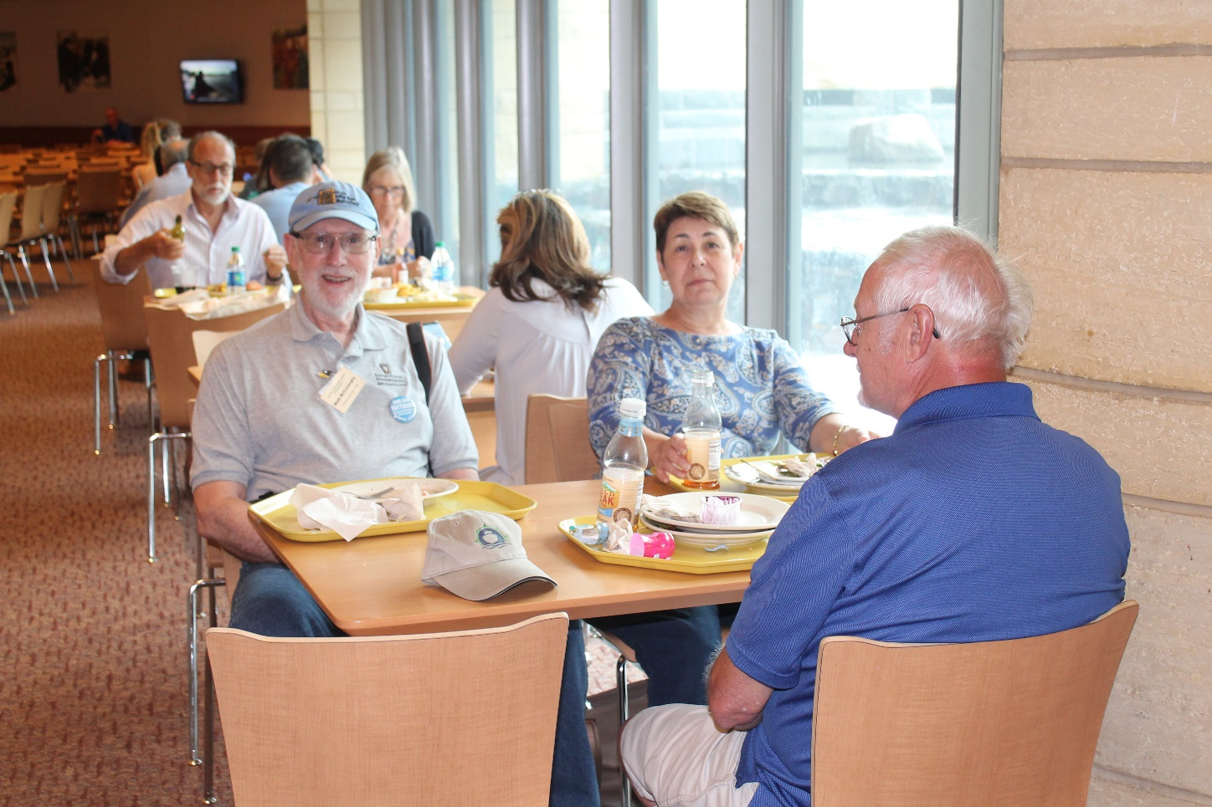
For lunch, members of our group had a lunch voucher for the cafeteria which served Native American entries

Slide 4
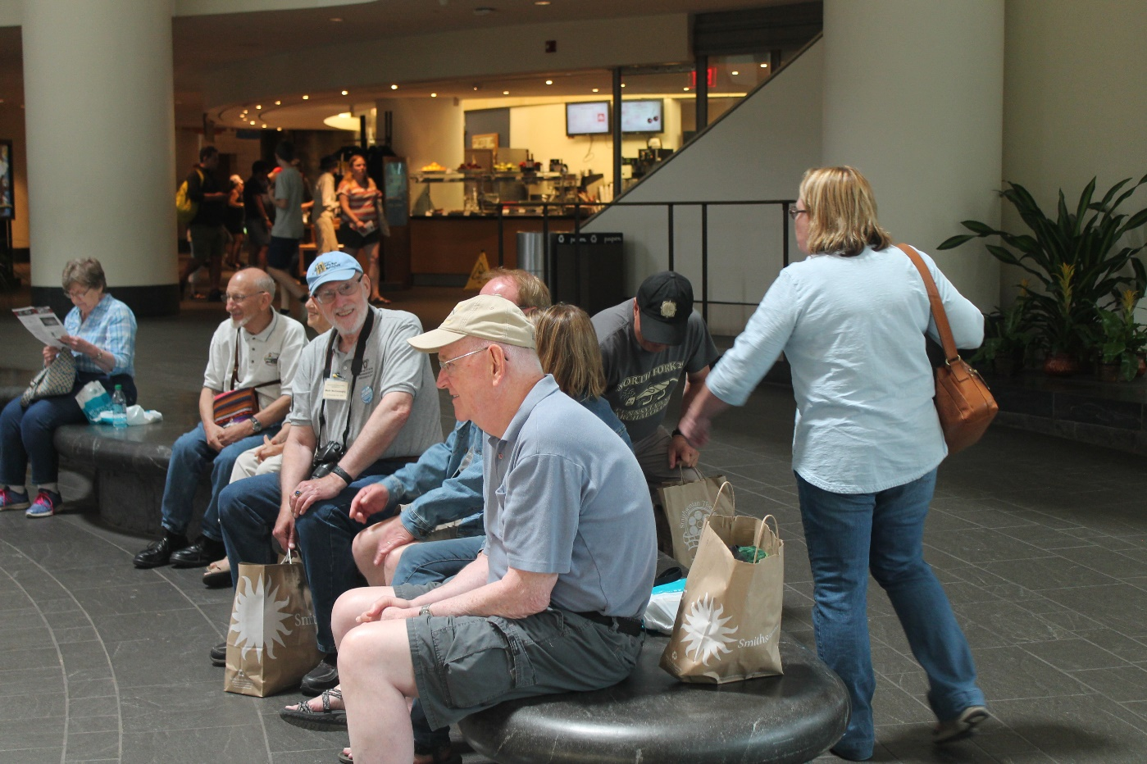
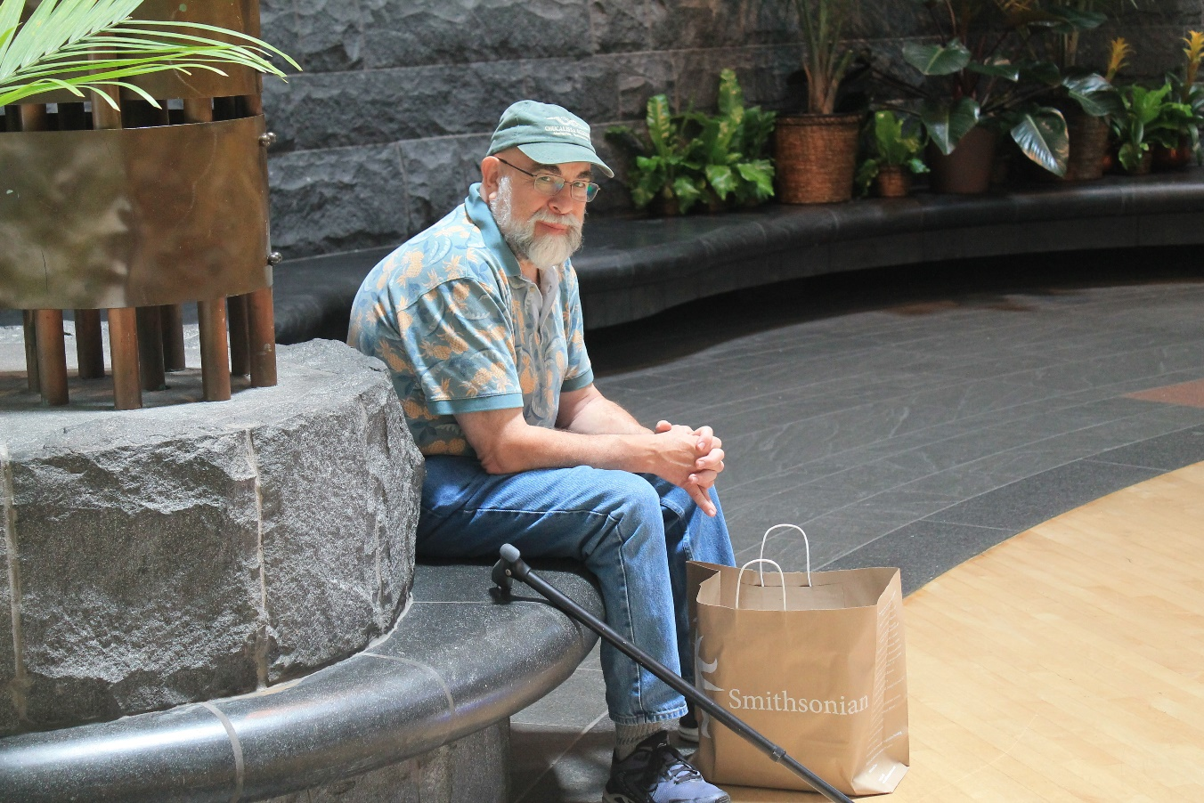
Group members resting in the spacious entryway after viewing the exhibits and gift store shopping prior to returning to hotel

Slide 5
After dropping off those attendees who drove to the hotel in Frederick to get their vehicles, the remainder of us continued onto California to conclude this year’s incredibly trip!

Slide 6
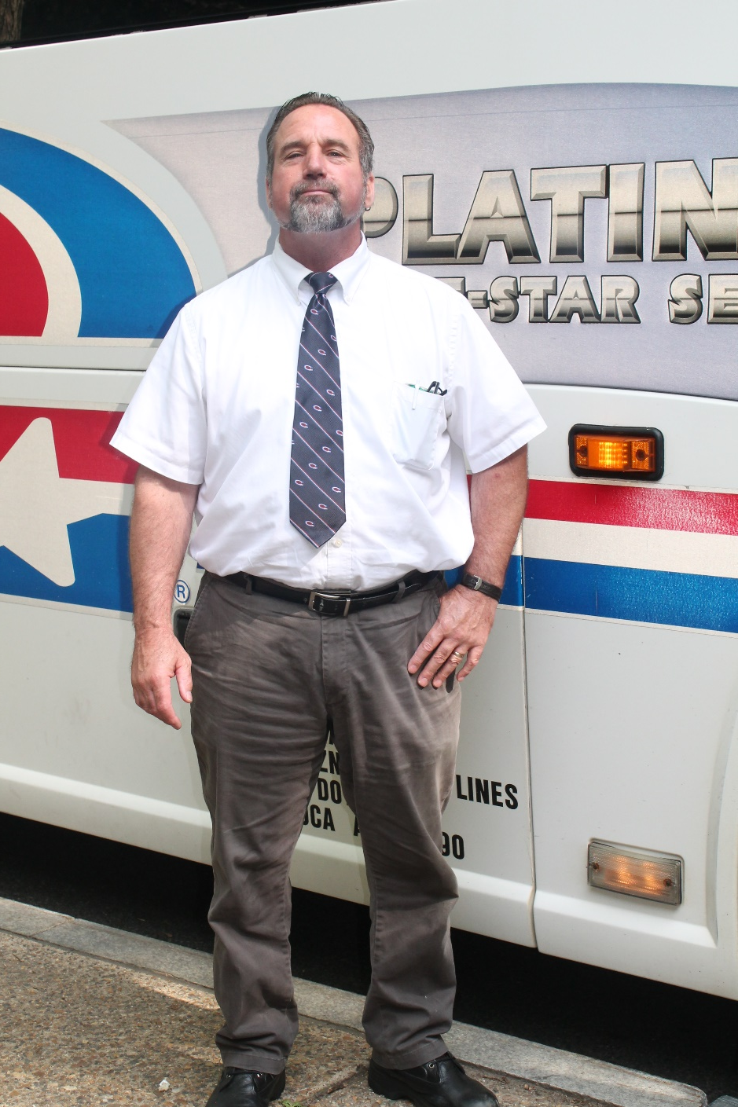
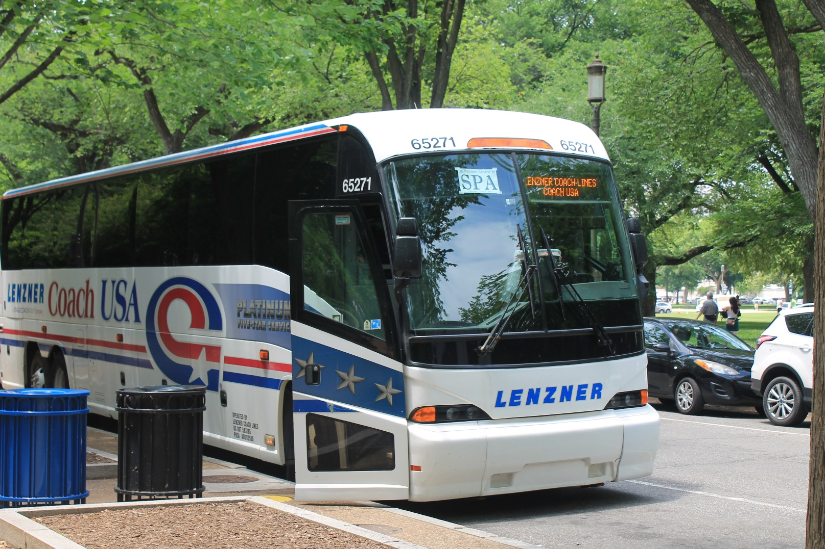
Our Shaffer for the trip, Rick Schubert. He was an excellent driver and a great addition to our trip

