Slide 1
After leaving Terra Haute, we traveled to Dayton to visit Sunwatch Village.

Slide 2
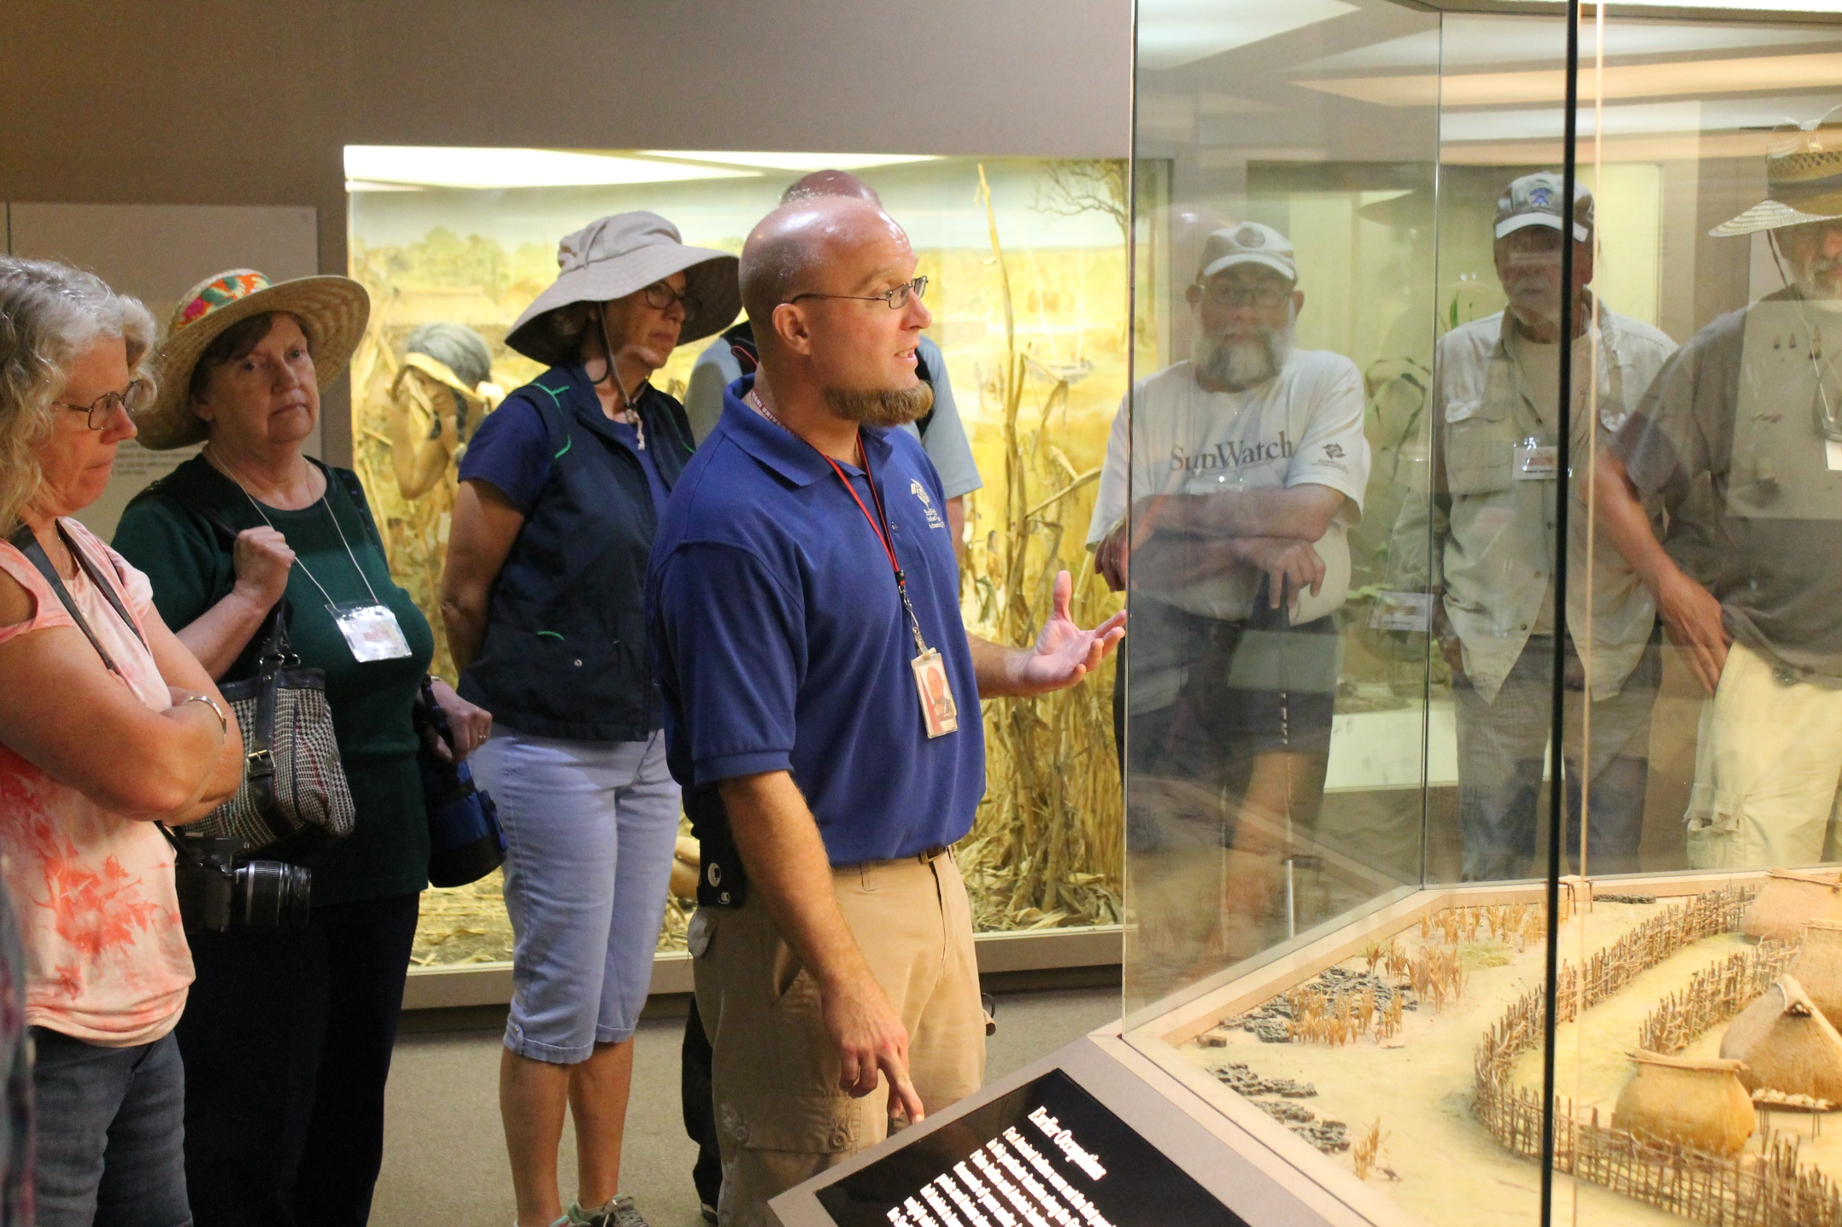
Andy Sawyer describing the center post feature and other important architectural features at Sunwatch as part of our orientation

Slide 3
Members of the group looking at the model of Sunwatch village

Slide 4
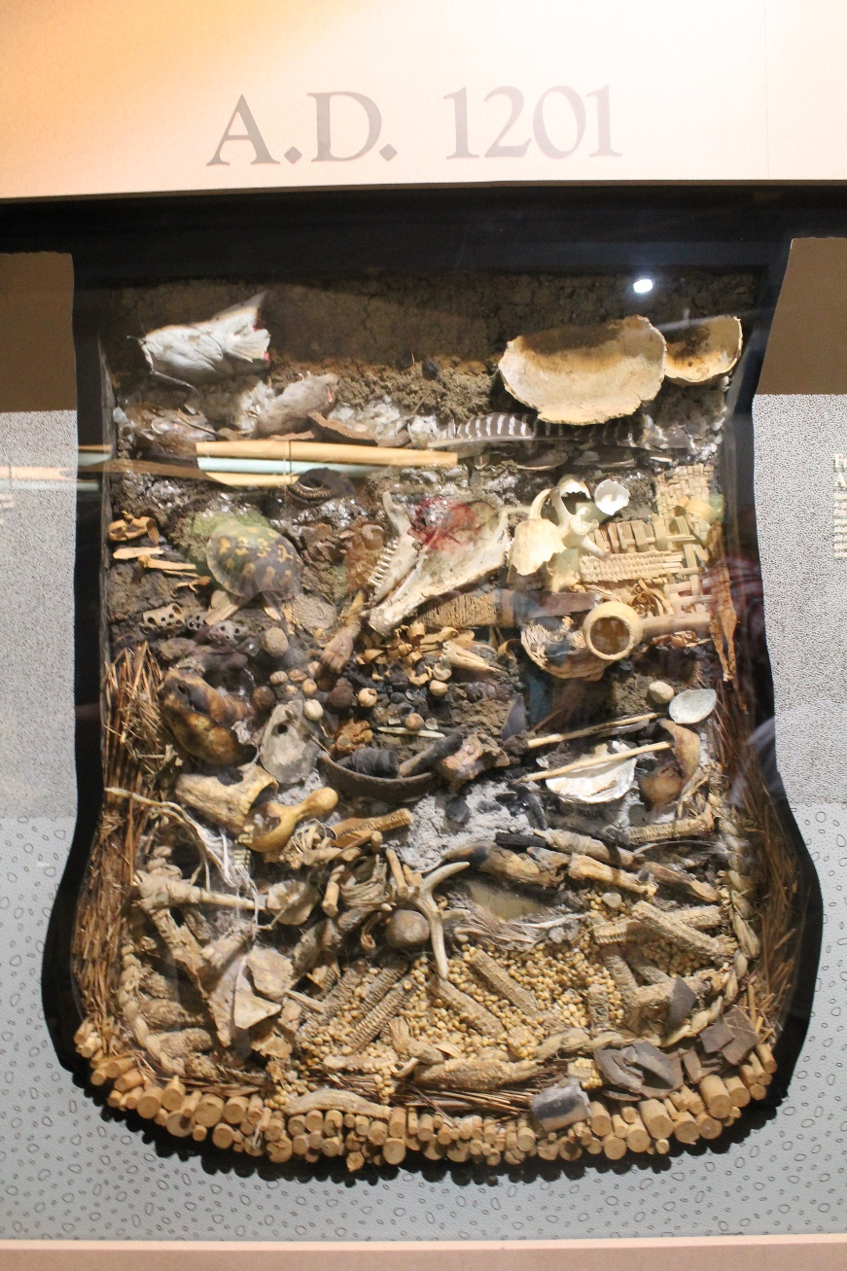
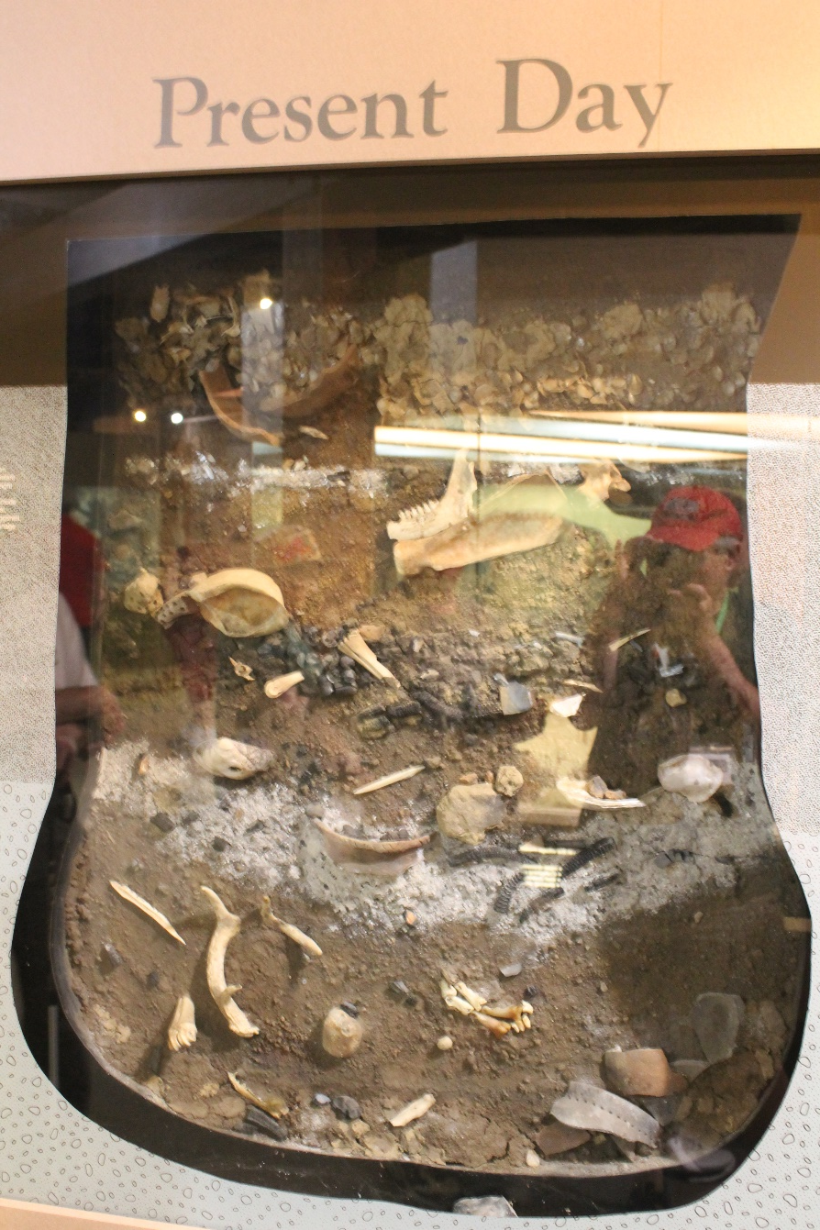
Life-cycle of storage pits at Sunwatch Village

Slide 5
Image of partially restored palisade and dwellings
The group gathering on observation deck prior to guided tour of village

Slide 6
Another image of partially restored village
Andy describing the reconstruction to those on the tour

Slide 7
Back at California, the group had one more photograph taken.

