Slide 1
June 16, Day Four
Cahokia

Slide 2
On Saturday morning, several of us went on a 2/5 mile walk through the Cahokia site led by Dr. John Kelly. First stop, orientation and visitation of the recent Fingerhut Tract excavation.
Group listening to Dr. Kelly’s overview of the morning walk
Dr. Mary Vermilion (St. Louis University) talking about her continuing excavations at the Fingerhut Tract

Slide 3
The long walk in the part
Stephen and Barbara Israel
Nick and Russ Bromley

Slide 4
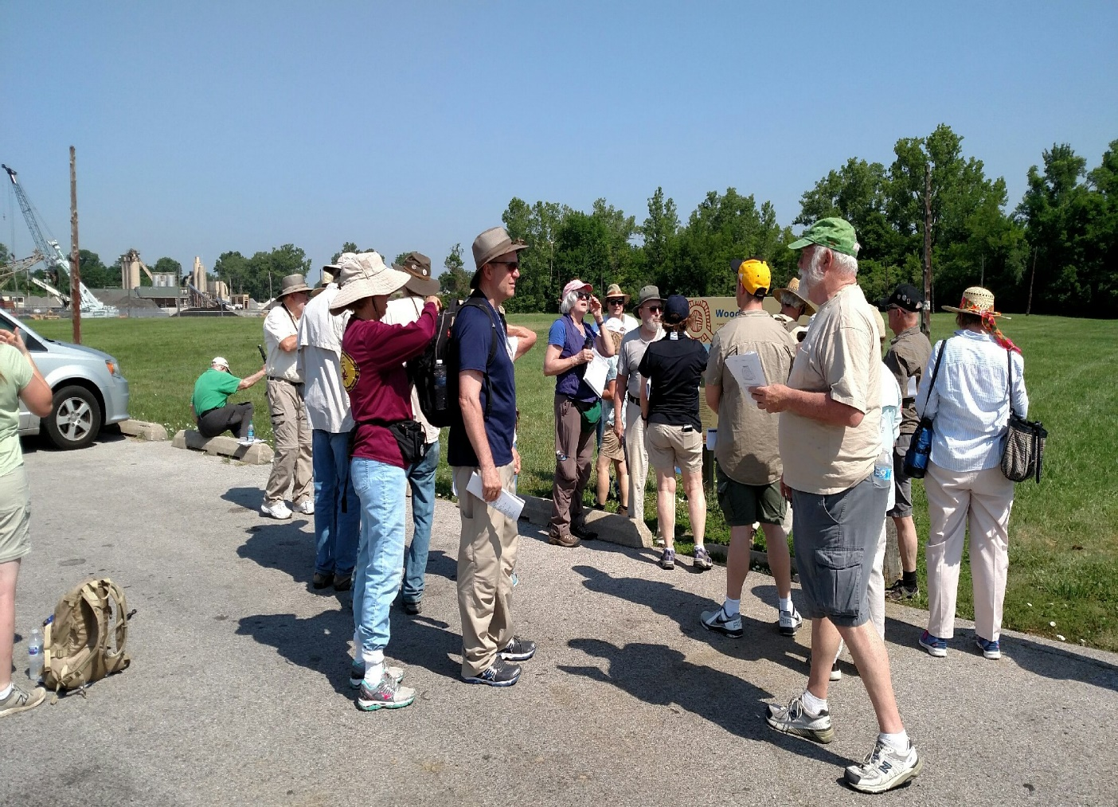
Walking tour prior to talk by William Iseminger about woodhenge
William Iseminger discussing the discovery and thinking behind the version of woodhenge that was recreated

Slide 5
Images of Woodhenge post alignment

Slide 6
Walking towards the center post at Woodhenge
Cedar center post at Woodhenge

Slide 7
Portion of reconstructed palisade
Close-up of reconstructed palisade

Slide 8
Images taken during the long walk through the park
Borrow Pit now filled with water
View of mounds looking across the main plaza

Slide 9
Signage about Monks Mound
The long way to the top of Monks Mound

Slide 10
Monks Mound, the largest earthen structure in the Americas

Slide 11
Museum from atop Monks Mound
One of many large, flat-topped mounds at Cahokia

Slide 12
St. Louis from atop Monks Mound

Slide 13
After lunch and another visit to the giftshop, it was back onto the bus and on to Terra Haute for the night; but not before one additional picture
Kurt Carr and Debora Saylor in the giftshop
Nick, Russel Bromley and Bob Harris discussing what they purchased

