Slide 1
Friday, June 15
After breakfast and loading the bus, we departed for the Wickliffe Mounds State Historic Park.

Slide 2
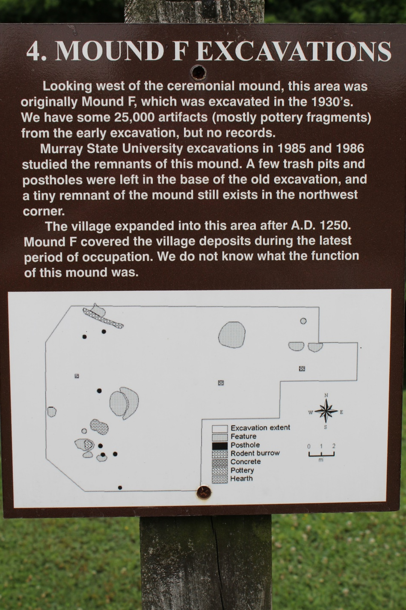
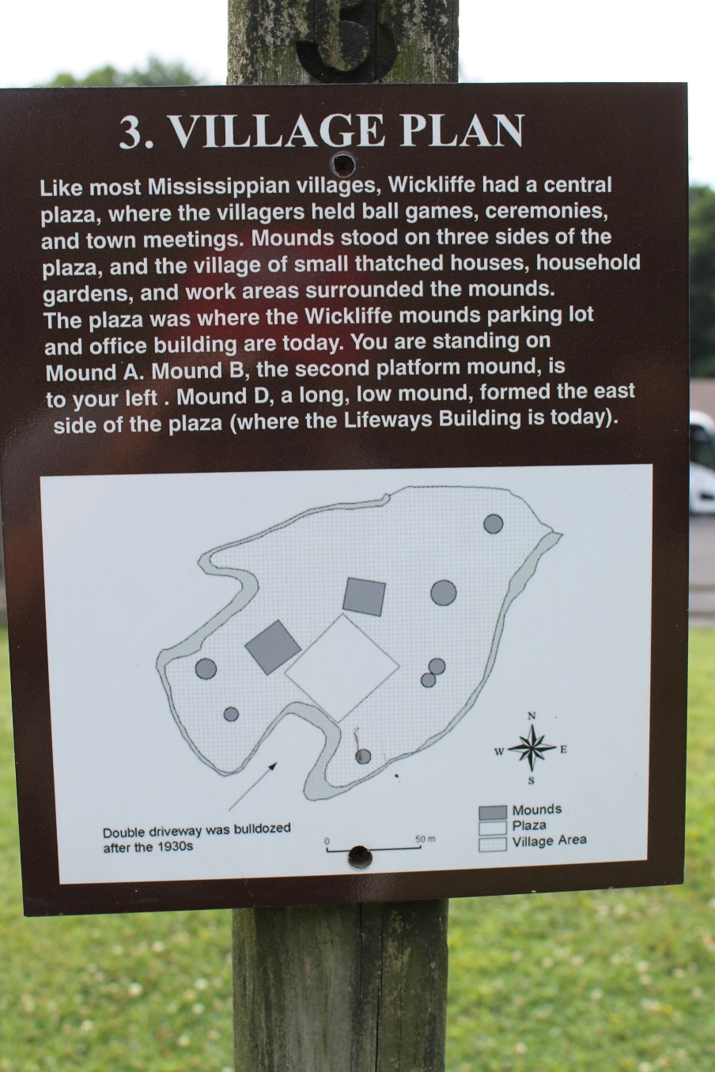
Maps of Site and Excavations

Slide 3
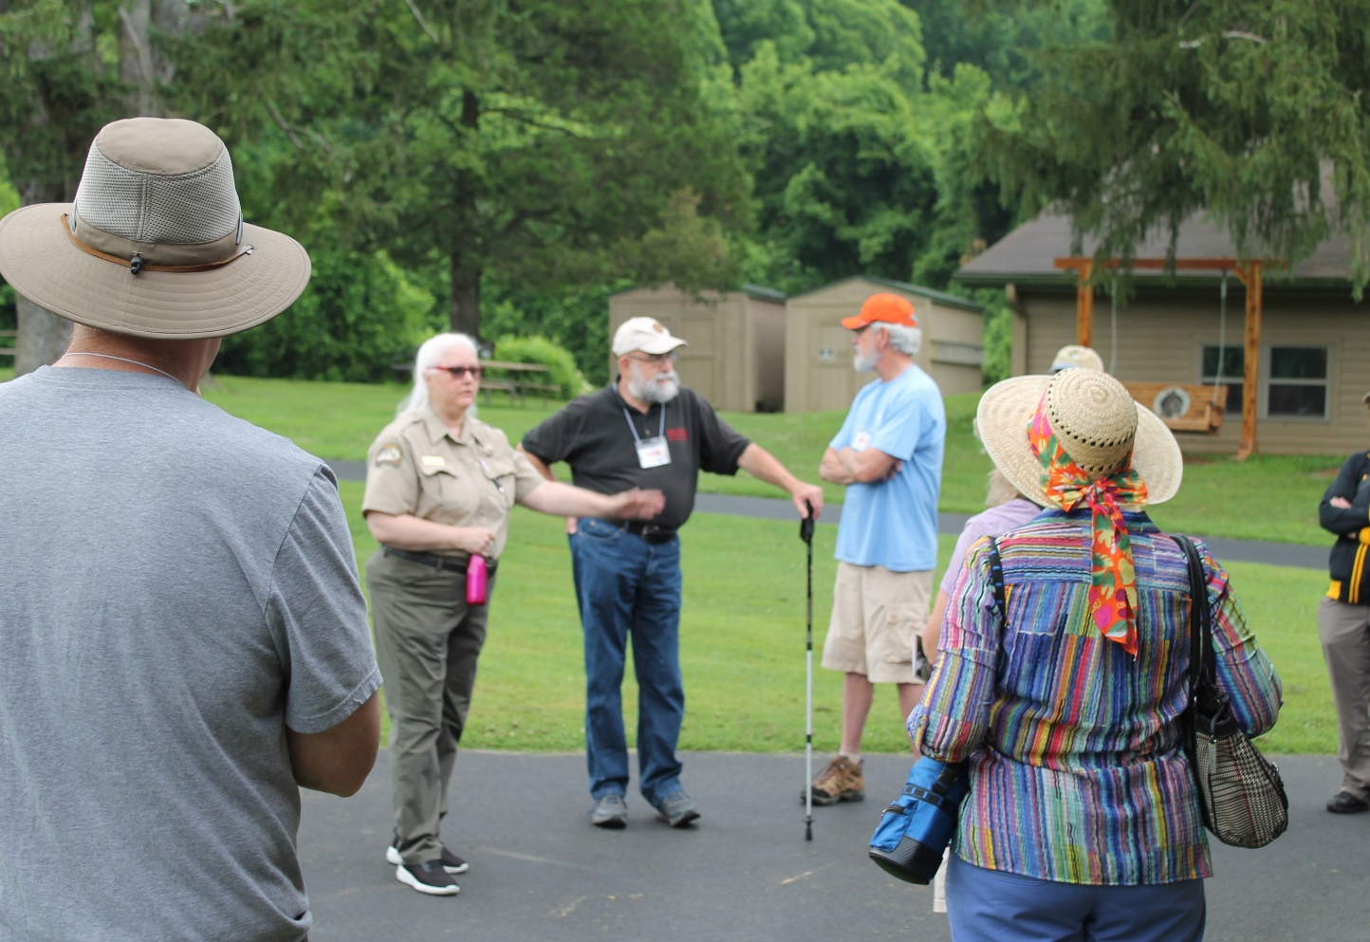
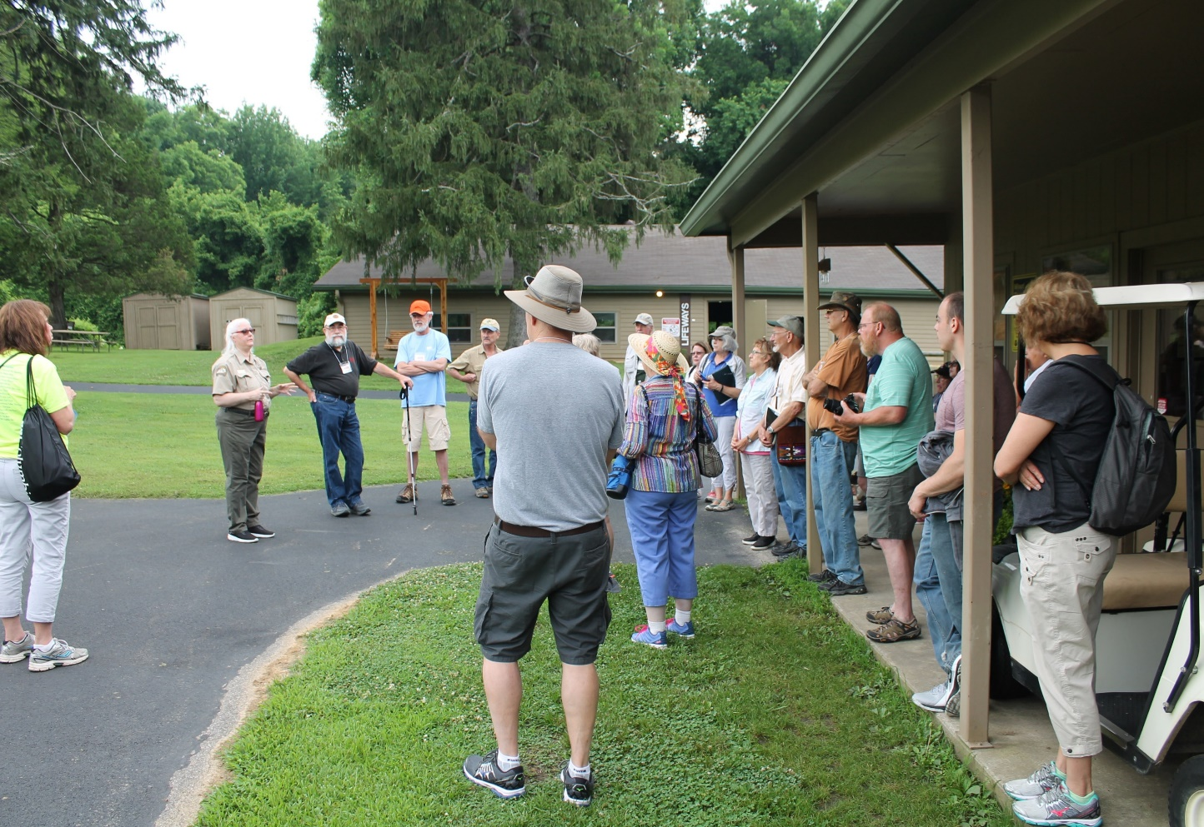
Group listens to the history of the site by Carla Hildebrand, Park Manager
Park Ranger and Manager Carla Hildebrand describing the history of the site
Park Ranger and Manager Carla Hildebrand describing recent excavations at the site

Slide 4
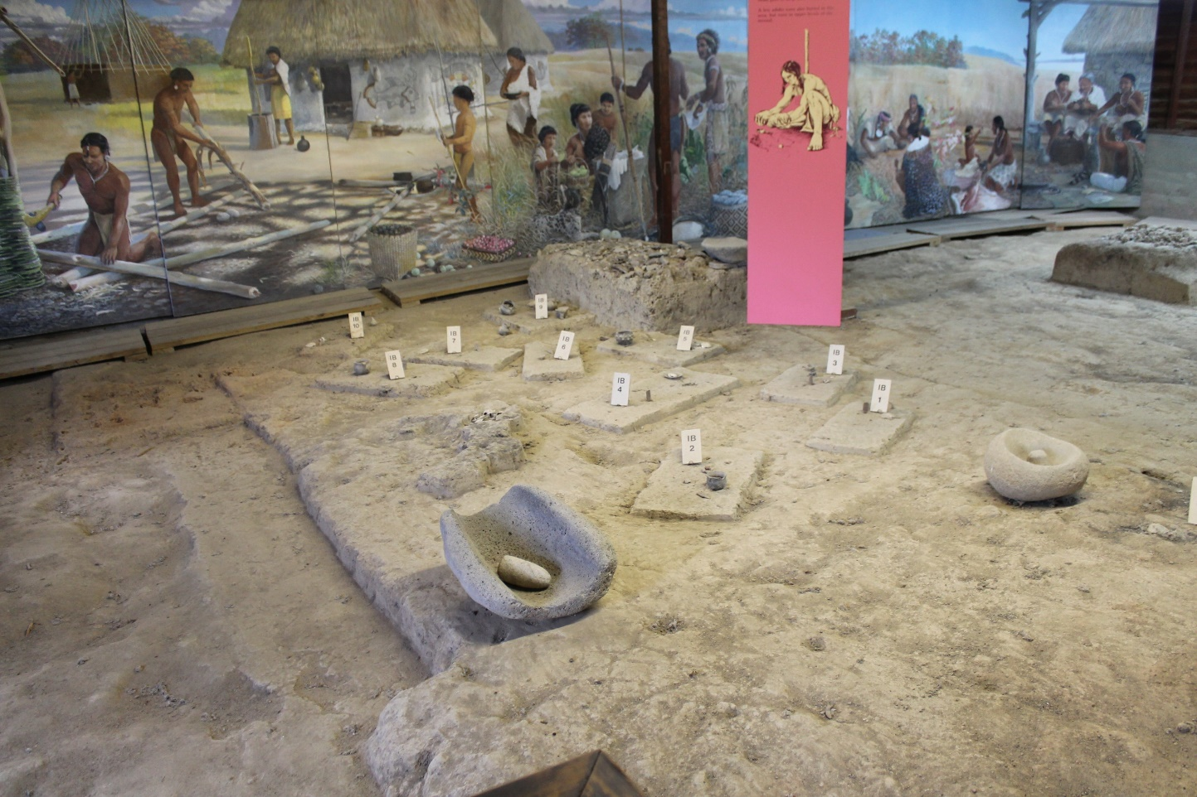
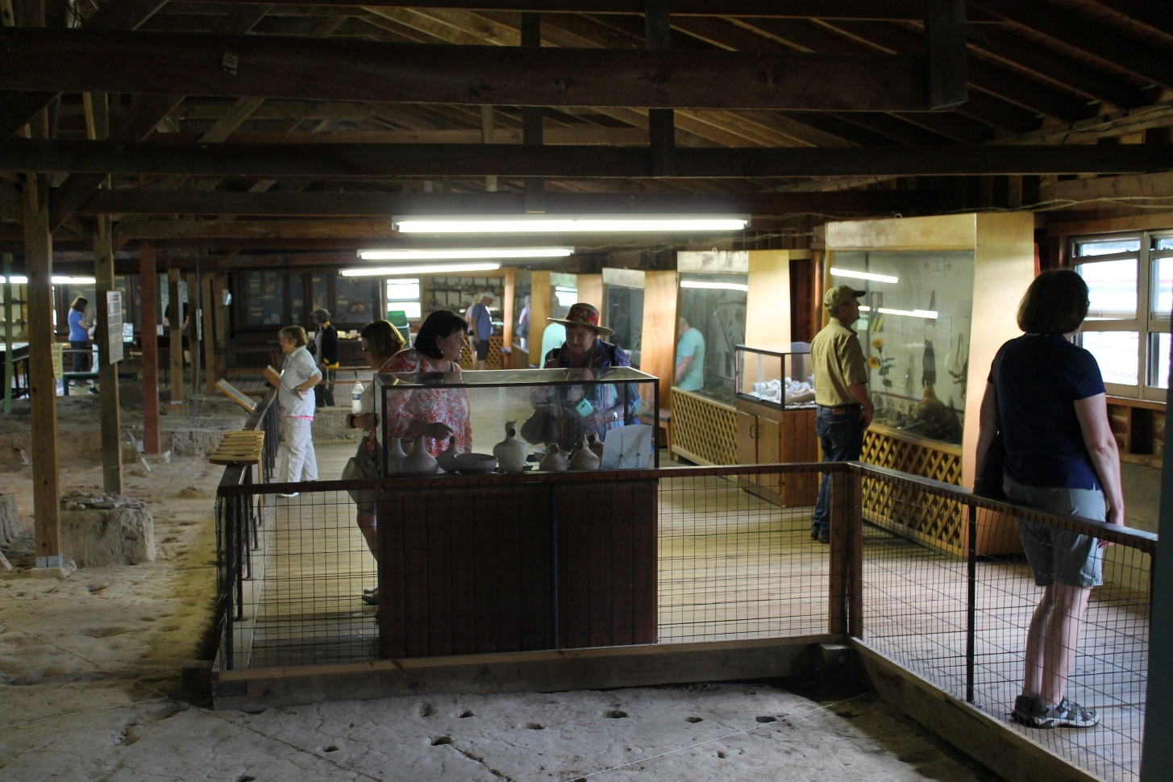
The “Chief” Mound, Mound B
Inside the structure built over top of the floor associated with the chief’s dwelling, Mound B
Inside the structure over Mound B. Members of our group reading the exhibits and looking at the artifact displays.

Slide 5
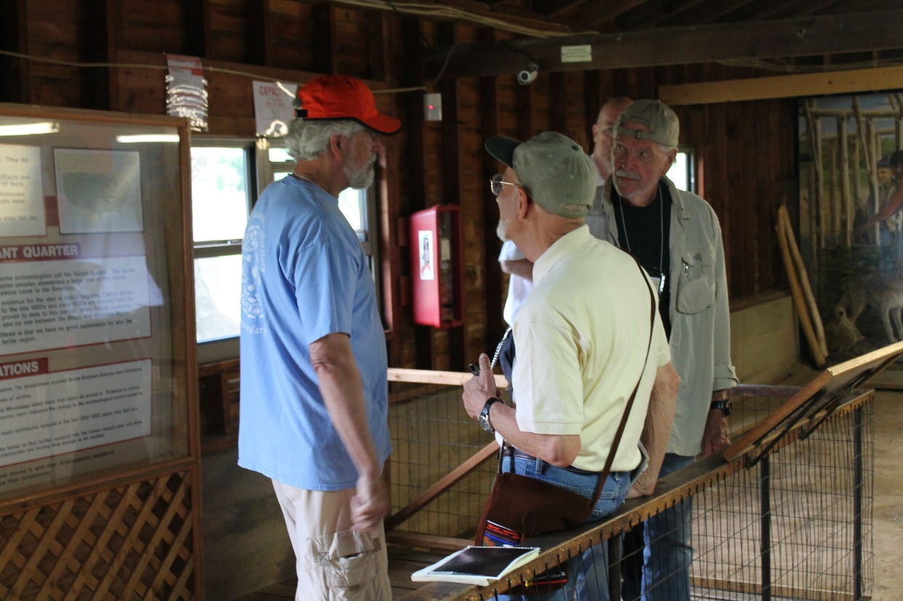
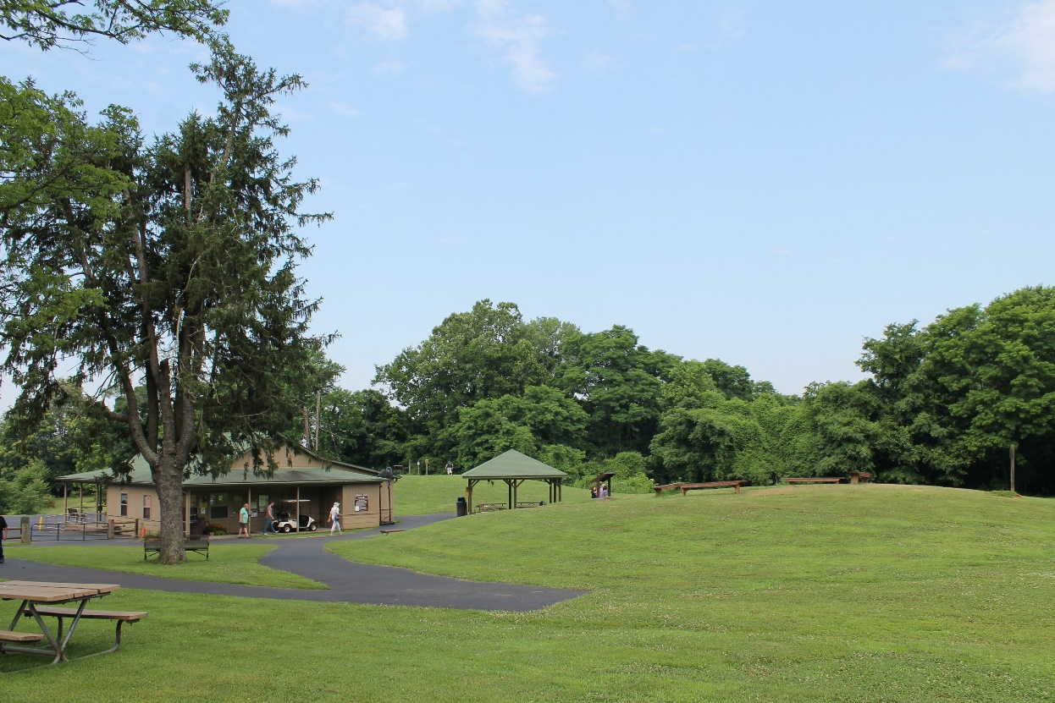
Additional Images from Wickliffe Mounds
Inside the structure built over Mound B.
Looking towards the visitor’s center and the atlatl practice range.

Slide 6
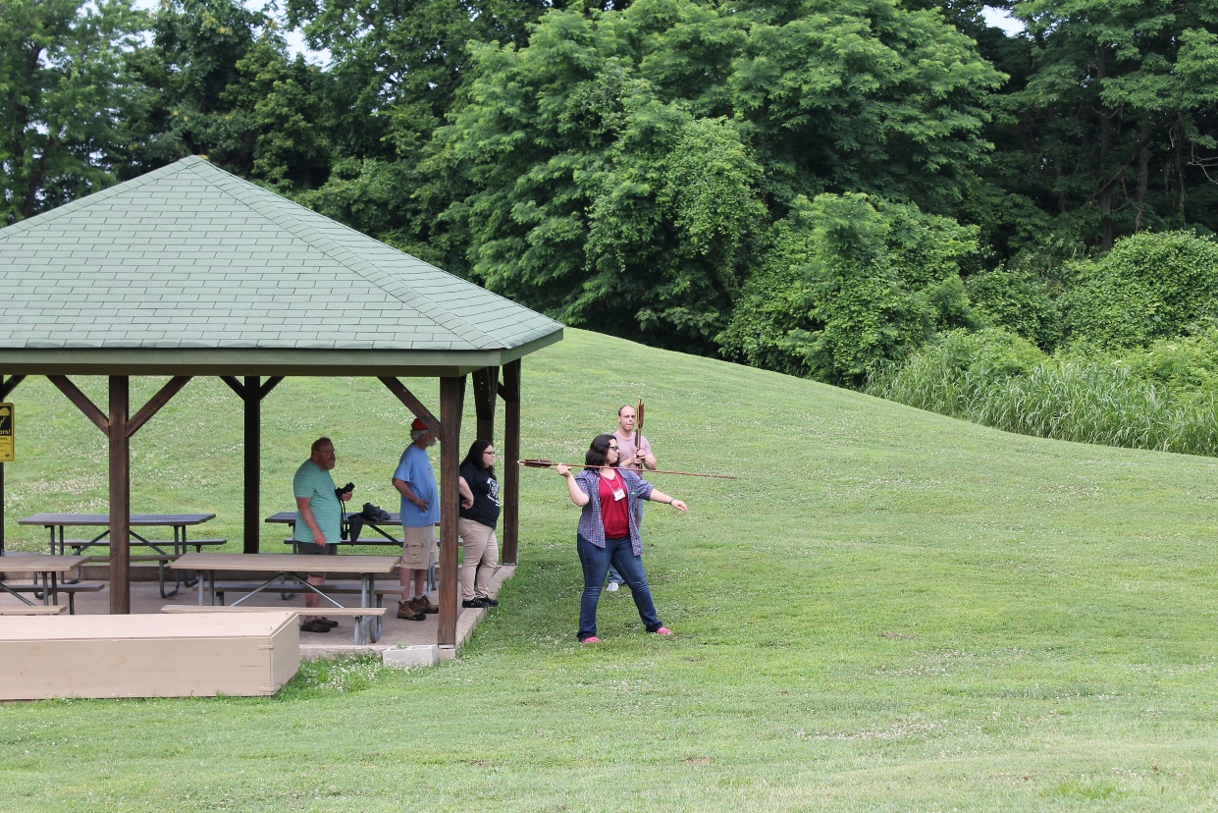
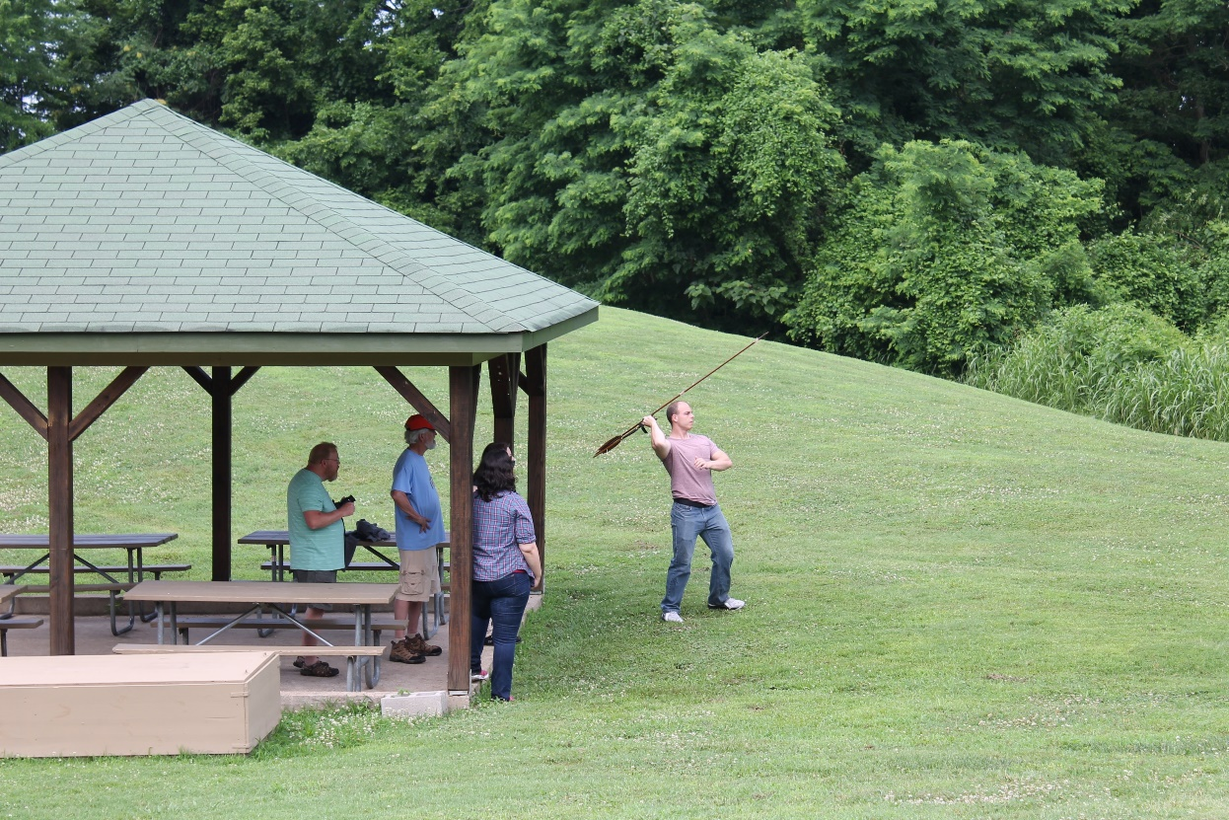
Atlatl Practice Field
Sarah Baughman throwing the atlatl
Nick Bromley throwing the atlatl

Slide 7
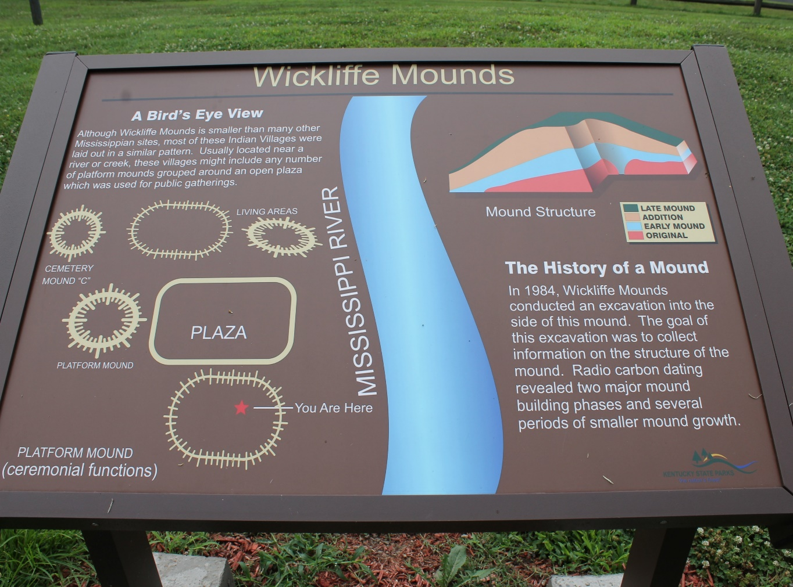
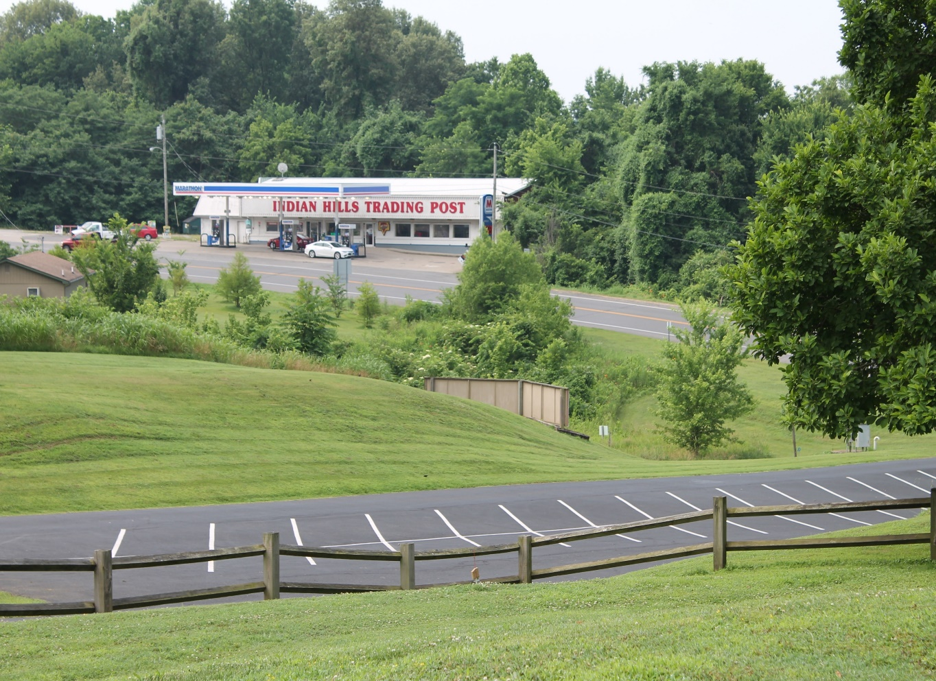
Pictures in and around the mounds
Picture of the Indian Hills Trading Post across the street from the park
Signage about the excavation of the chief’s mound

Slide 8
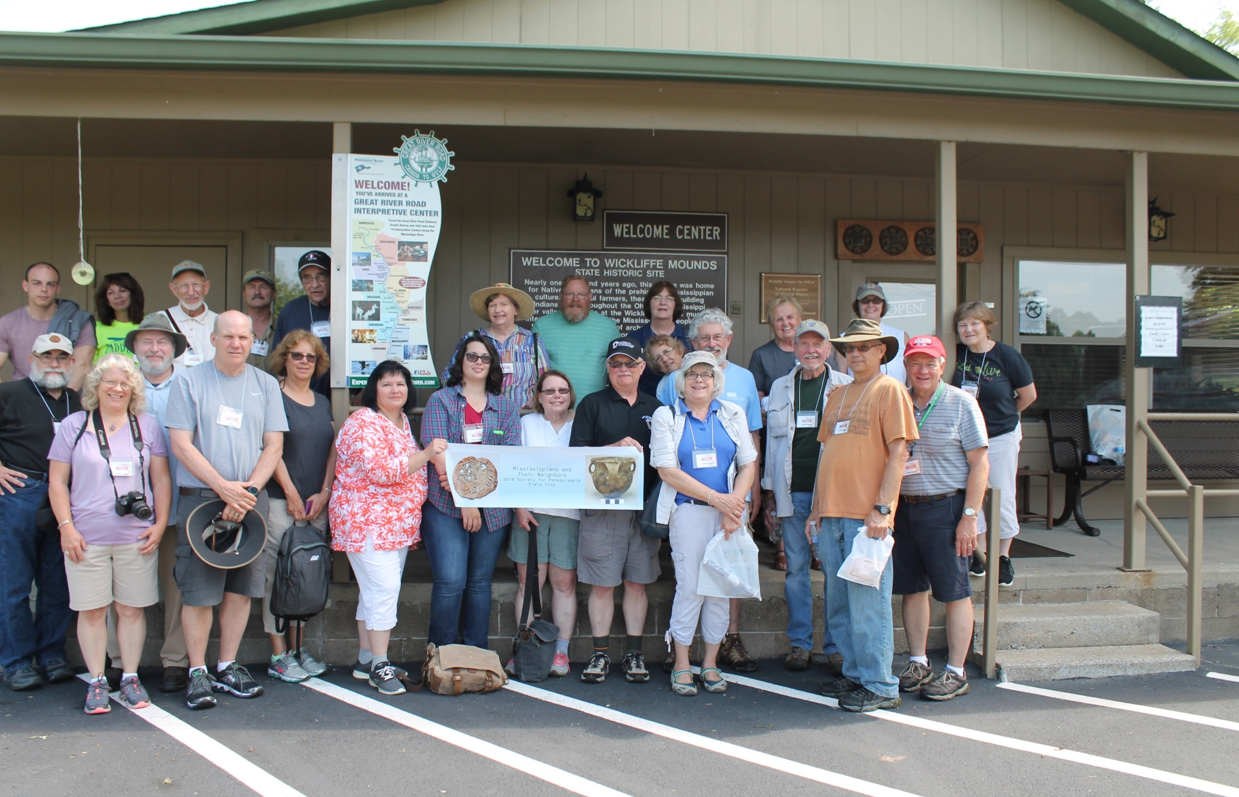
Group Picture at Wickliffe Mounds

Slide 9
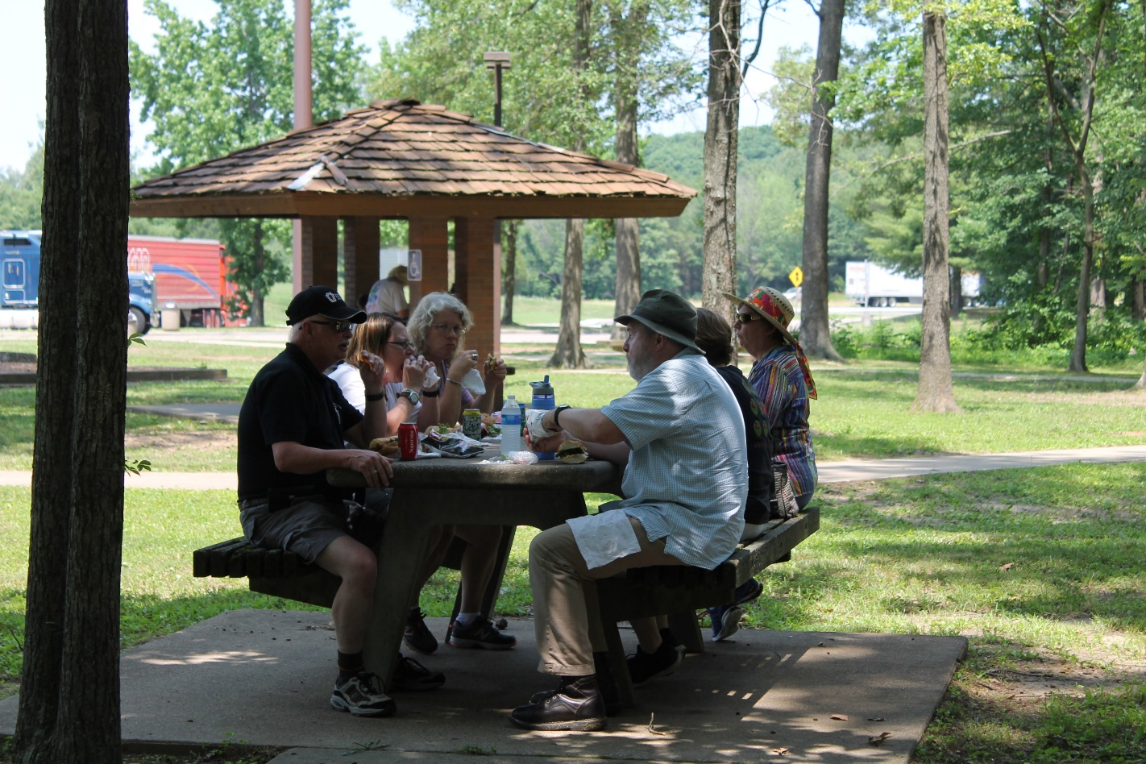
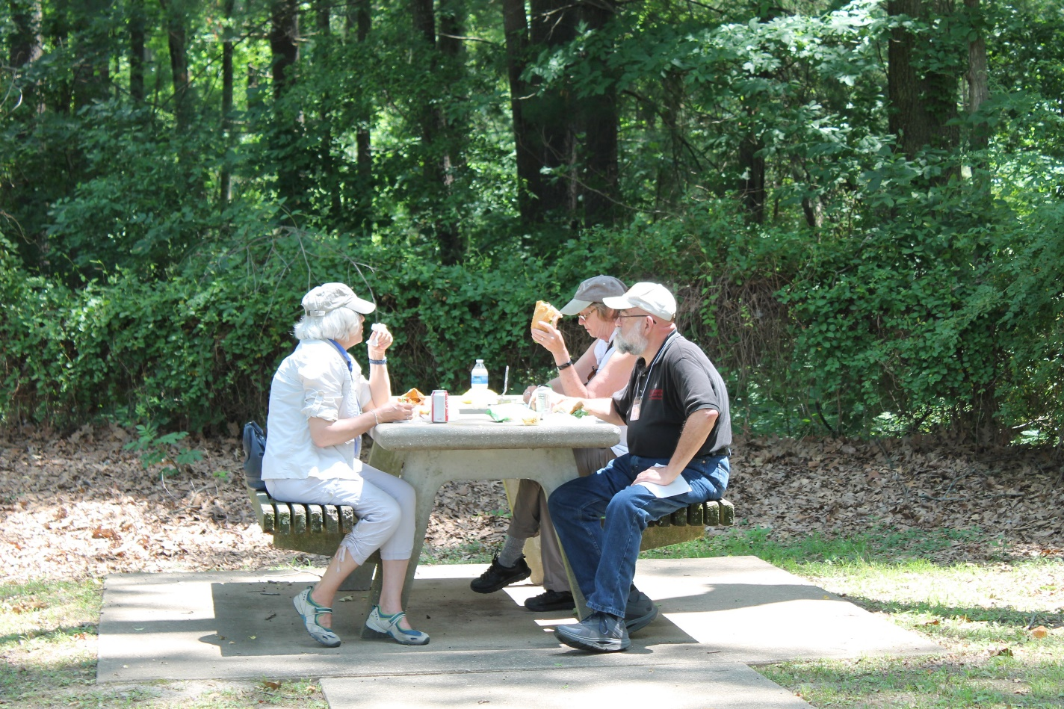
Lunch along the Interstate in Illinois

Slide 10
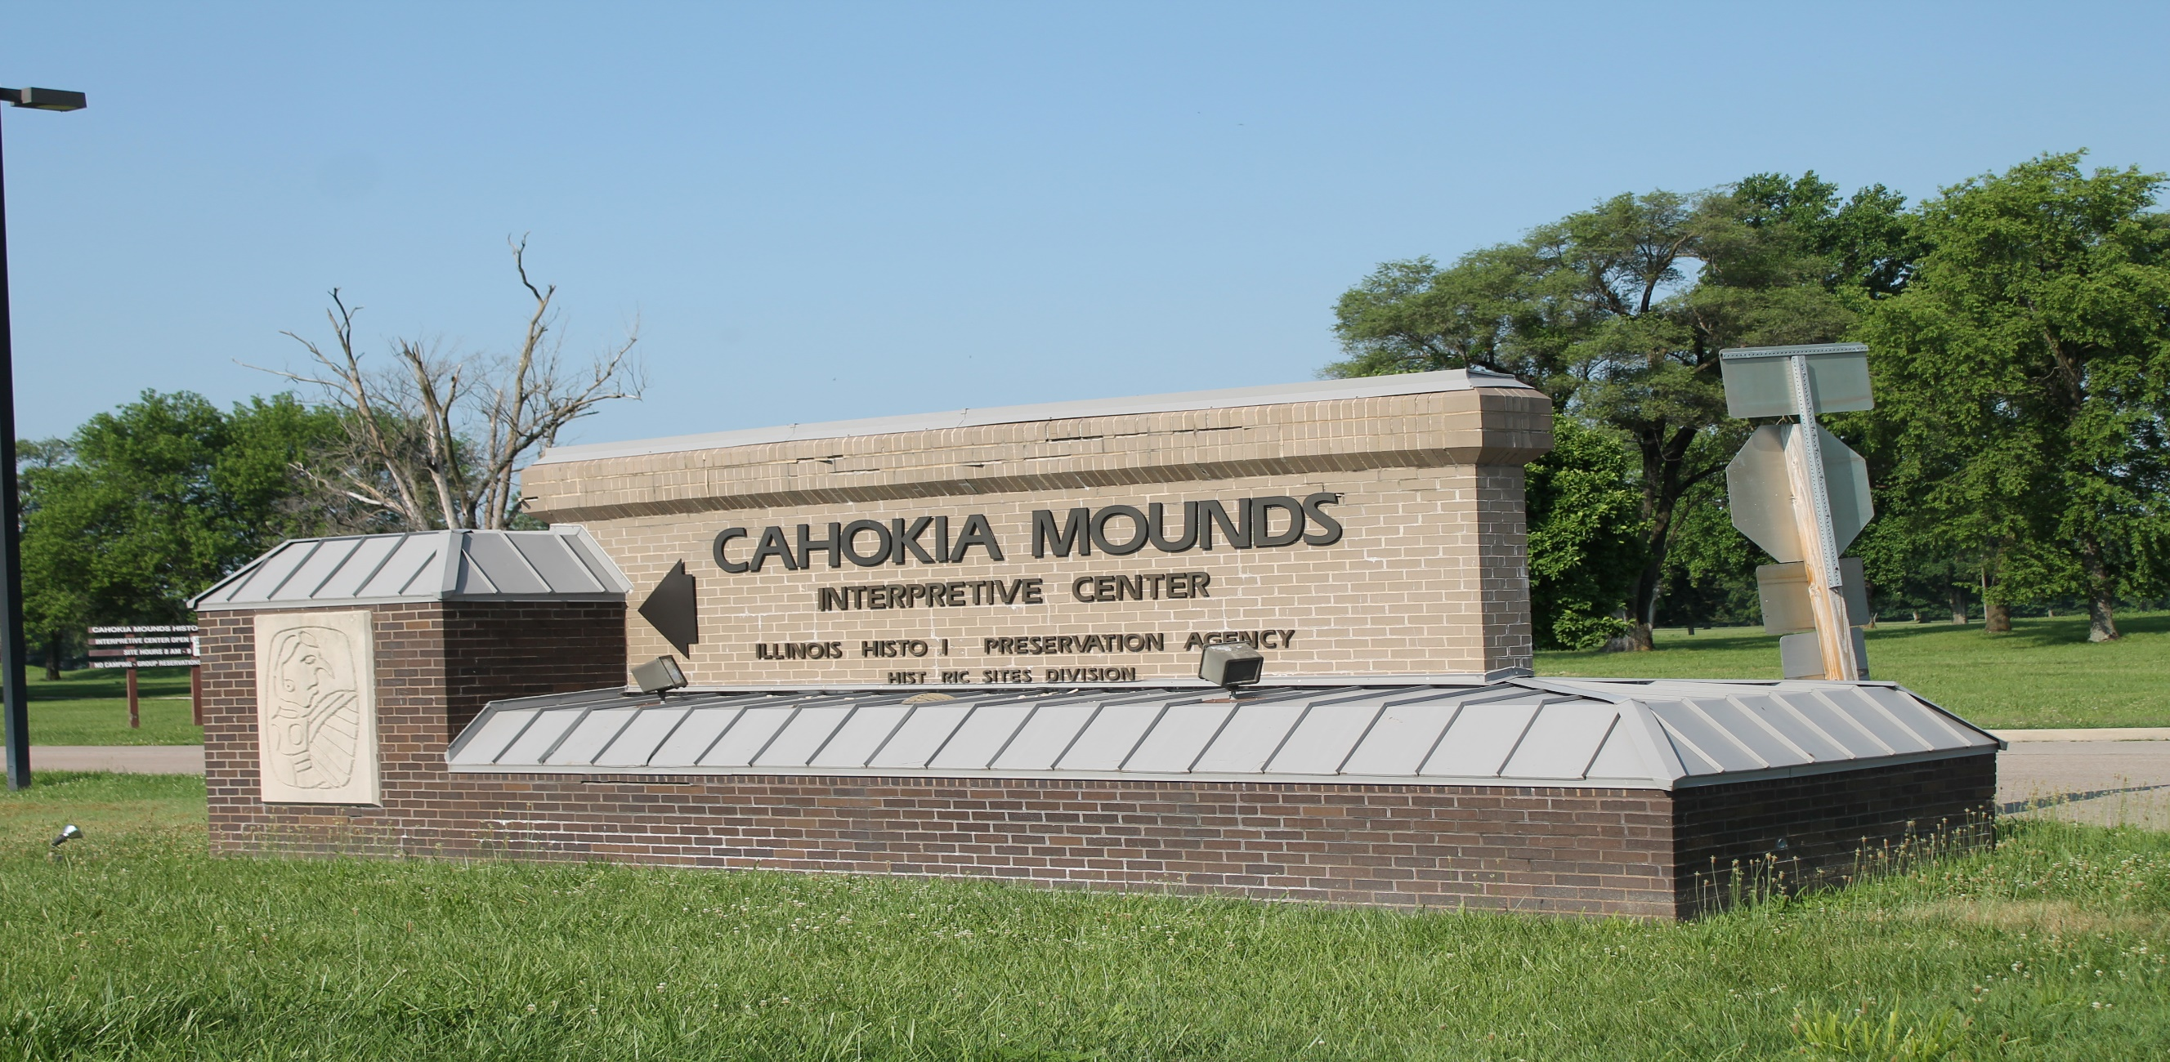
After leaving Wickliffe Mounds, we departed for the granddaddy of all Mississippian sites, Cahokia.

Slide 11
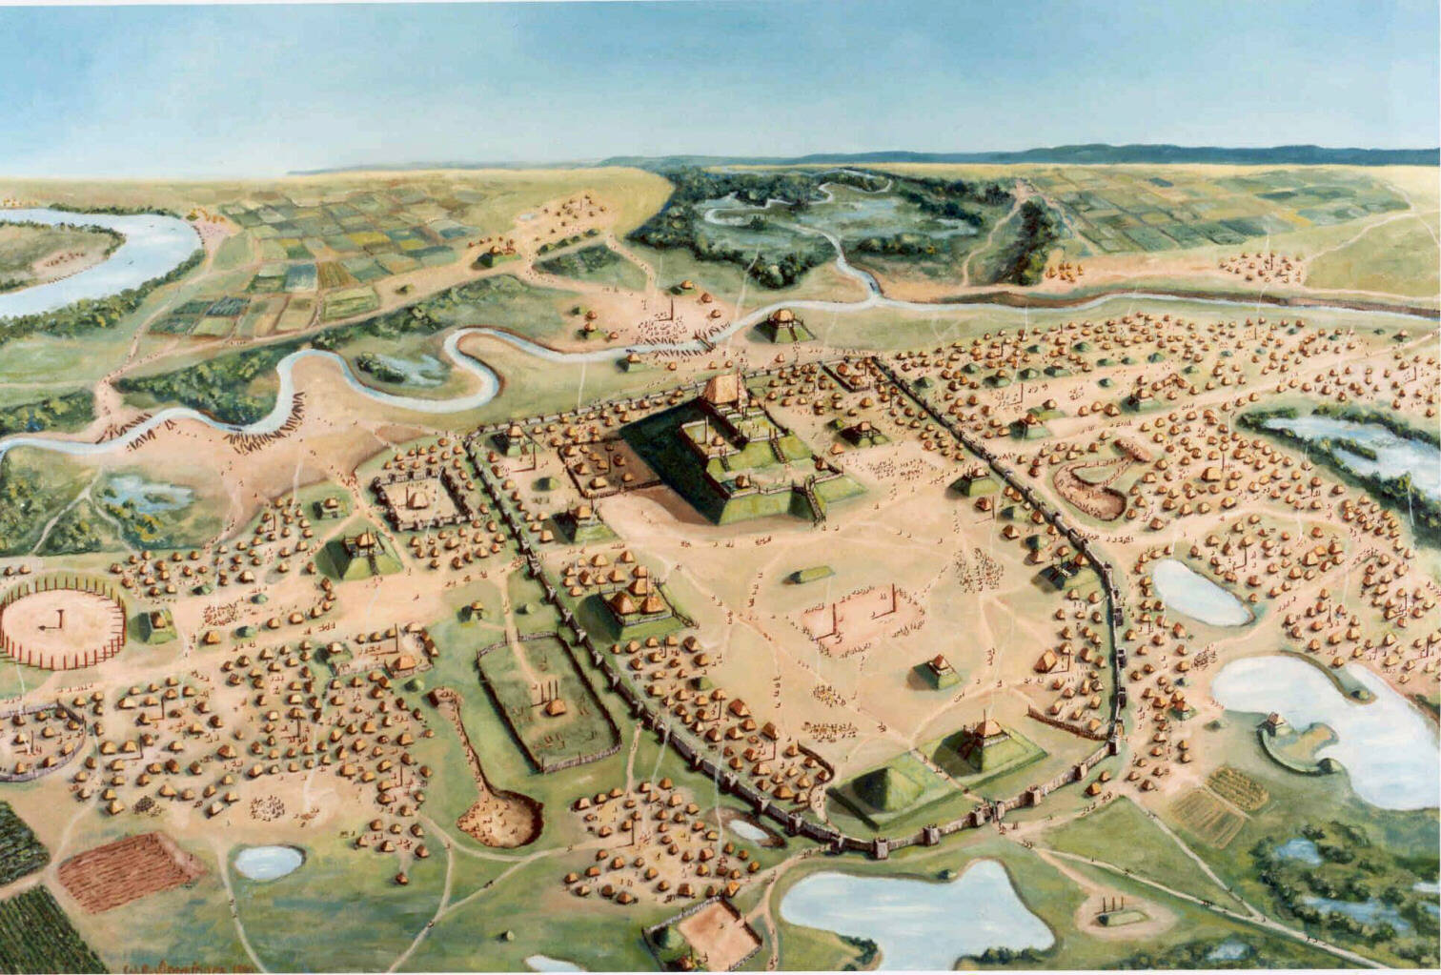

Slide 12
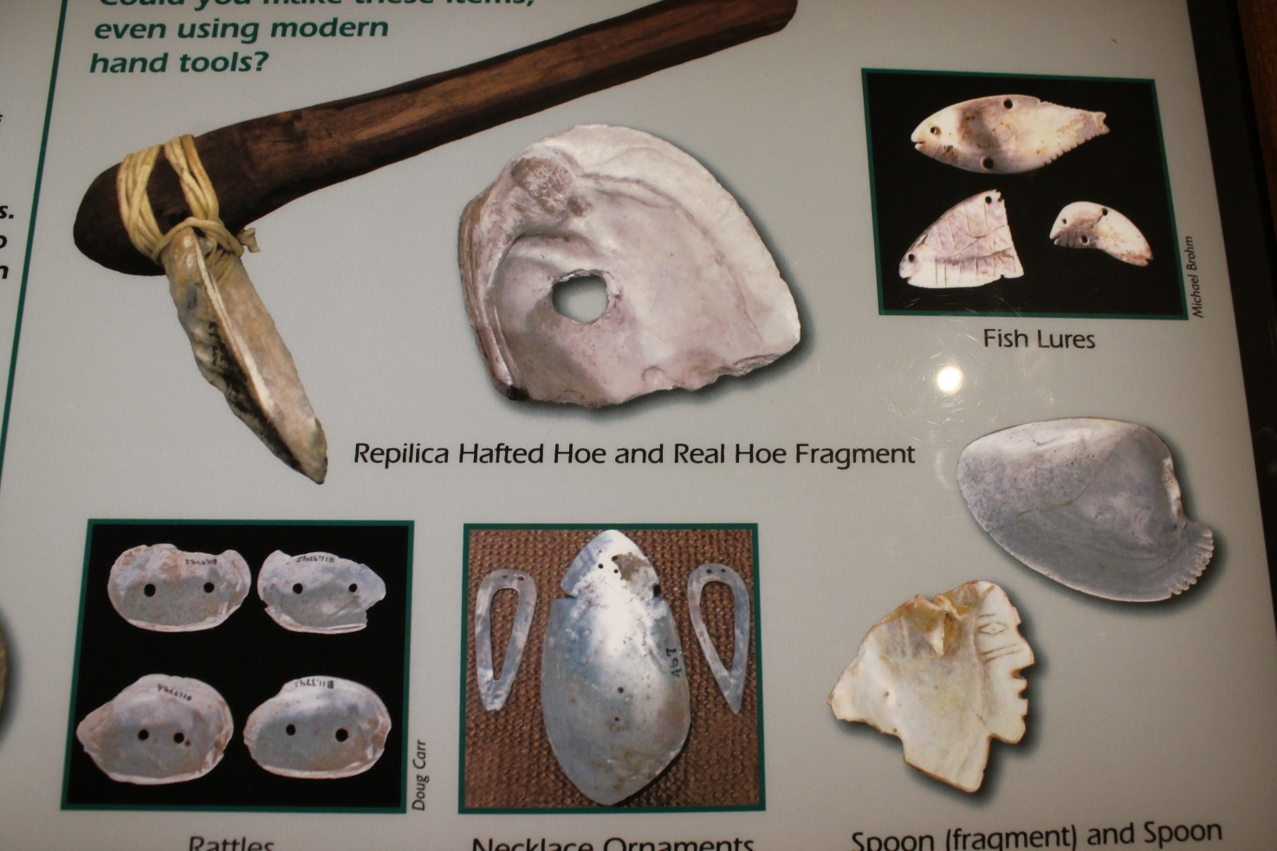
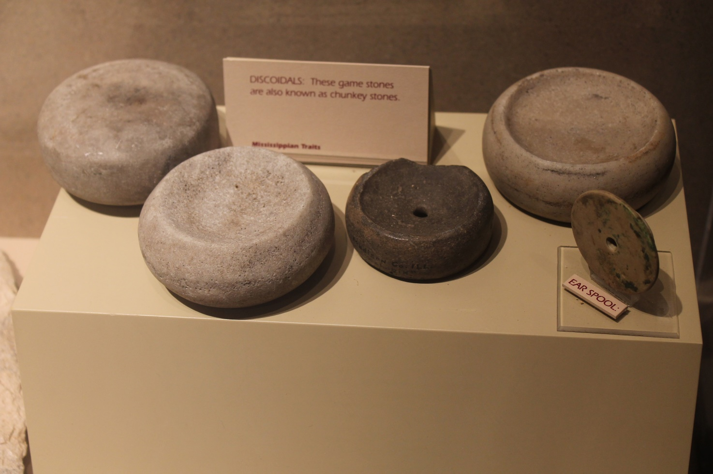
We started in the museum at the site and after an introductory film, we explored the museum
Various types of mollusk shell artifacts
Examples of Clunky Stones

Slide 13
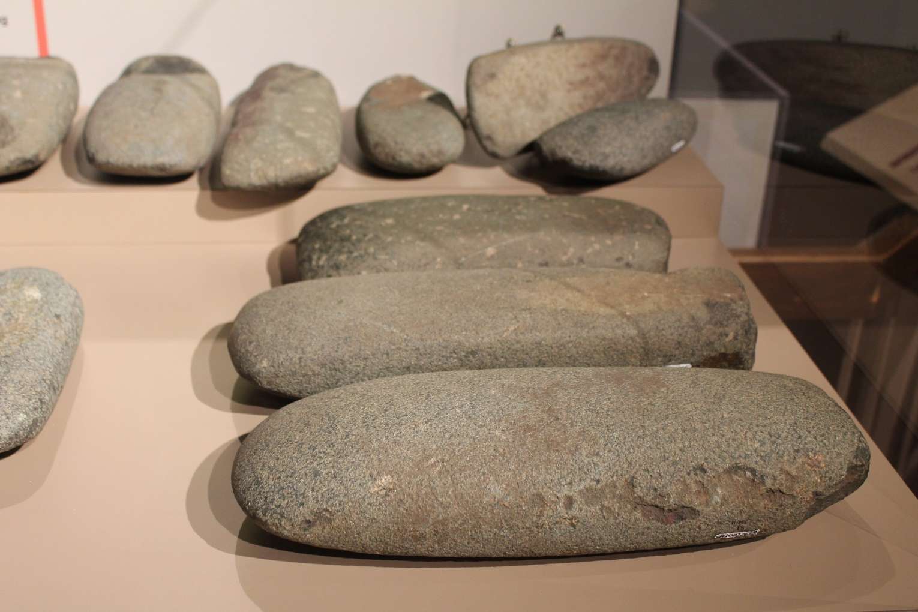
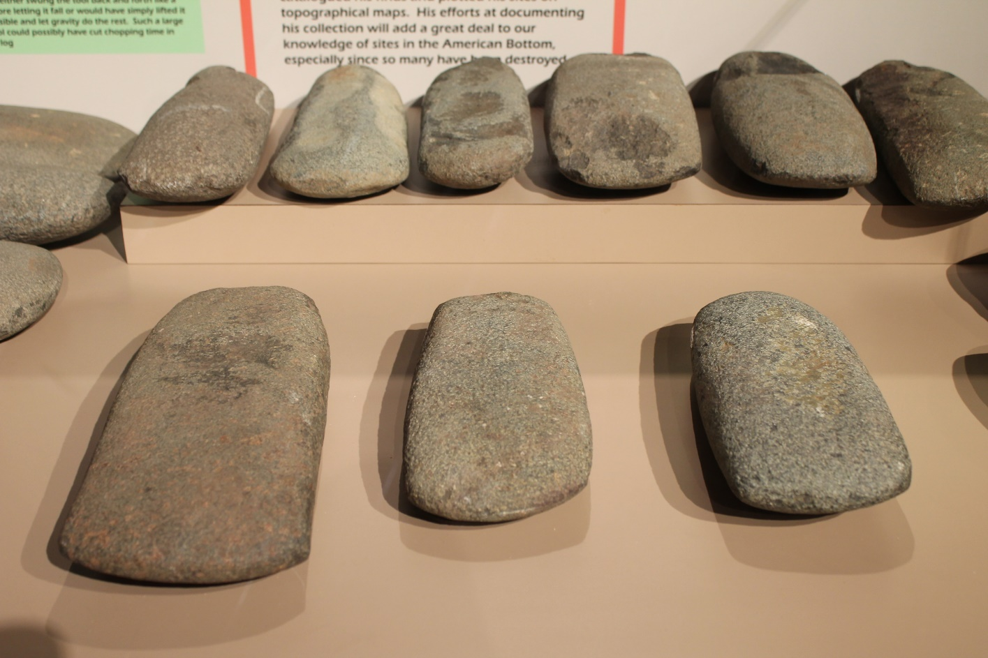
Examples of granite celts. These were large, some weighting close to 20 pounds
Additional examples of granite celts.

Slide 14
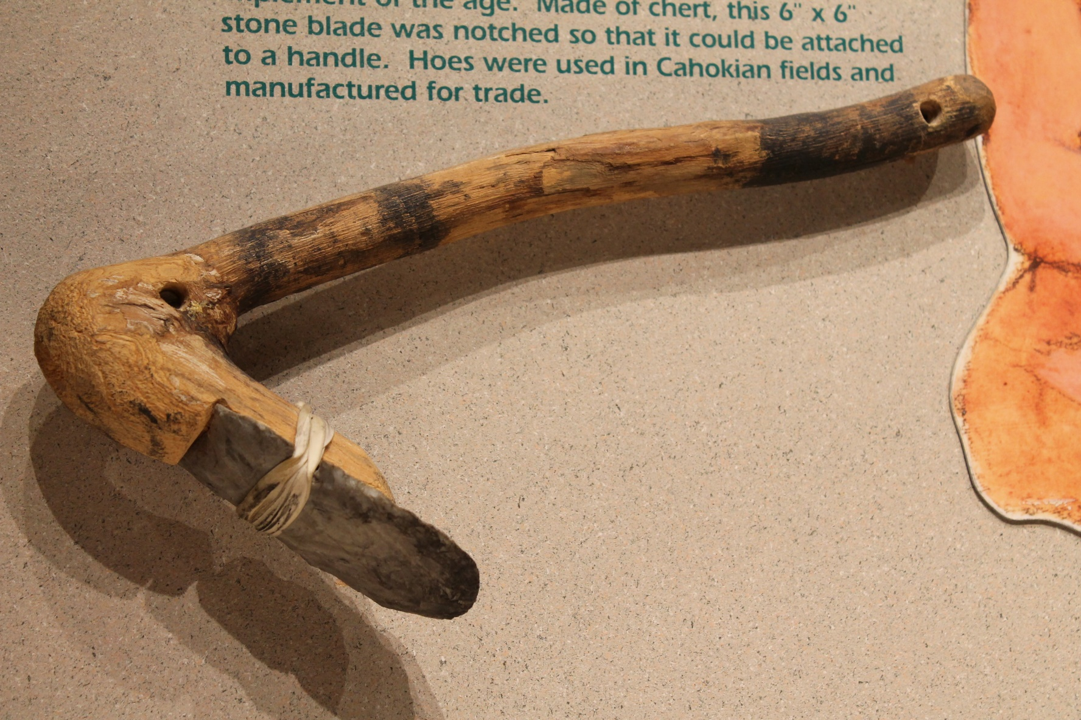
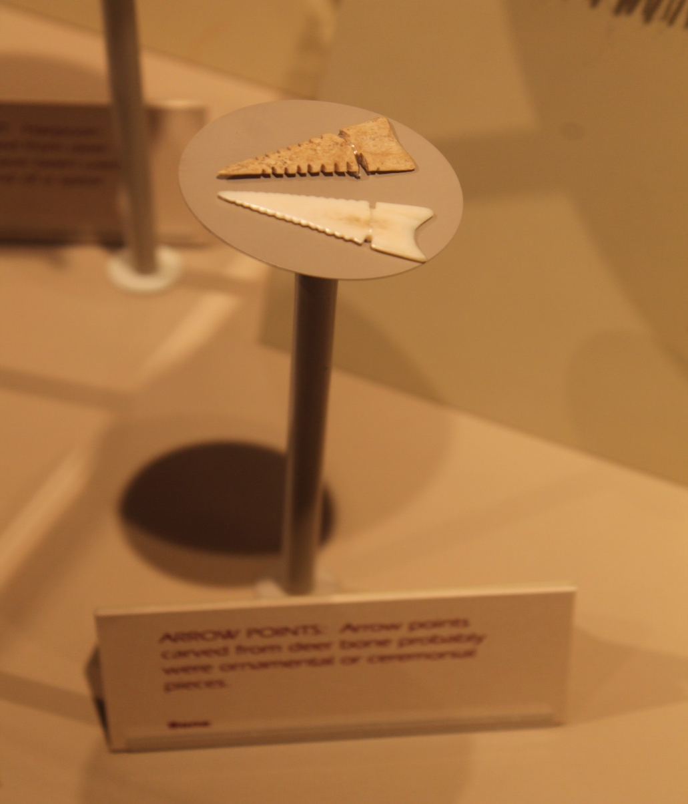
Mississippian chipped stone hoe hafted to a handle
Examples of Classic Cahokian projectile points

Slide 15
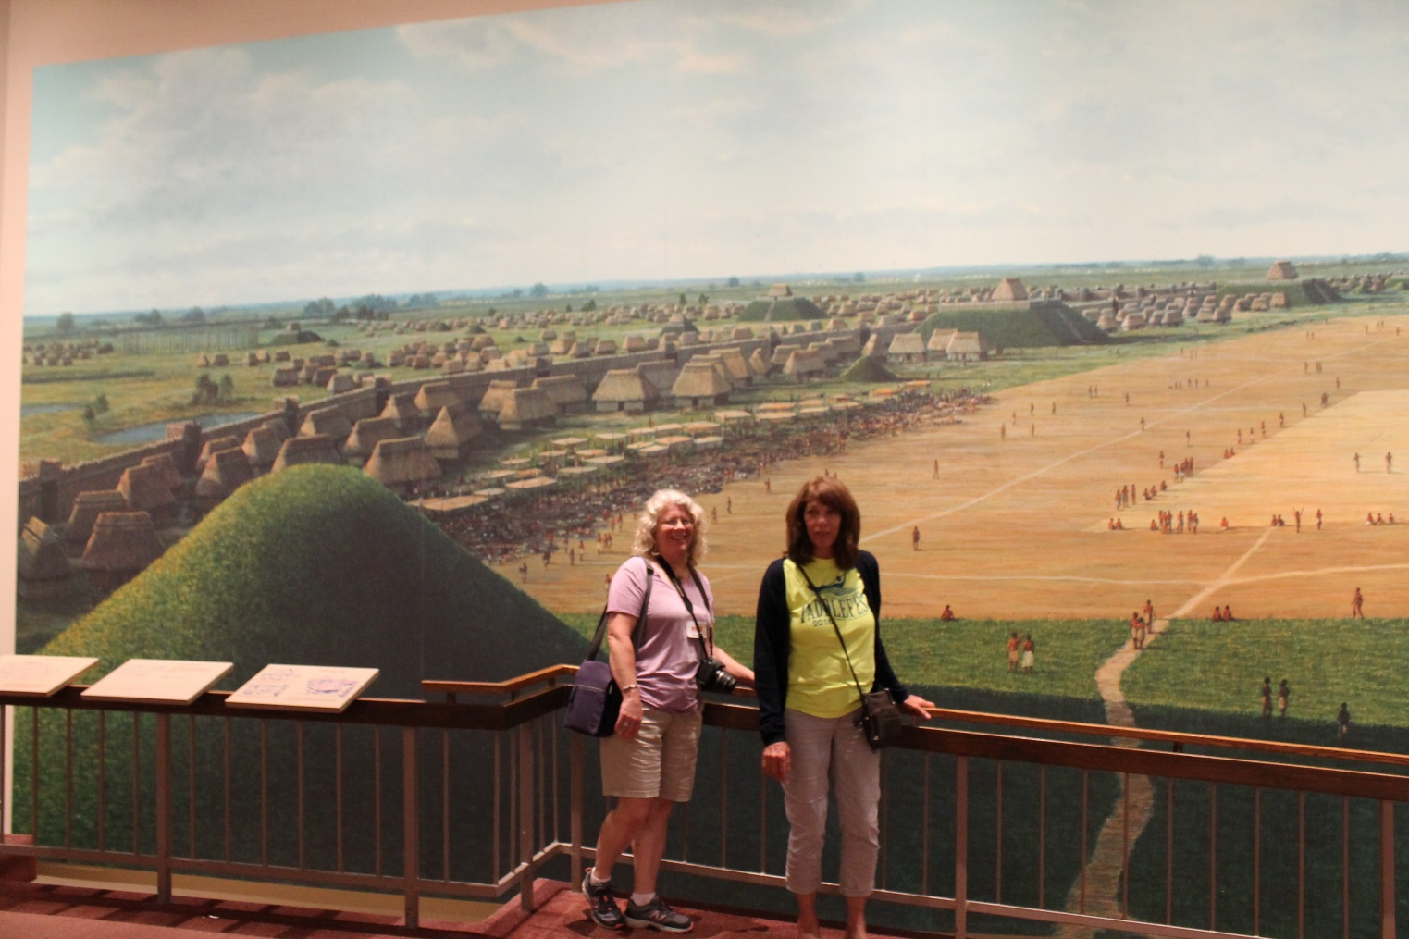
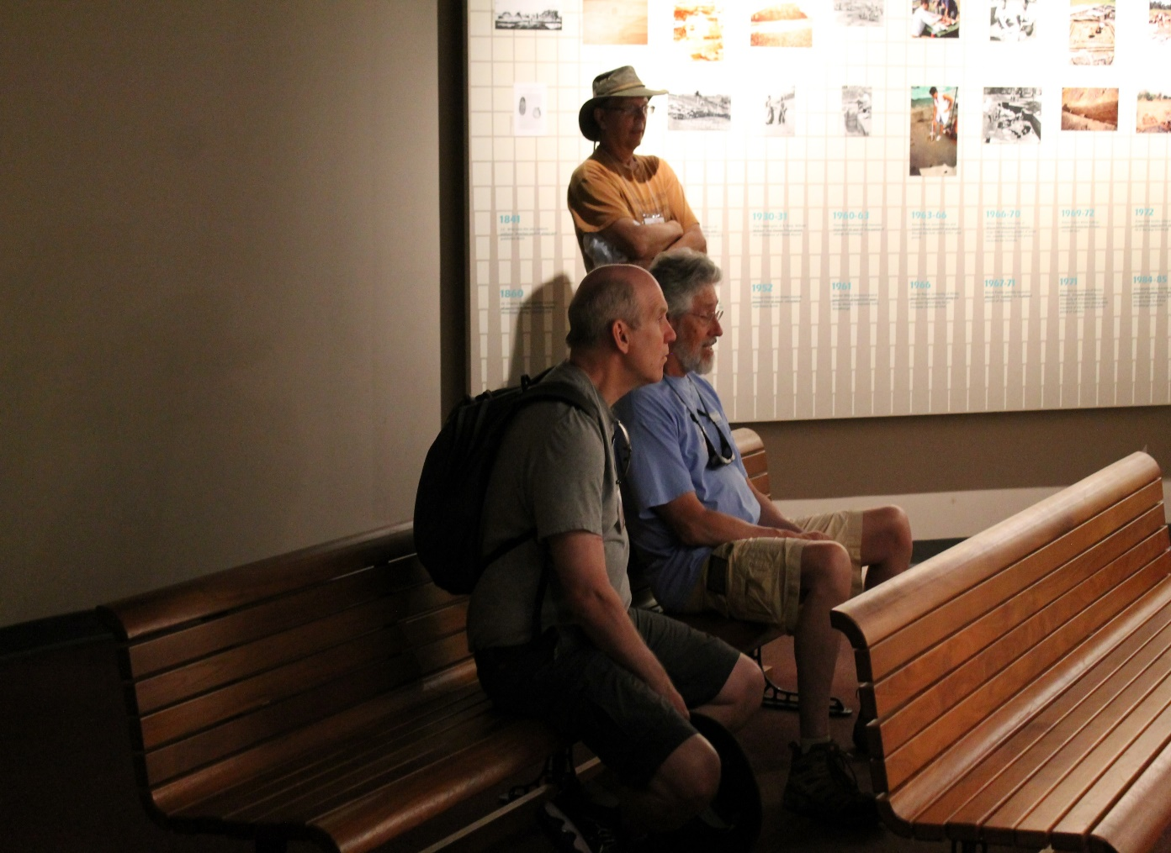
Amanda Valko and Lynne Baer in front of the mural of Cahokia
John Tonkavitch, Bill Hutchison, and Don Rados watching a short file in the museum

Slide 16
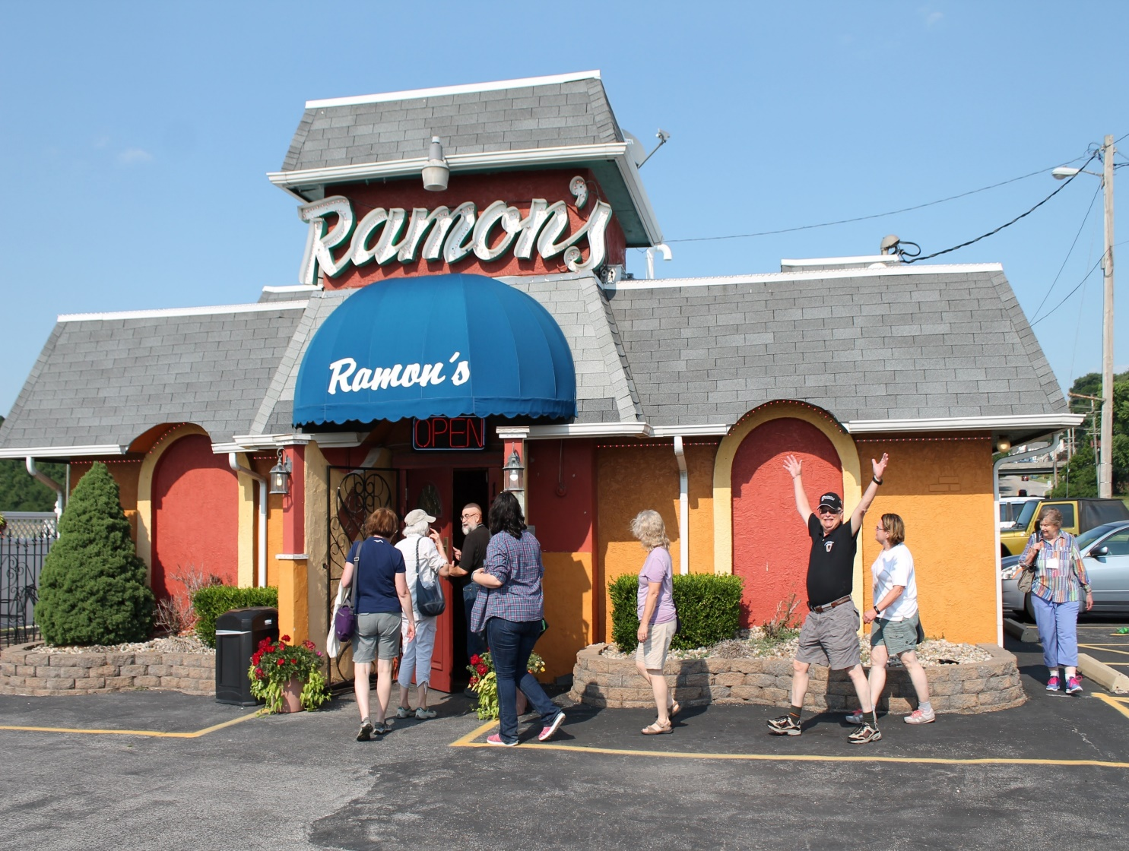
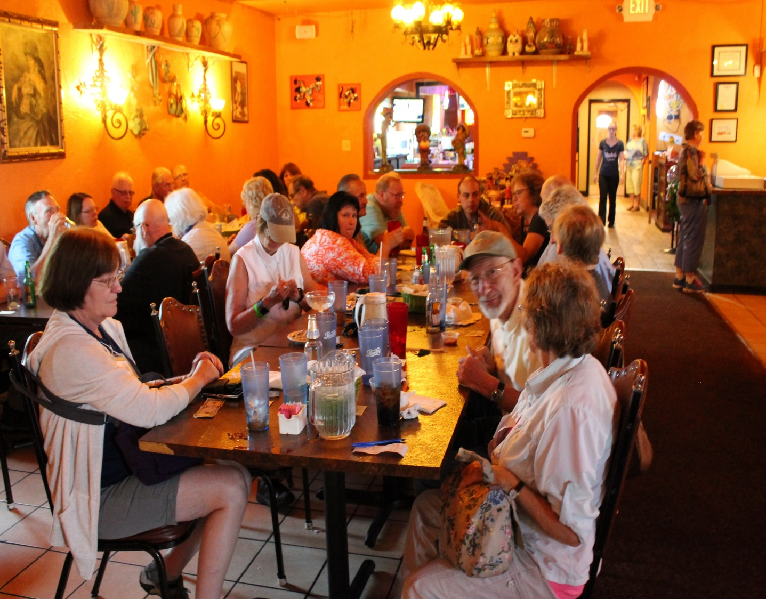
After walking through the museum, everyone went to Ramon’s for supper. Ramonn’s has been a local archaeological fixture for food and drink for years.

Slide 17
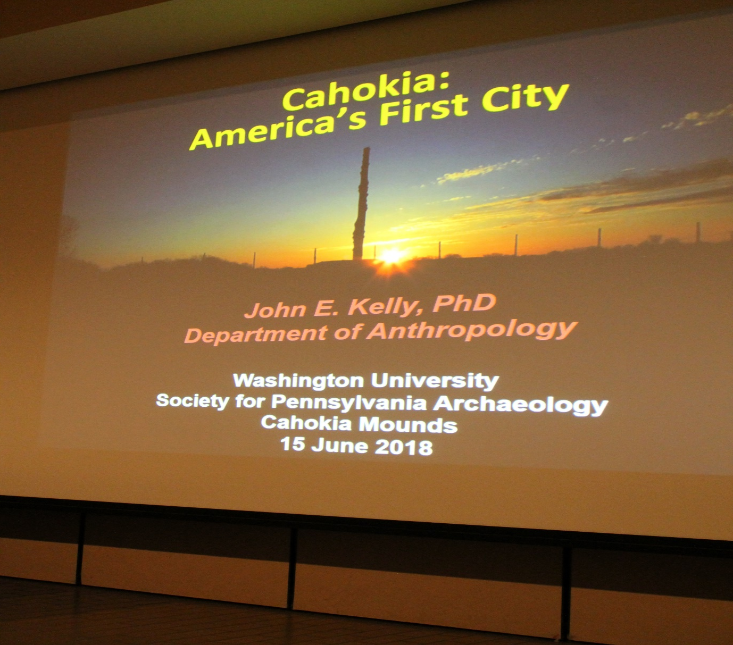
After dinner, we returned to the museum for a special lecture on Cahokia by Dr. John Kelly, who has worked at the site for several years

Slide 18
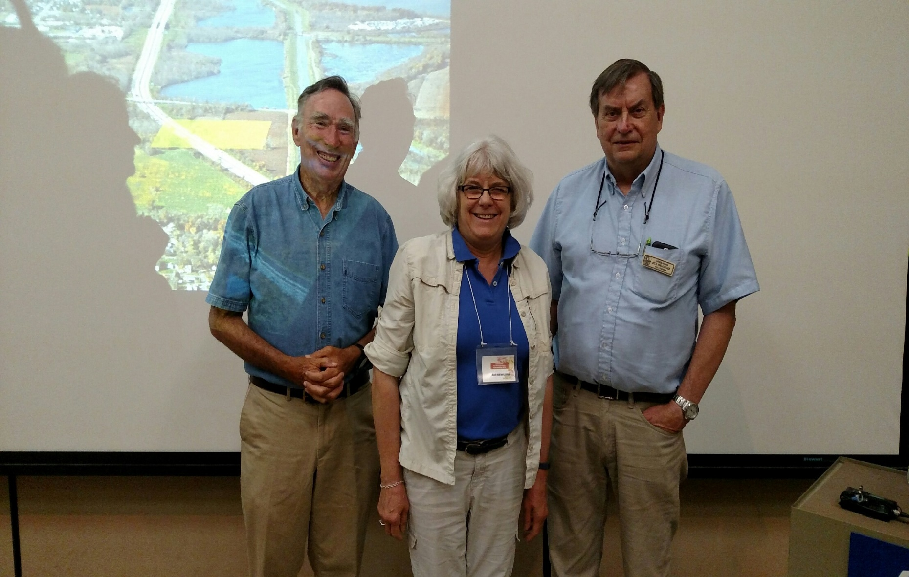
Picture of Dr. Kelly, Sarah, and William Iseminger, Assistant Site Manager, who has also written about Cahokia and has also excavated at the site as well.

Slide 19
After walking through the museum, everyone went to Ramon’s for supper. Ramonn’s has been a local archaeological fixture for food and drink for years.

