Slide 1
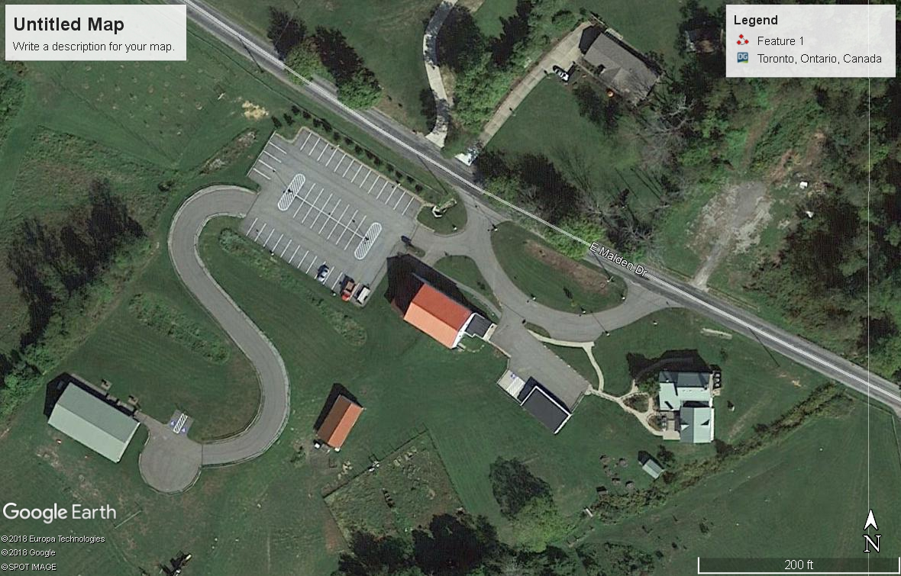
June 13, Day One
After departing California University at 730 AM, our first stop was the Ohio Historic Connection where the group met. The group had met the previous evening at the SAI Farm Conference Center for snacks and orientation. Red Arrow points to the conference center.

Slide 2
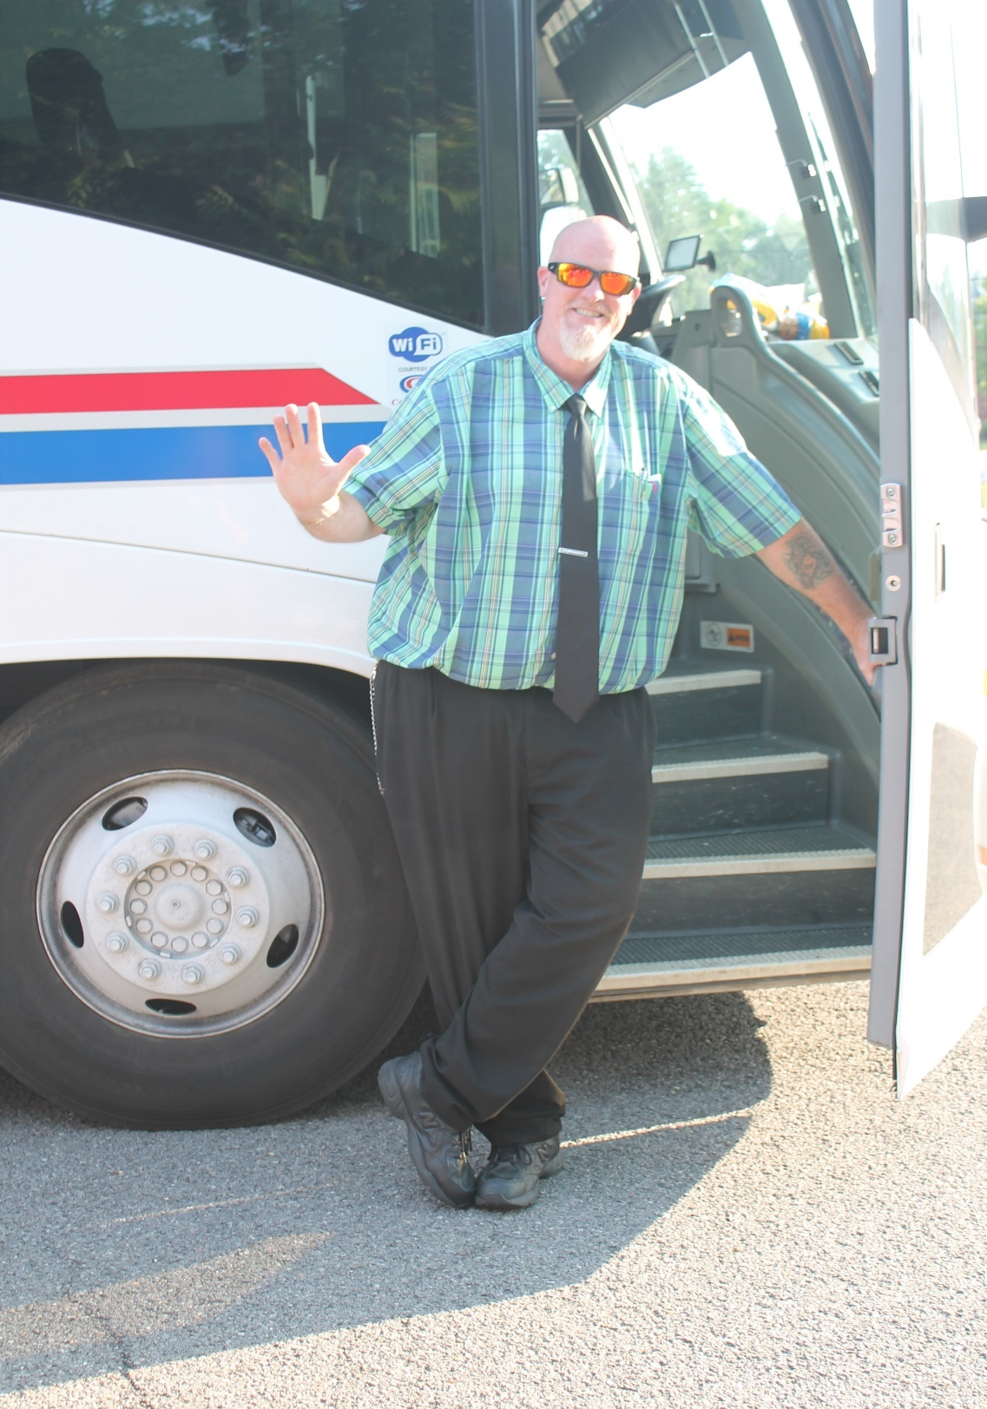
Our driver for the trip was “Big Ron”. He kept us on time and was a very enjoyable individual. He learned a lot about archaeology on this trip.

Slide 3
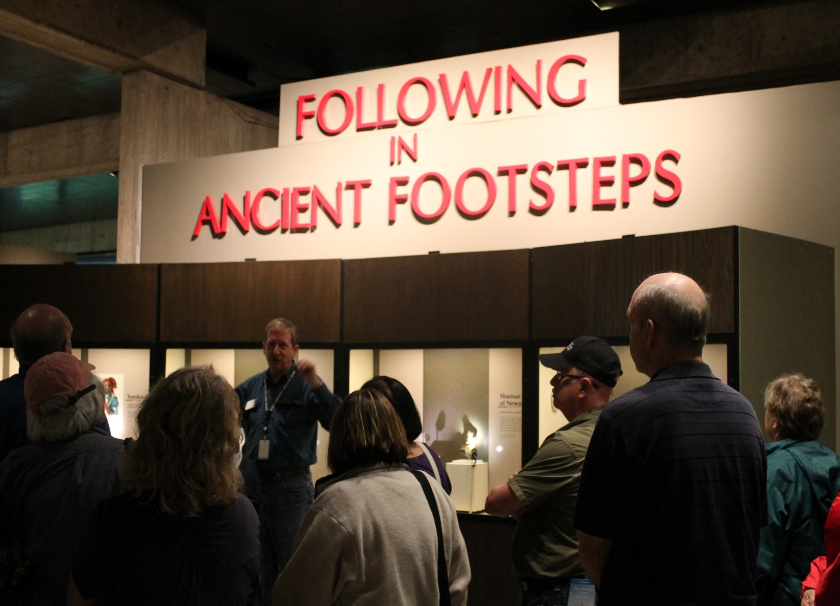
Dr. Brad Lepper who served as our tour guide. Brad explained reasoning behind the existing archaeology exhibits and the educational outcome the exhibits were designed to achieve. The entrance to the
Archaeology Exhibit

Slide 4
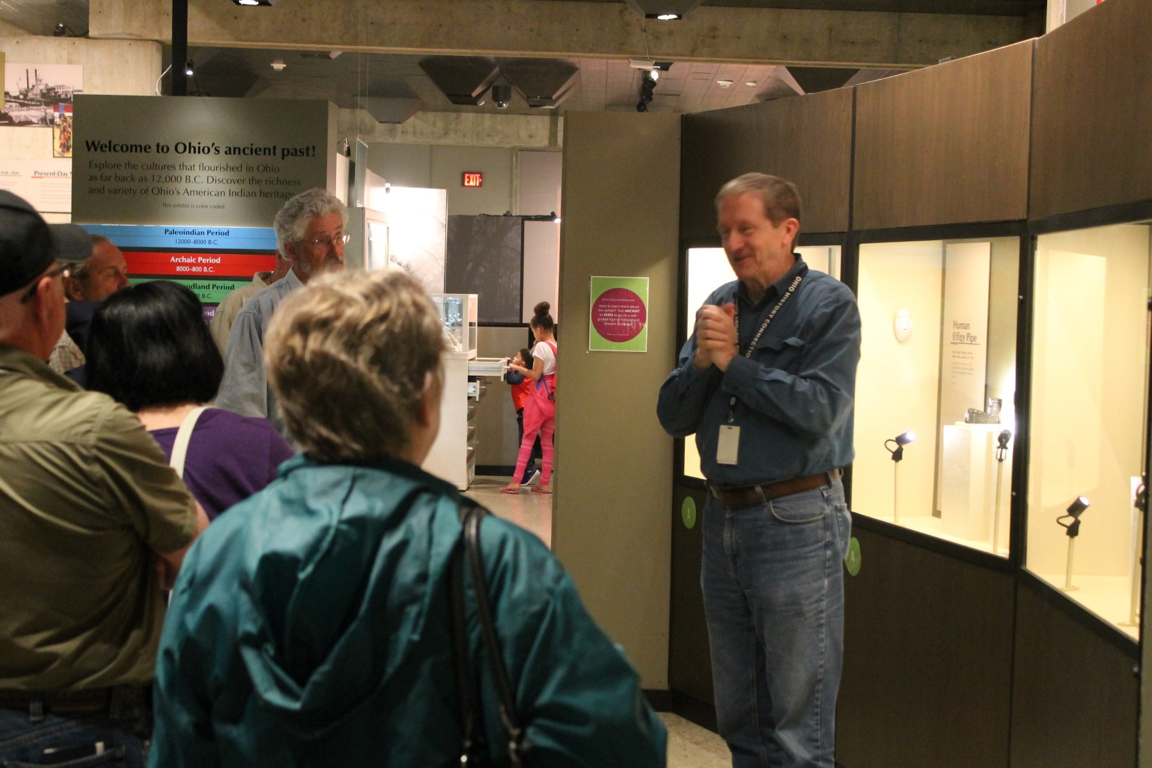
Brad explaining to the group how the exhibits are organized

Slide 5
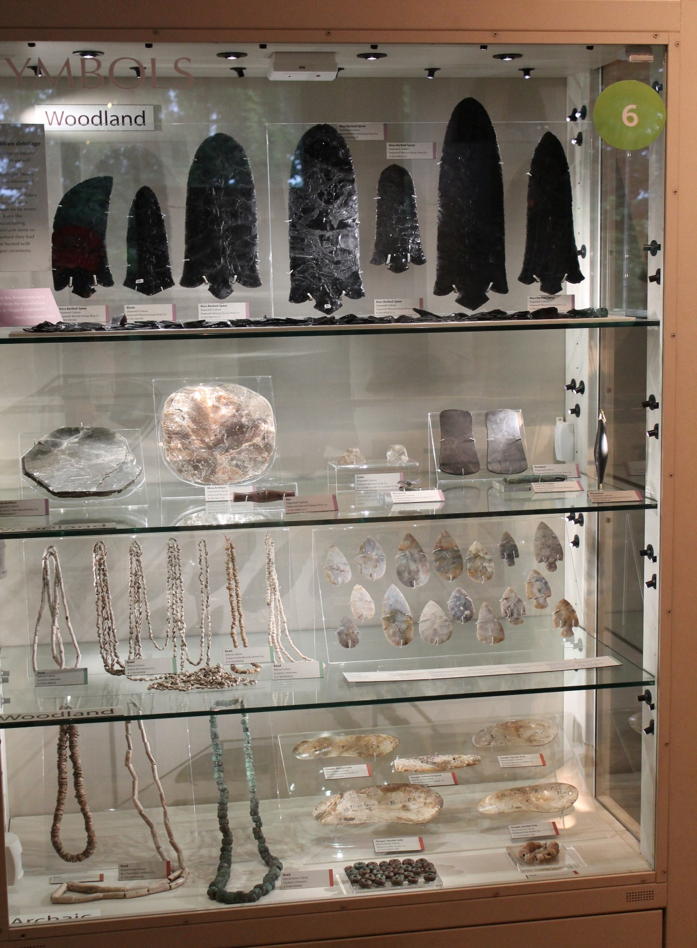
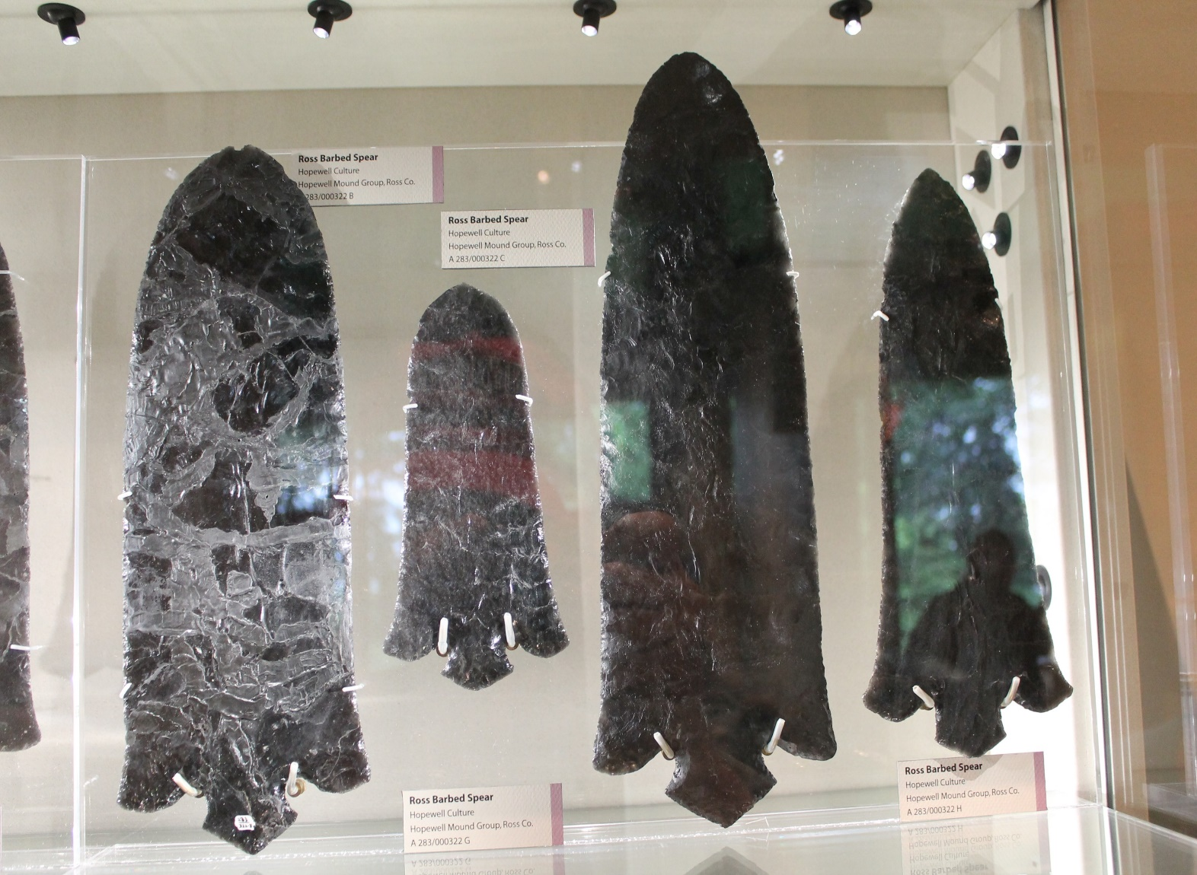
Examples of Hopewellian Artifacts from Ohio

Slide 6
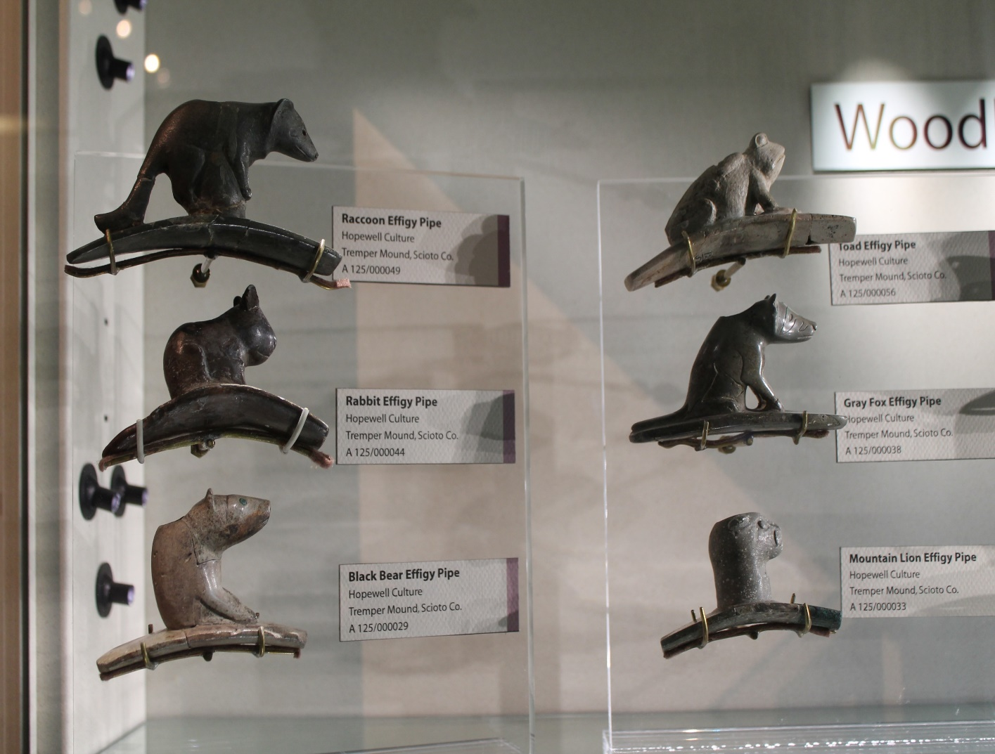
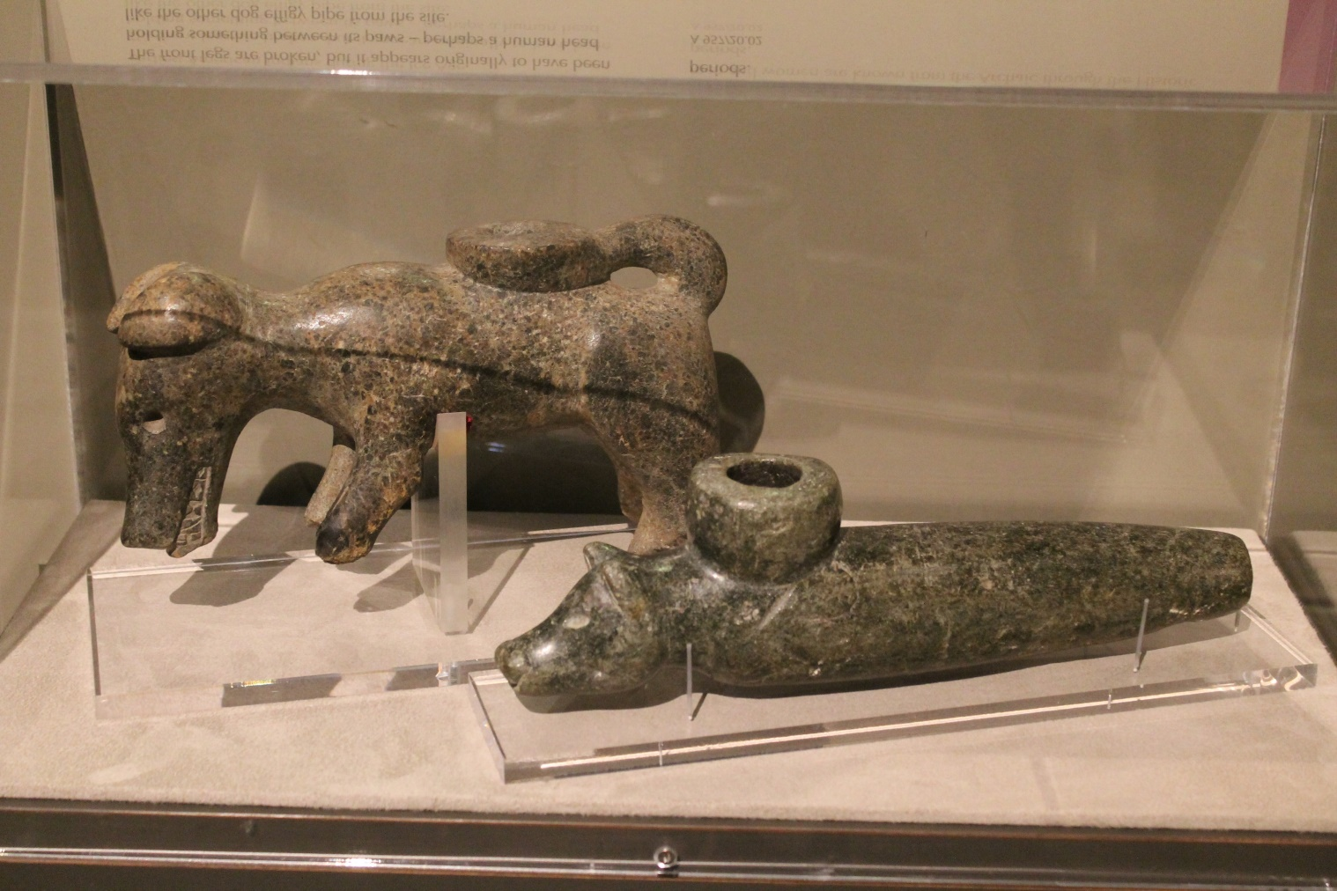
Examples of Pipestone Pipes from Ohio

Slide 7
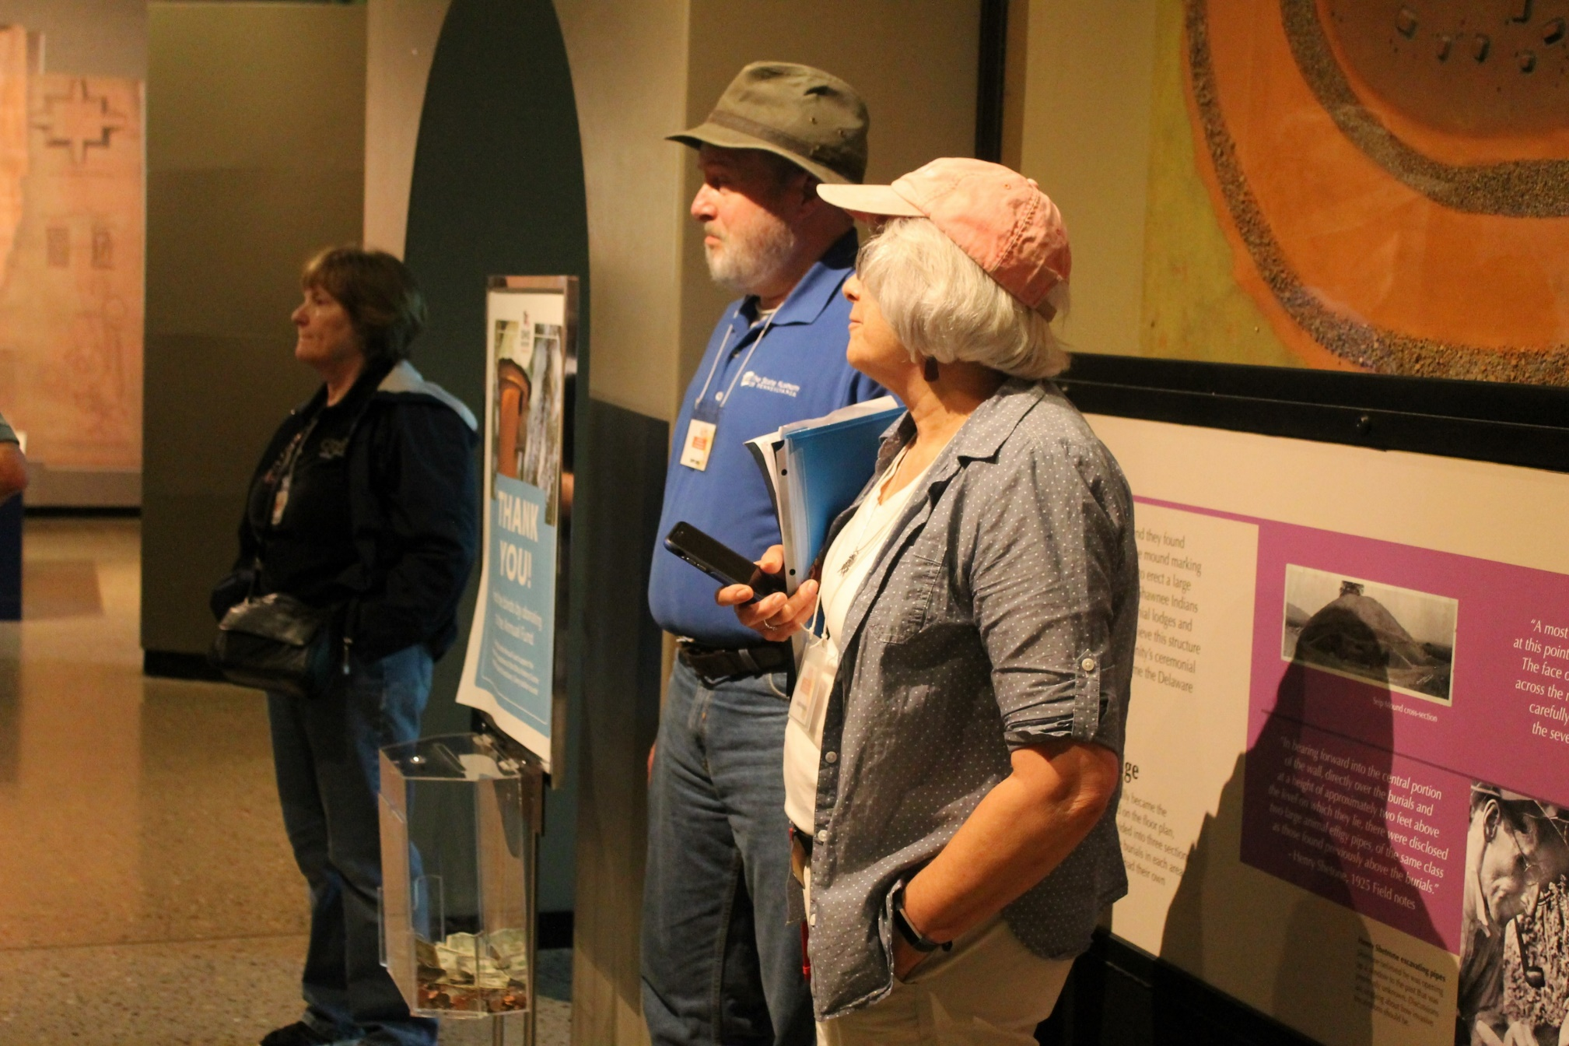
Judy, Kurt and Sarah listen to Brad during the tour

Slide 8
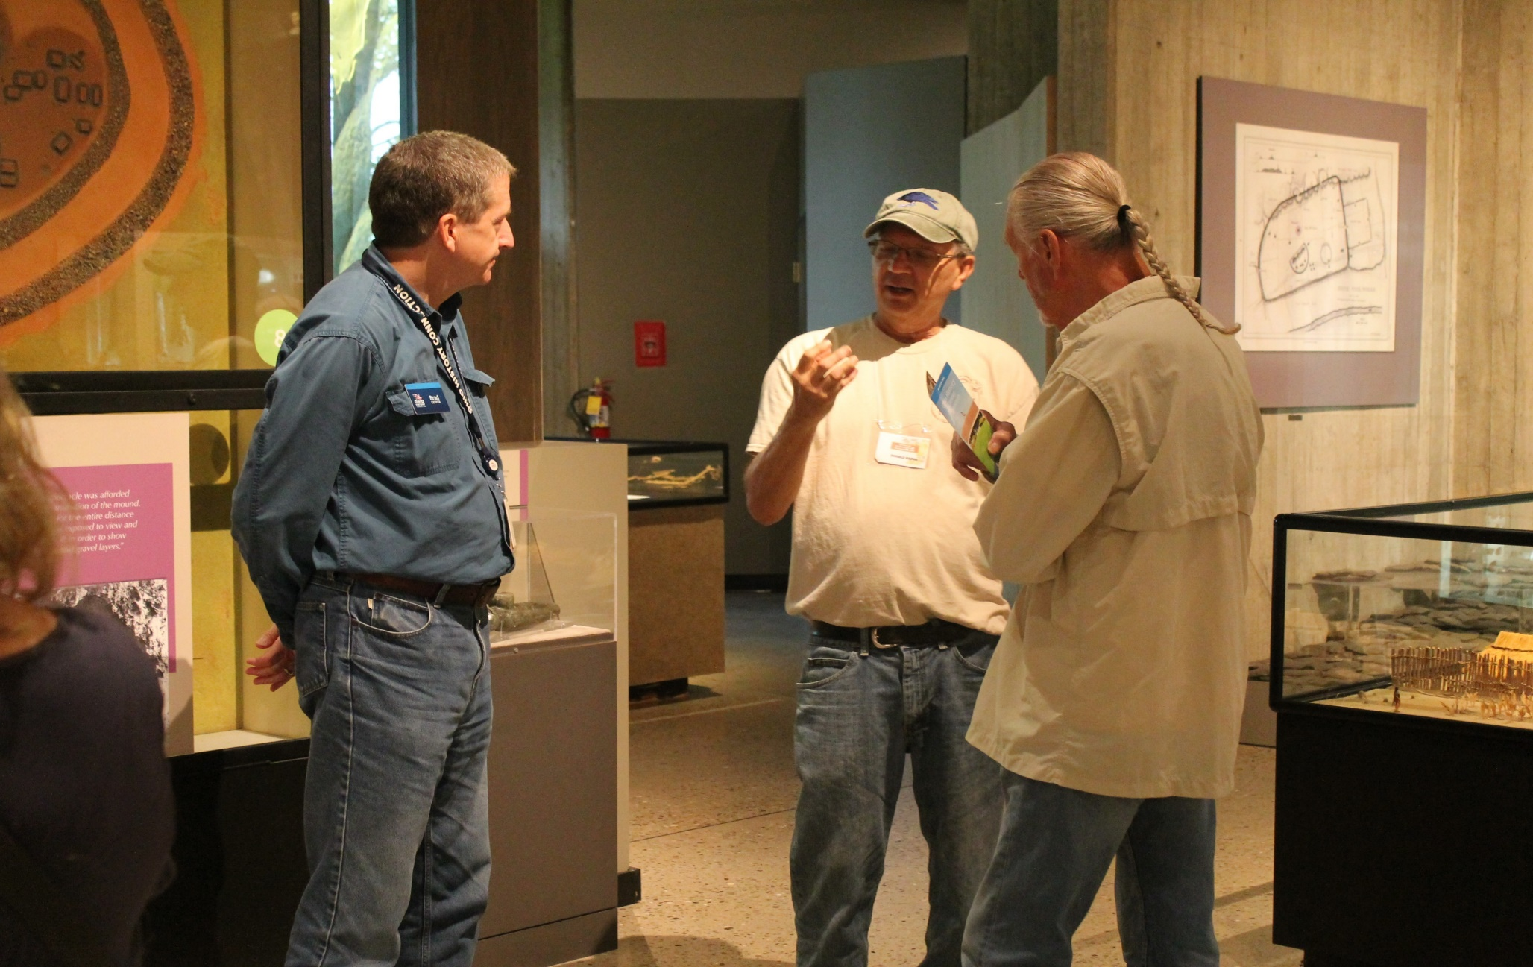
Brad talks with Don Rados and Bob Harris

Slide 9
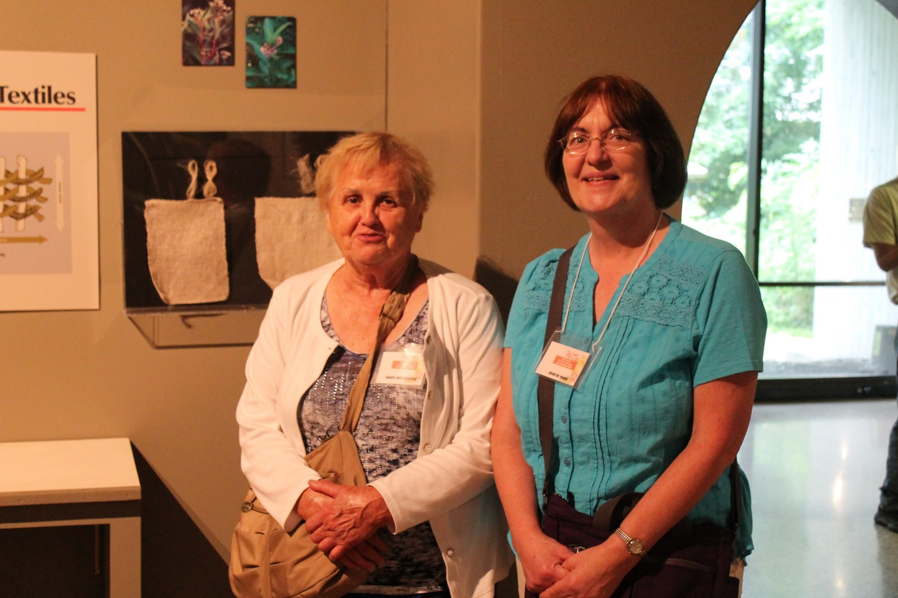
Mary Jane and Jean in the Archaeology Exhibit Gallery

Slide 10
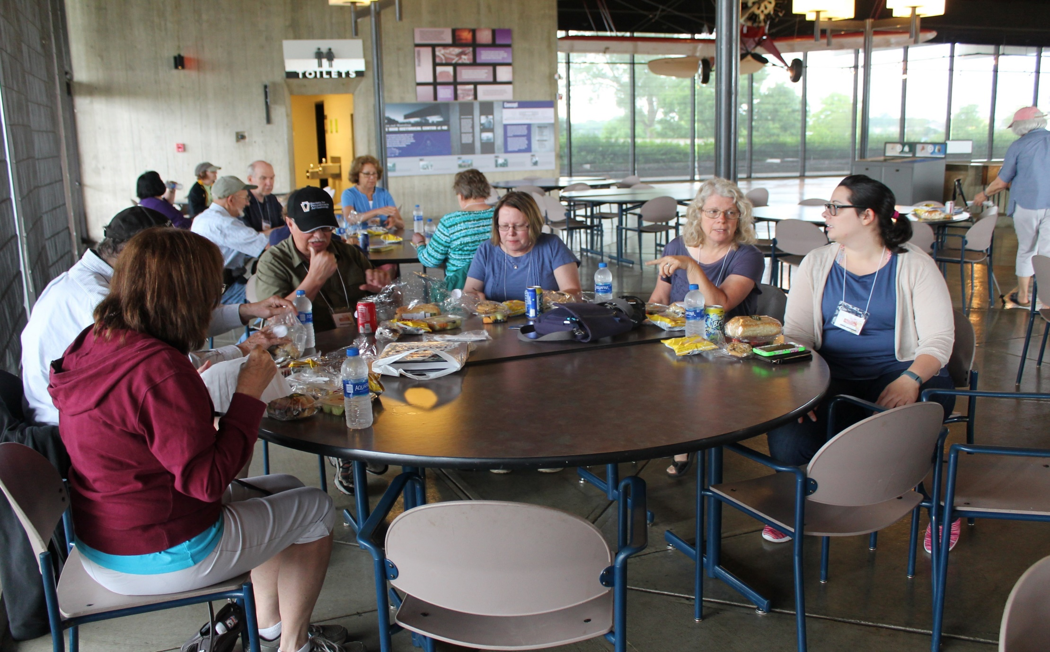
Lunch at the Ohio Historic Connection

Slide 11
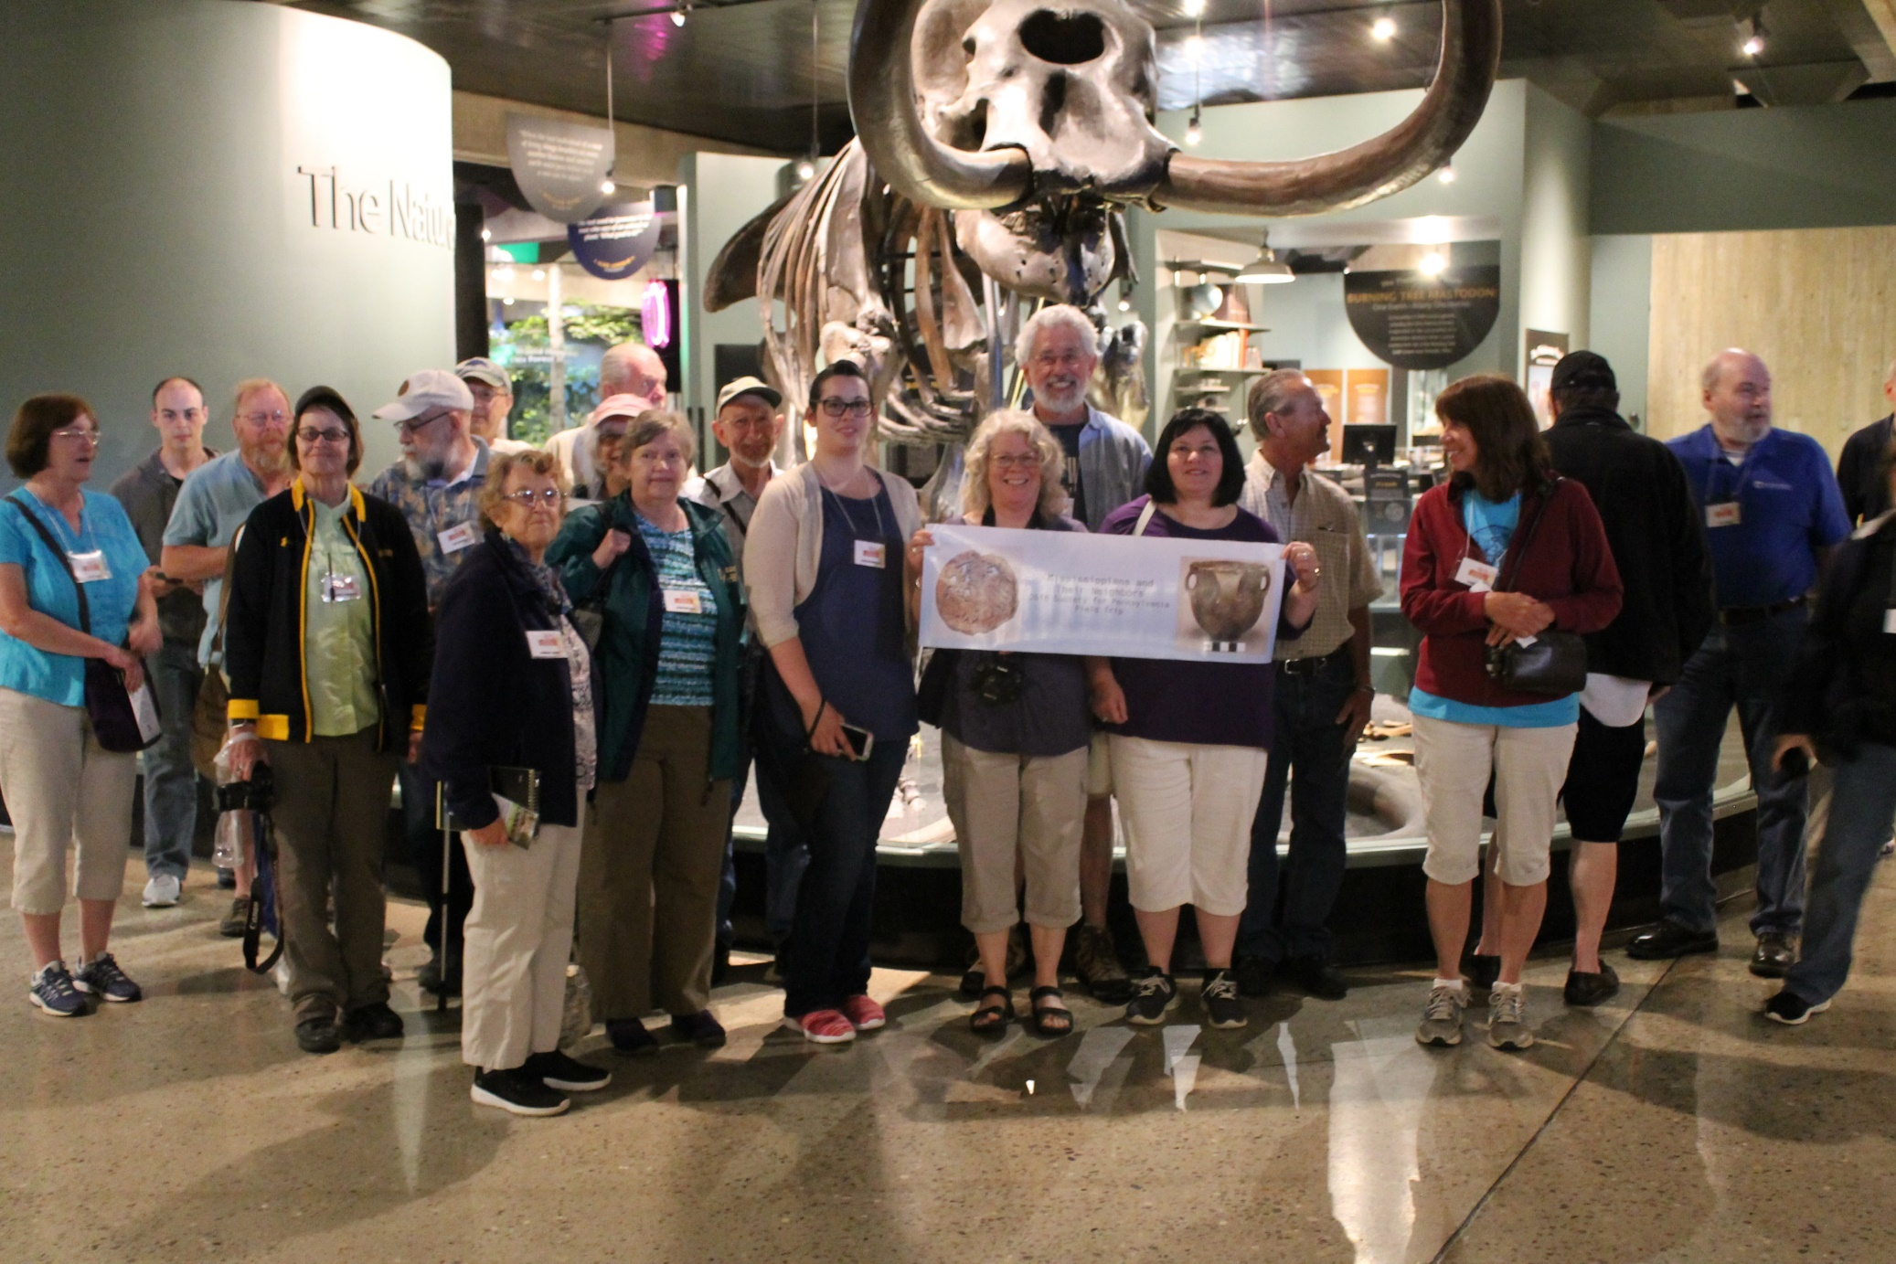
Group Picture in front of Mastodon Skeleton

Slide 12
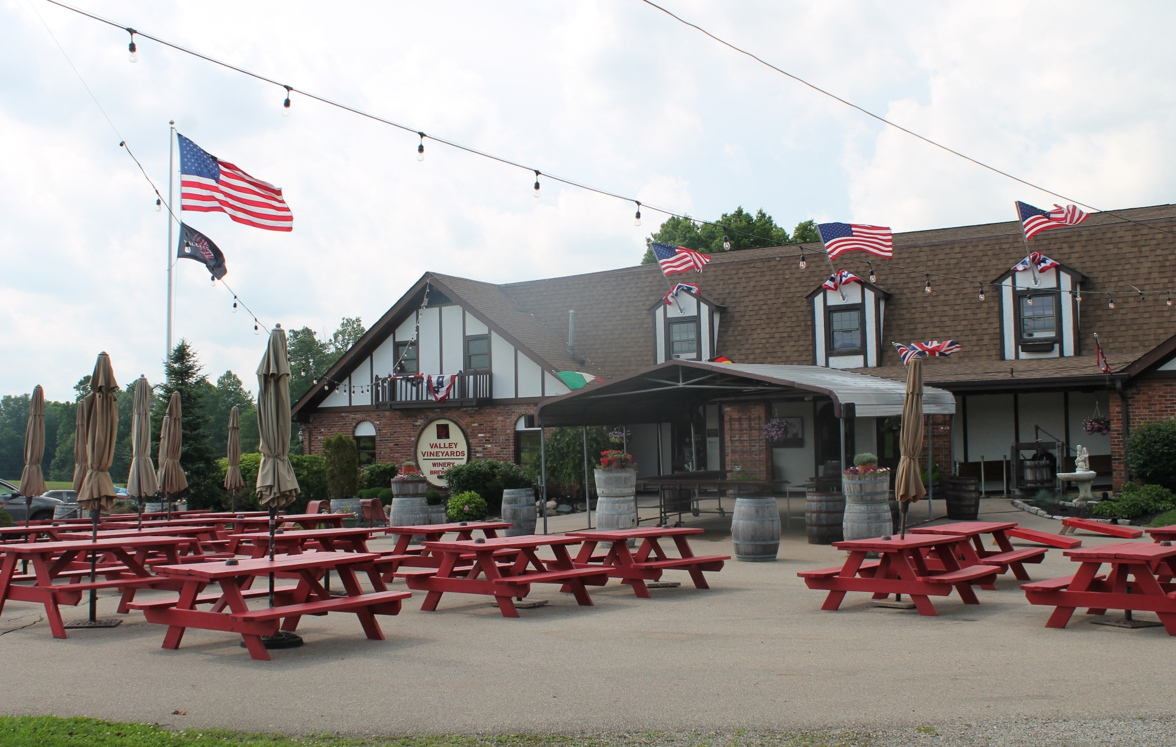
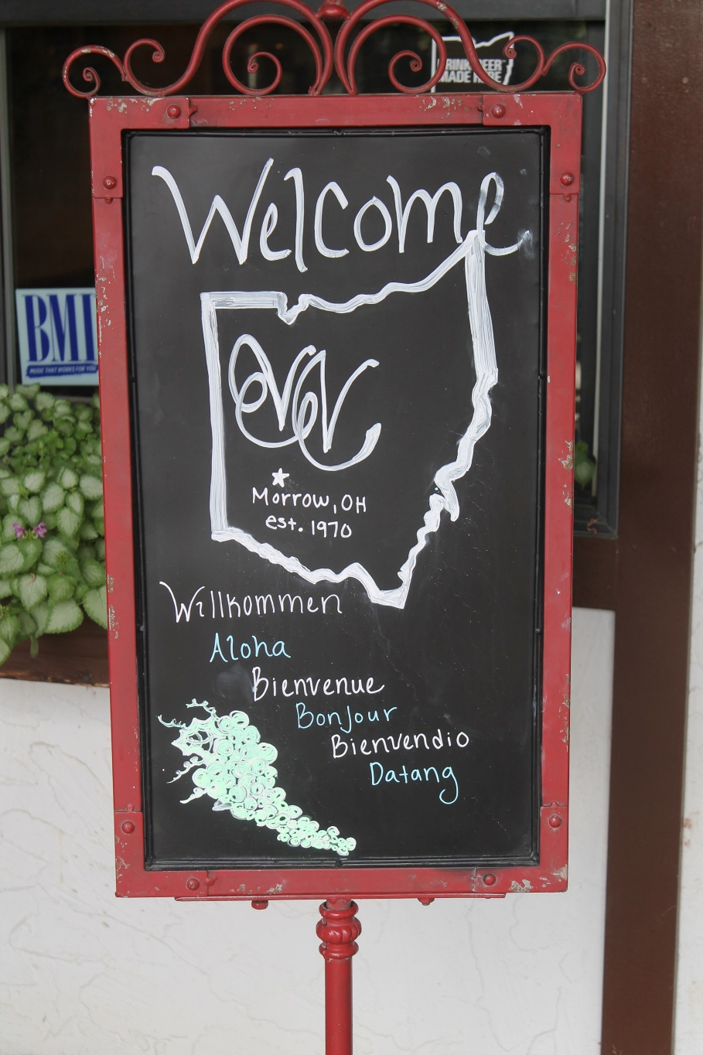
After leaving the Ohio Historic Connection in Columbus, our next stop was the Valley Vineyards and Brewery in Morrow, Ohio

Slide 13
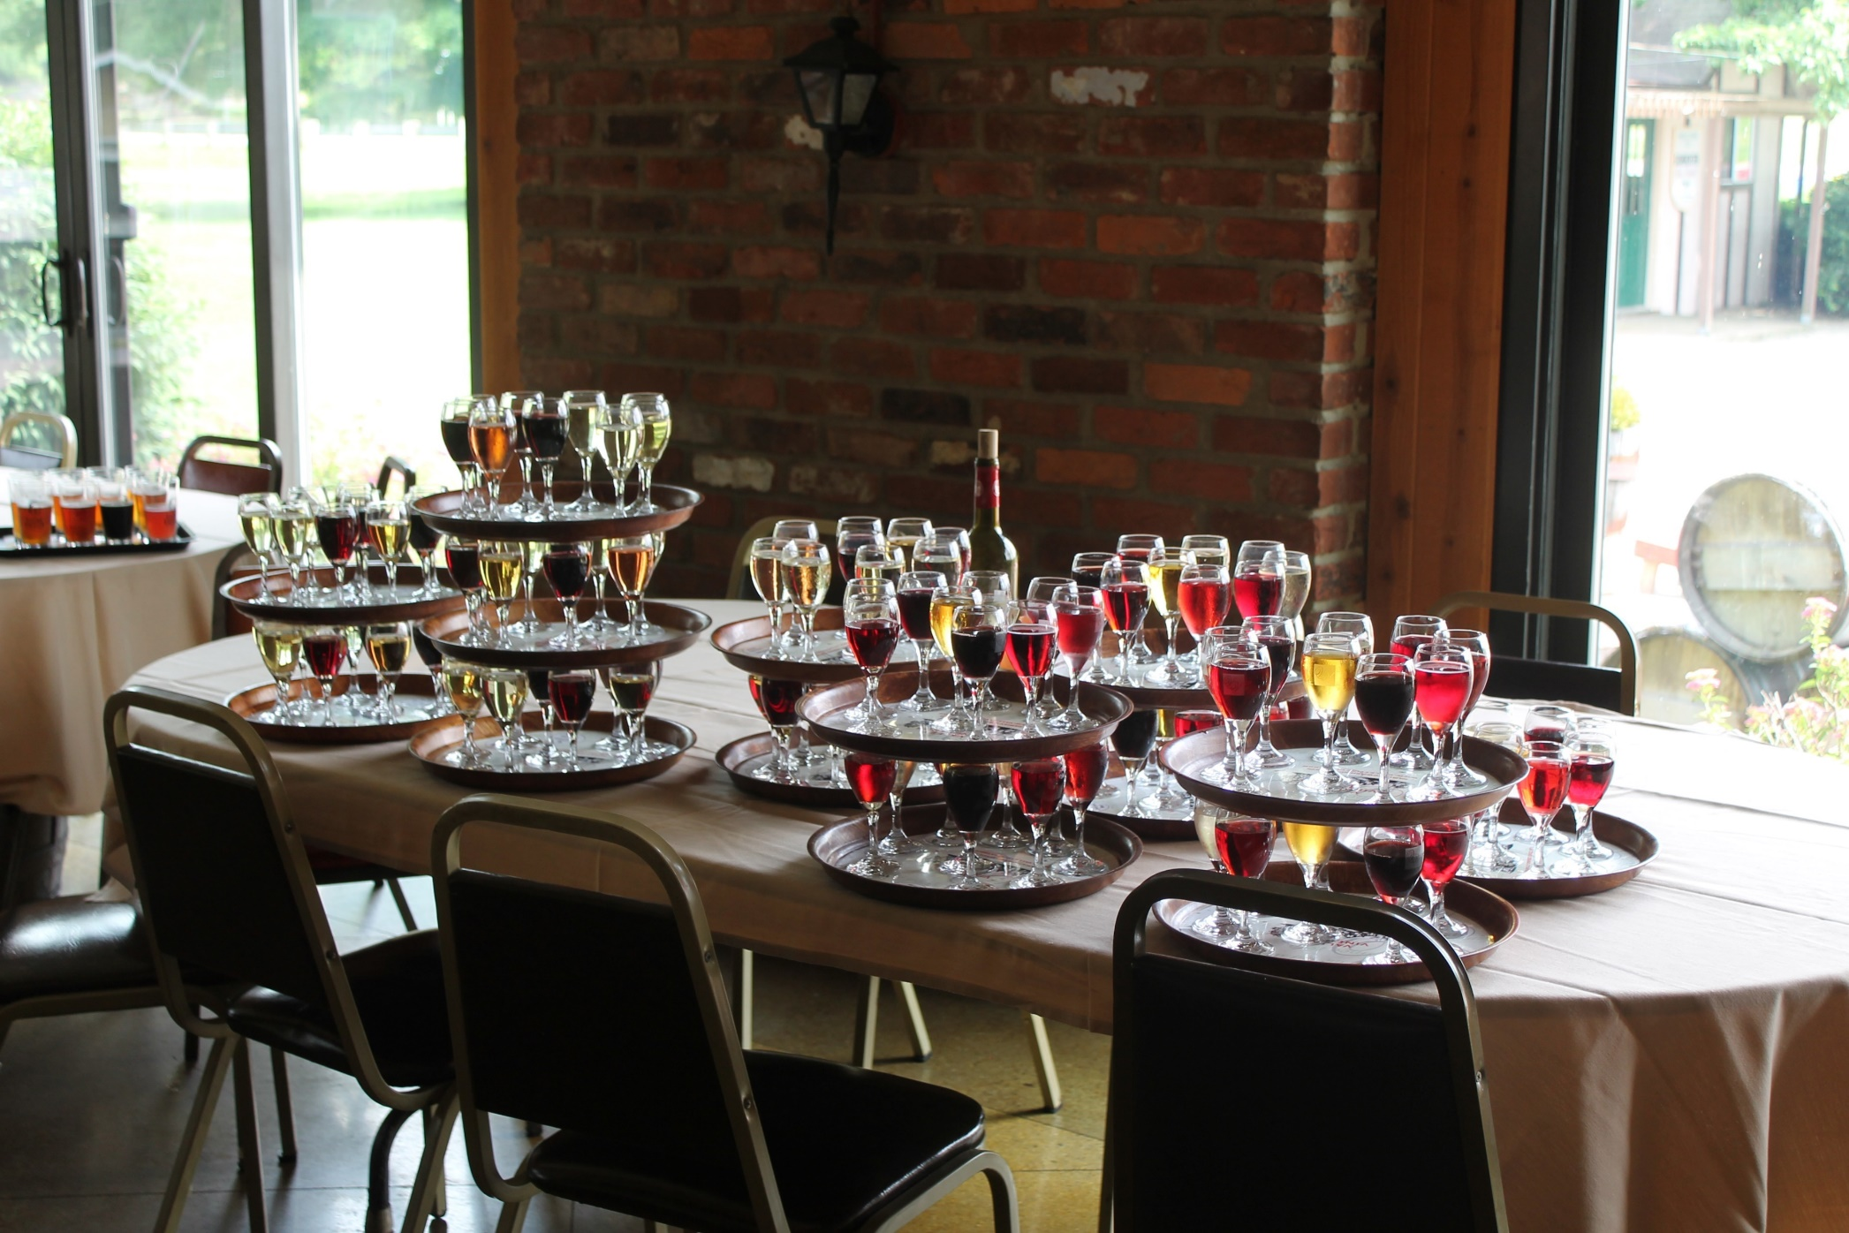
Wine sample trays

Slide 14
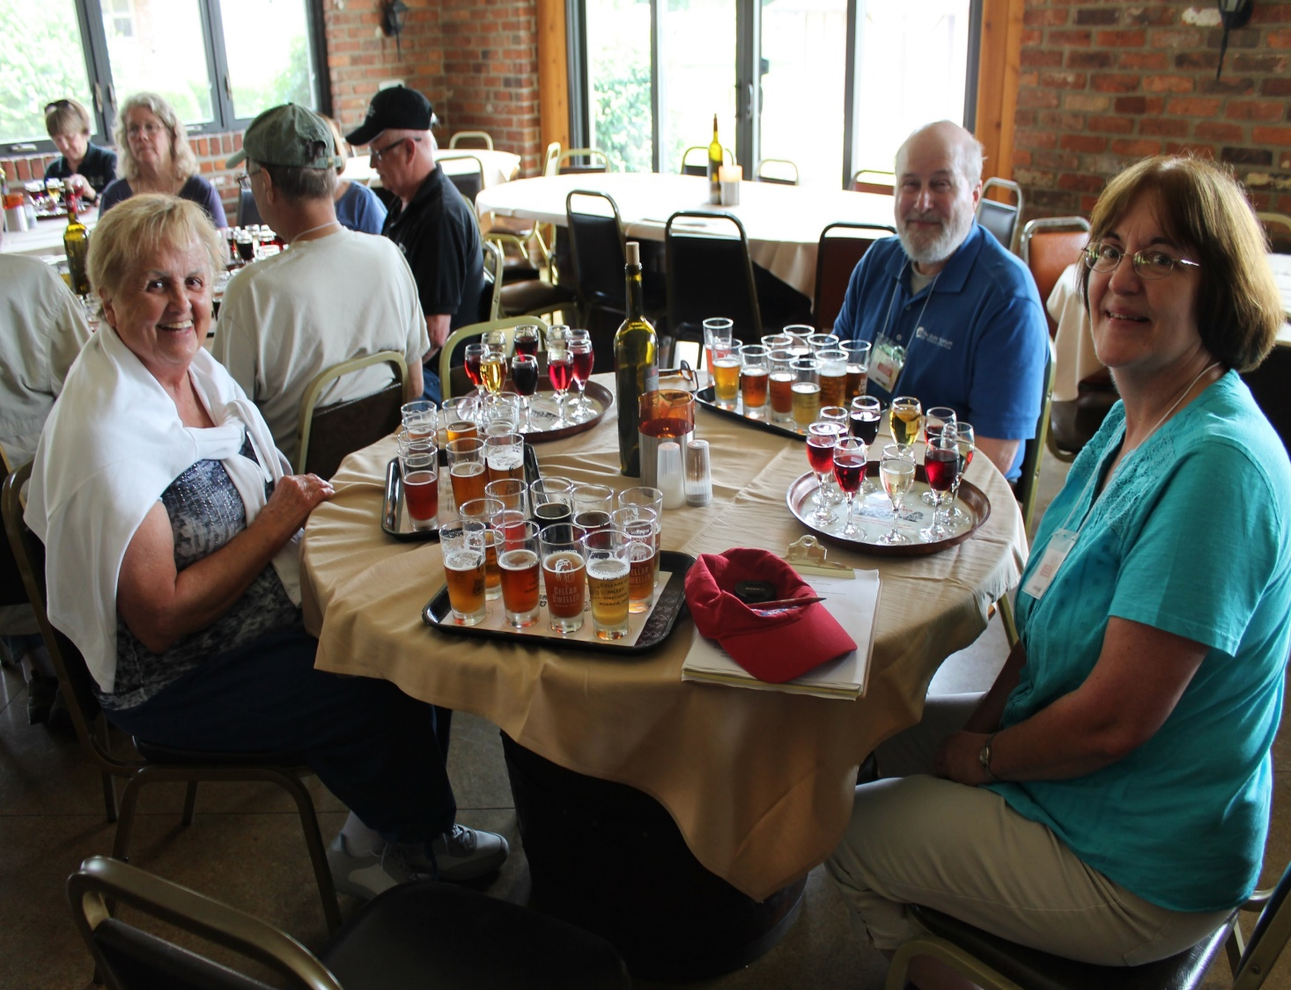
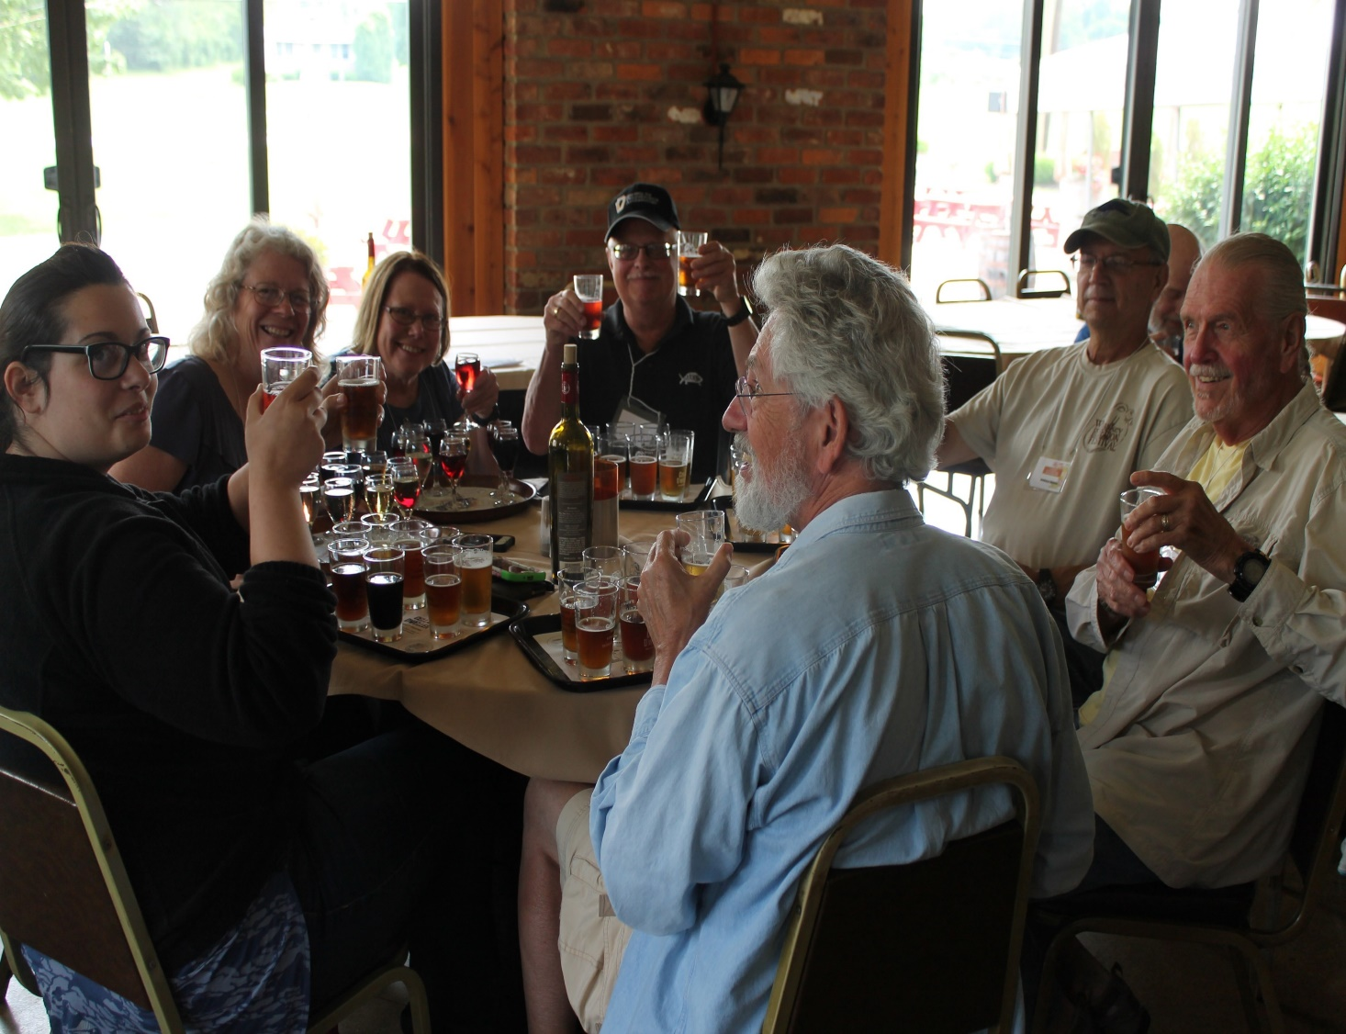
Wine and Craft Beer Tasking. After visiting the gift shop, everyone boarded the bus and we left for Florence, Kentucky, our first night’s stop

Slide 15
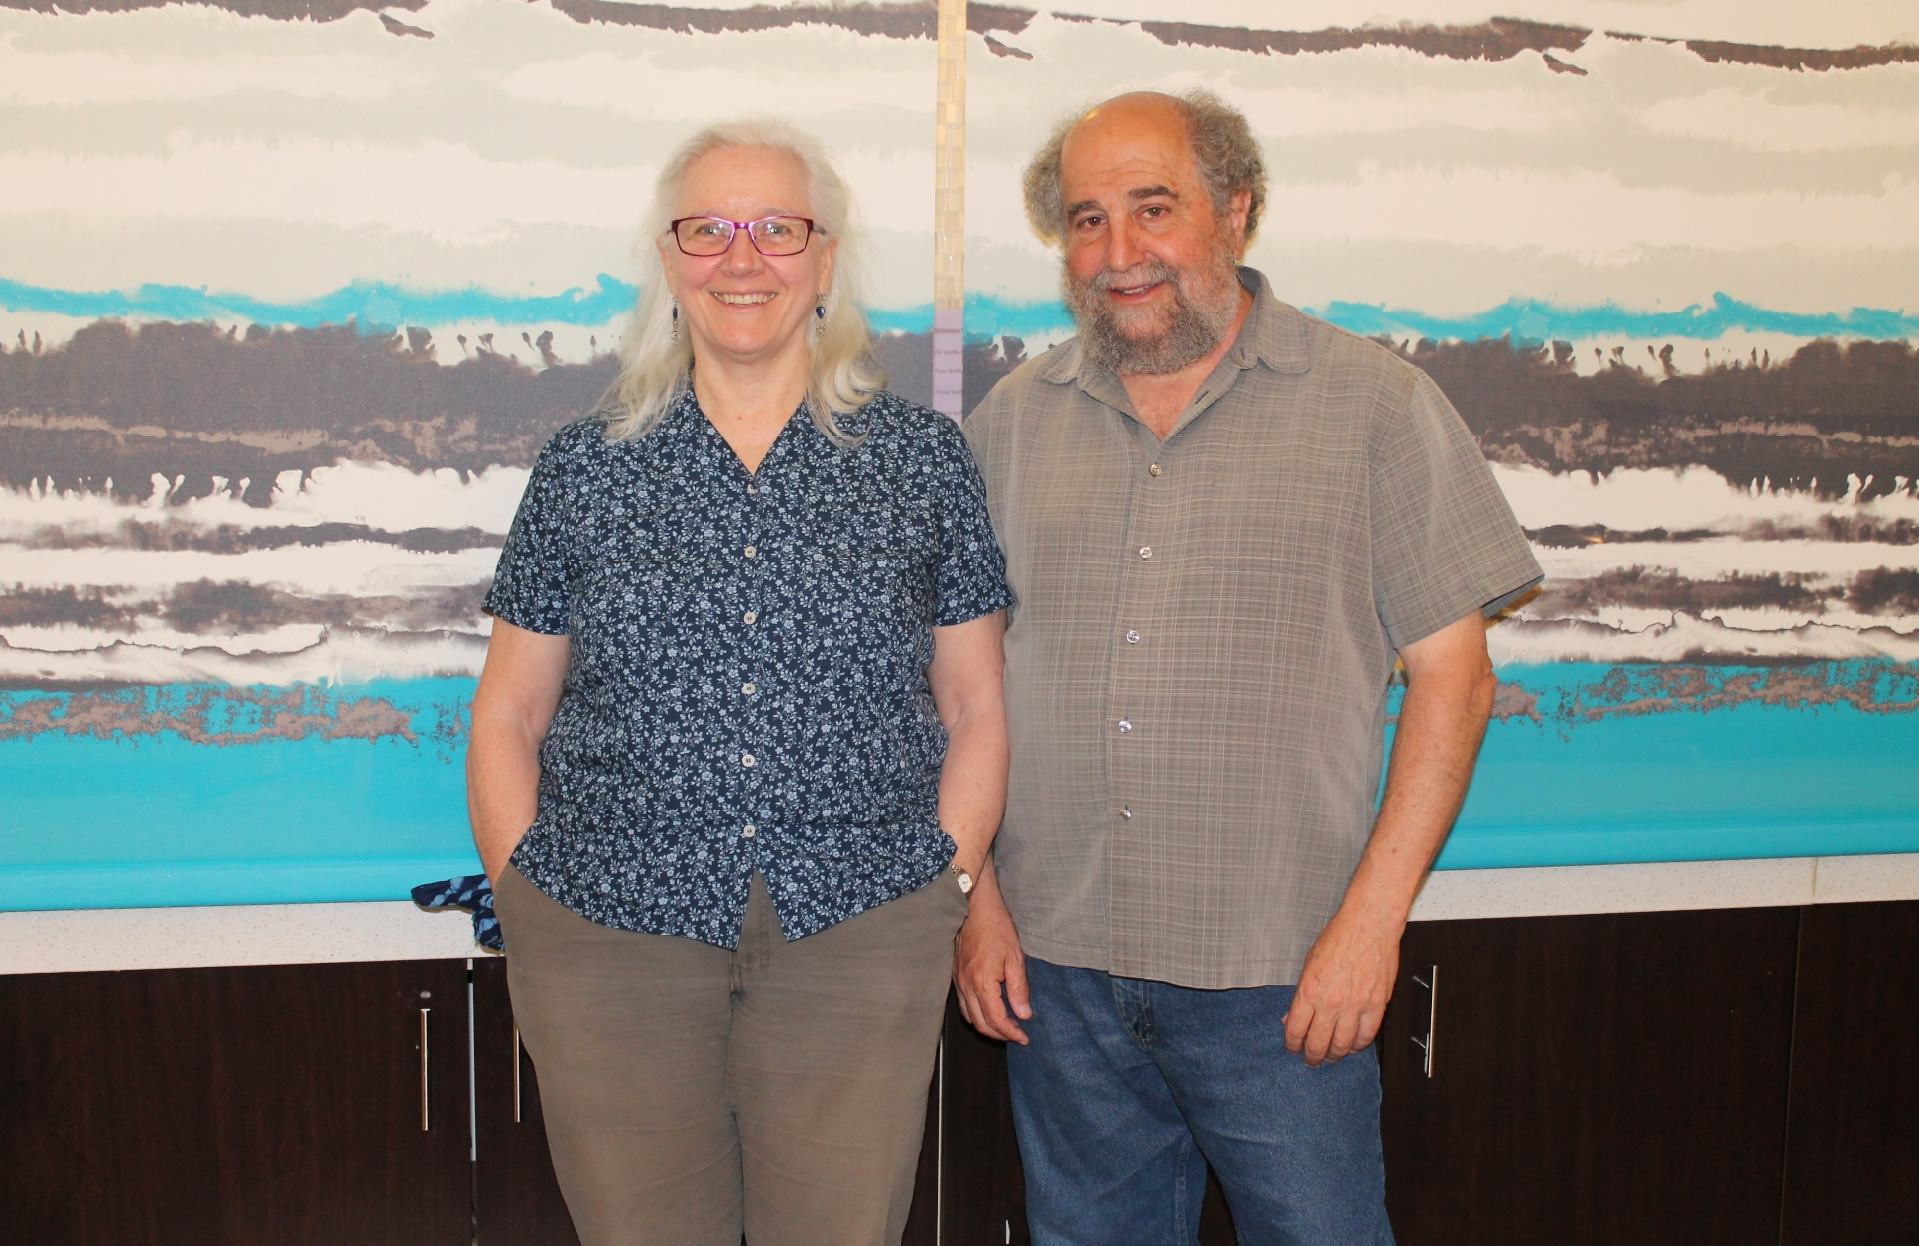
After Supper, Guest Speakers Gwenn Henderson and David Polack talked about Fort Ancient Tradition Sites in Kentucky in the evening. Fort Ancient peoples were one of the neighbors of the Mississippians

