Slide 1
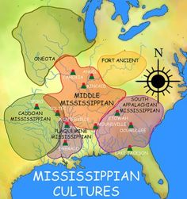
2018 Society for Pennsylvania Archaeology Field Trip “Mississippians and their Neighbors”

Slide 2
This Year’s Attendees
Amanda Valko (l) and Sarah Baughman (r)
John and Isabella Tonkavitch

Slide 3
Bill Hutchison
Deborah and Larry Saylor

Slide 4
Don Rados (l) and Bob Harris (r)
Barry Kent

Slide 5
Kurt Carr and Janet Hawthorn
Stephen and Barb Israel

Slide 6
Mary Jane Kanyok
Lynne Baer

Slide 7
Ken and Cheryl Burkett
Beverly Chiraulli (l) and Chrisine Kula (r)

Slide 8
Nick Bromley (l) and Russel Bromley (r)

Slide 9
Your Tour Guides and Organizers
Phil and Sarah Neusius
John and Jean Nass

