Slide 1
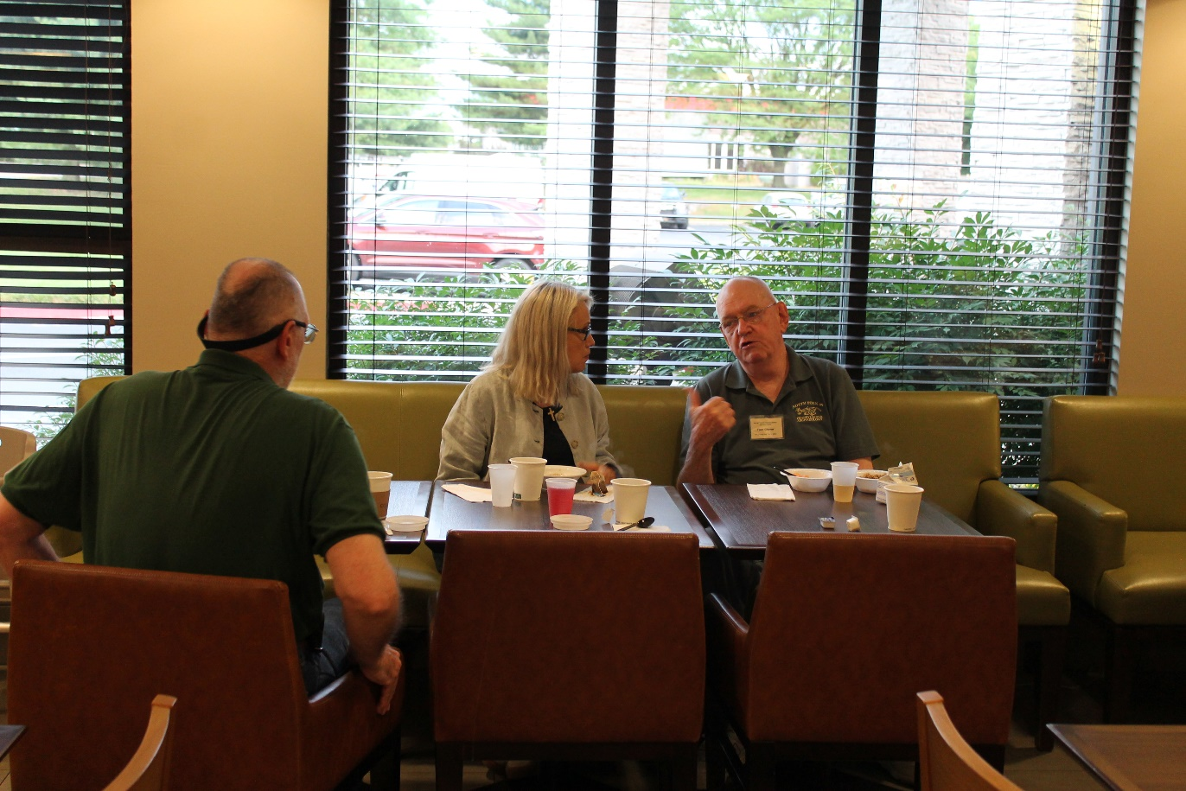
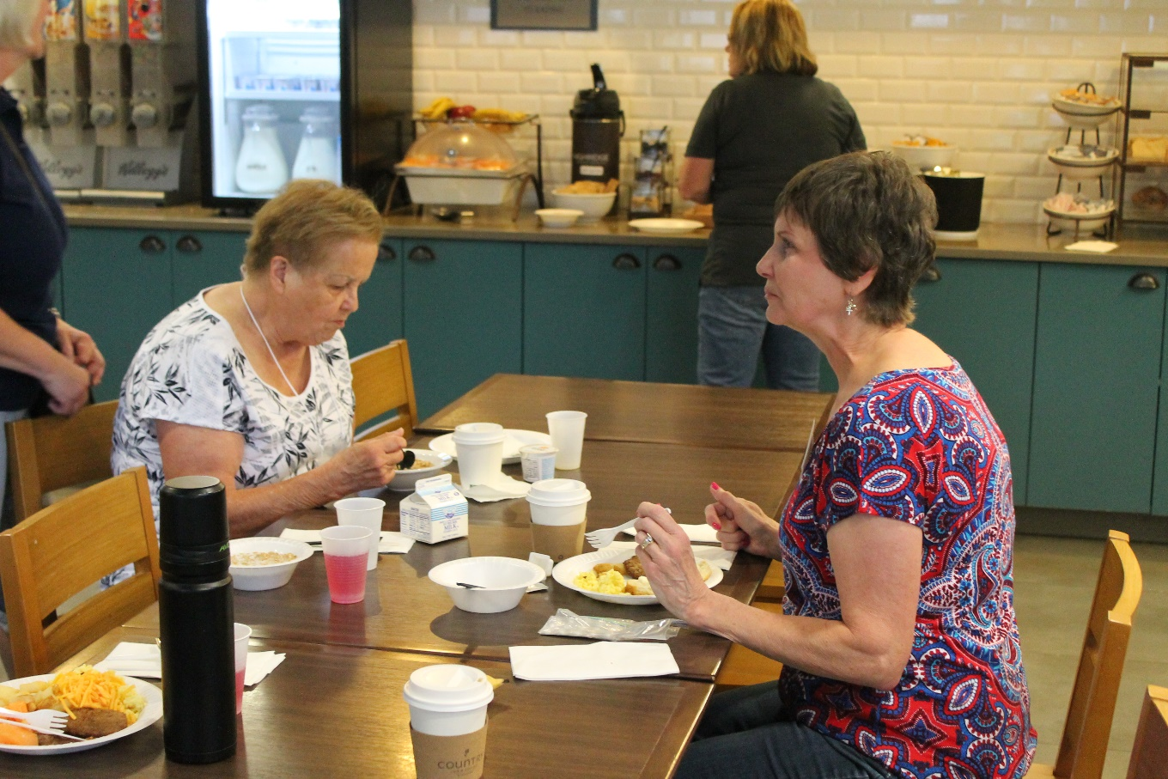
Day One, Friday, June 14
6 am Breakfast at the Comfort Inn and Suites

Slide 2
Leaving the Hotel at 715 am for the MAC Lab in Maryland

Slide 3
Sarah conducting a headcount prior to departure

Slide 4
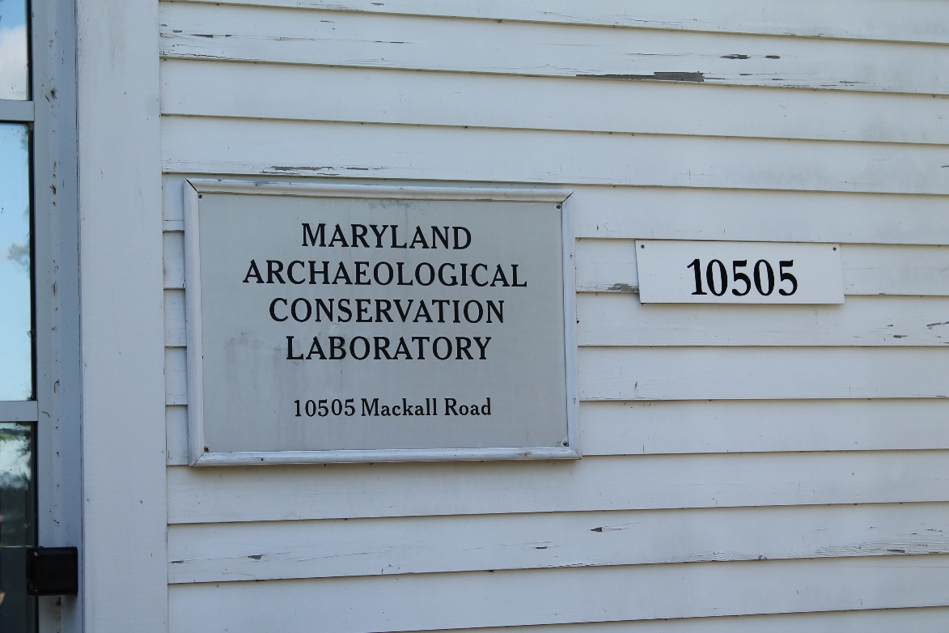
Arrival at the Maryland MAC Lab in the Jefferson-Patterson Park Complex, Saint Leonard

Slide 5
Ed Chaney (Assistant Director) and Dr. Patricia Samford, Director

Slide 6
Gathering for orientation to the lab in classroom

Slide 7
Tour of the Lab lead by Ed

Slide 8
Lunch by Moe’s Southwest Grill

Slide 9
Group Picture outside of National Museum of the American Indian, Cultural Resources Center, Collections and Conservation Departments

Slide 10
Maria Martinez and

Slide 11
Group Viewing Textiles from Central America

Slide 12
After leaving the National Museum of the American Indian, Cultural Resources Center, everyone walked through the woods to visit the Museum Support Center. For obvious reasons, no pictures of items from the collections will be shown in any slides unless permission was given.

Slide 13
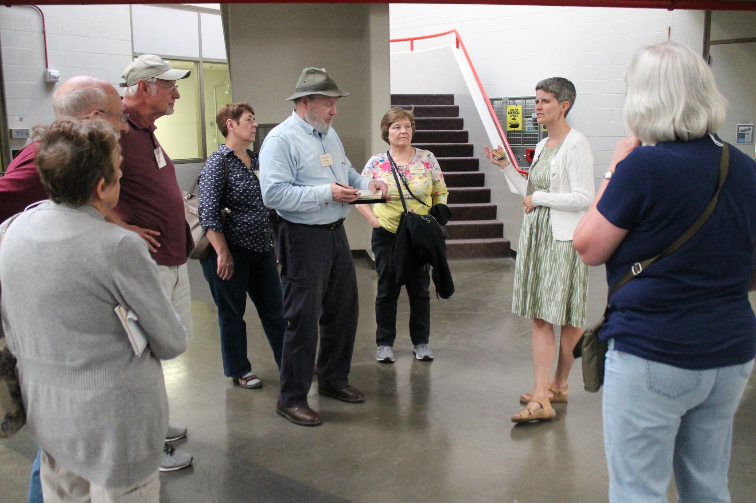
David Rosenthal, Group listening to staff Collections Manager member discuss collections Museum Support Center

Slide 14
After our tour of the museum support center, everyone boarded the bus for our return to the hotel.

